Slide 1
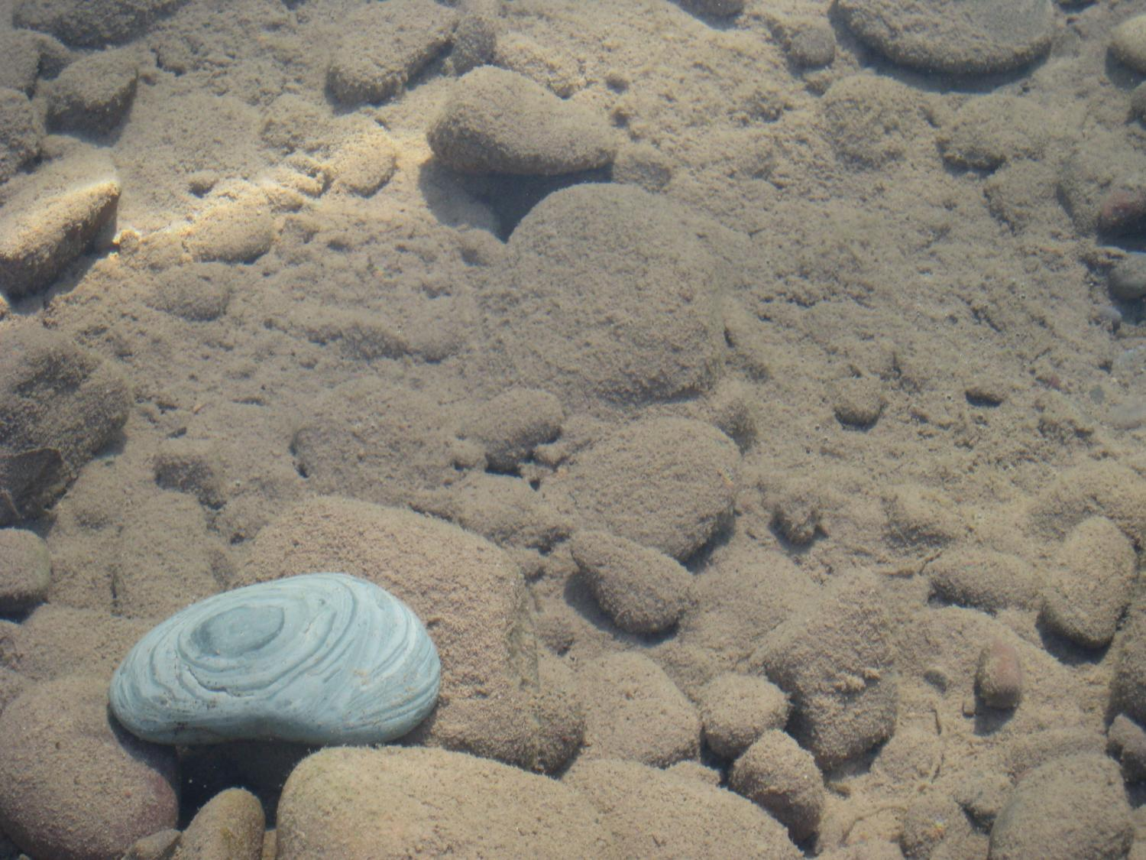
System-level Hypothesis Testing: A Novel Approach to Developing Parsimonious Models of Complex Ecosystem Dynamics
Geoffrey Poole
Clem Izurieta
Robert Payn
Ashley Helton
Meredith Wright
Emily Bernhardt
Jack Stanford

Slide 2
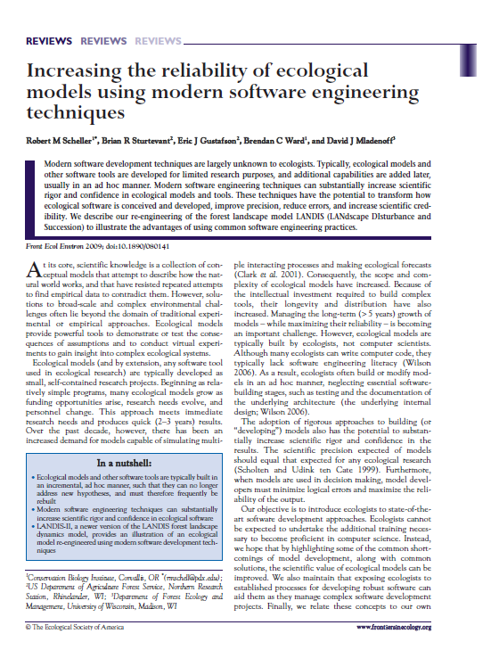
An Imperative
SE techniques yield:
Model parsimony
Code reliability, extensibility, reuse, longevity
Grid-based high-performance computing
Virtual laboratories
Scheller et al. 2009

Slide 3
The NEED
Virtual laboratory; model parsimony
Requires: rapid creation, maintenance, management, and execution of multiple competing model variants
Code reliability, extensibility, and reuse
Requires: encapsulation and modularization of code
High performance computing
Requires: A simple means of developing multi-threaded code

Slide 4
What IS A Model?
Umax
Uptake
k
[Solute]
Biomass
[Solute]
Time

Slide 5
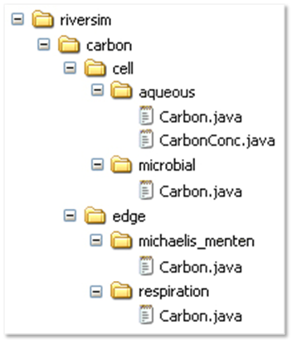
Rethinking models...
NEO
Simulation run
Values
Code
r = 0.034
Input/Output/
Initialization
u = 6.2
K_{s} = 1.73
Execution control
Model
W = 600
U = 17.3
Calculations
R = 6.5
X = 13.4
S =1800.0
[S] = 3.00

Slide 6
CREATING A NEO SIMULATION
Solution
Biomass
Uptake
Respiration
E1
E2
C1
C2
NEO INPUT FILE: Matrix Table
EdgeID | FromCell | ToCell
E1 | C1 | C2
E2 | C2

Slide 7
Ks
W
µ
r
E1
E2
C1
C2
NEO INPUT FILE: Parameter file
HolonID | Variable | Value
C1 | W | 600
E1 | Ks | 1.73
E1 | u | 6.2
E2 | R | 0.034

Slide 8
Solution
Biomass
Uptake
Respiration
eq4
eq2
S
Ks
eq1
eq3
R
W
eq5
U
X
[S]
µ
r
E1
E2
C1
C2
NEO INPUT FILE: Holon Type Table
Model code hierarchy
Holon ID | Holon Type
C1 | Solution
C2 | Biomass
E1 | Uptake
E2 | Respiration
4
NEO INPUT FILE: Cell Type Behavior Table
5
Cell type | Carbon
Solution | aqueous
Biomass | microbial
3
NEO INPUT FILE: Edge Type Behavior Table
1
Edge type | Carbon
Uptake | michaelis_menten
Respiration | microbial
2

Slide 9
Solution
Biomass
Uptake
Respiration
eq4
eq2
S
Ks
eq1
eq3
R
W
eq5
U
X
[S]
µ
r
E1
E2
C1
C2
Biomass
[Solute]
Time

Slide 10
Solution
Biomass
Uptake
Respiration
eq4
eq2
S
Ks
eq1
eq3
R
W
eq5
U
X
[S]
µ
r
E1
E2
“FromCell”
“MyEdge”
“ToCell”
C1
C2
Model code hierarchy
Pseudo code
public class Carbon extends Dynam {
private StateVal Ks, u, conc, X;
public double initialize() {
Ks = myEdge.getStateVal(“Ks”);
u = myEdge.getStateVal(“u”);
conc = fromCell.getStateVal(“[S]”);
X = toCell.getStateVal(“X”);
return 0.0; }
public double calculate() {
return u.v * (Ks.v / (Ks.v + conc.v)) * X.v; } }
4
5
3
1
2

Slide 11
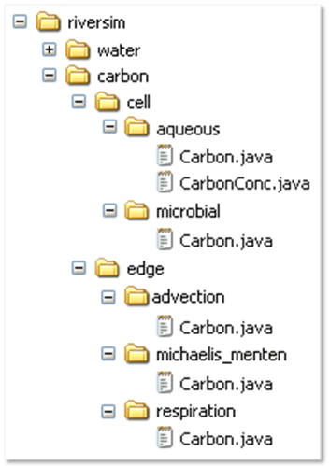
Multiple Interactive currencies
Microbial uptake and respiration
“HorzGroundwaterFlux”
Q
ΔS
W
S
Ks
R
µ
U
X
[S]
r
Uptake
Resp
Biomass
Q
ΔS
Water flux and solute transport
W
S
Ks
R
µ
U
X
[S]
r
Q
ΔS
W
S
Ks
R
µ
U
X
[S]
r
Q
ΔS

Slide 12
Code Reuse and recombination
Surface Water Flux
SurfaceWater
SWFlux
Biomass
Biomass
H₂0
DOC
SWFlux
Horizontal GW Flux
OC
Areal
Uptake
CO₂
GWSW
Exchange
Horizontal
GWFlux
Respiration
SurfaceWater
Areal Uptake
Horizontal
GWFlux
Biomass
H₂O
DOC
OC
M-M
Uptake
M-M Uptake
CO₂
Respiration
GroundWater
Respiration
Advective
Solute
Flux
CO₂
GWSW Exchange

Slide 13
Parallel Processing
Step 1: Perform multiple independent model executions (with different
parameters)
simultaneously
across multiple
processing
threads. Speeds
applications such
as sensitivity
analyses.
Step 2: Use parallel processing to expedite run-time of individual model
executions.
Speeds
applications of
highly detailed or
complex
models.
NEO model spawner
Model executions
Model execution
Processing threads
Processing threads
Model outputs
Model output

Slide 14
The bottom line…
As a modeling framework, NEO allows:
Specification of model parameters, structure, and algorithms at run time
NEO facilitates:
Rapid model development
Simple management of code complexity
Addition and removal of model dynamics
Applications on HPC platforms
Maintenance, management and execution of multiple model variants

Slide 15
System Level Hypothesis testing
Hypothesis testing requires making predictions
At a whole-system level, a model is required
Models variants are competing hypotheses
Complexity can be added/removed
Alternative behaviors can be substituted
Empirical data are used to reject models
Last model standing (if any) is supported

Slide 16
SYNERGY with Bayesian approaches?
Sources of error in model assessment
Empirical data
Model parameters
Model structure
Bayesian approaches presume that model structure is fixed.
NEO opens the possibility of Bayesian assessment to determine the probability of alternative model structures.

Slide 17
http://www.montana.edu/FLL

Slide 18
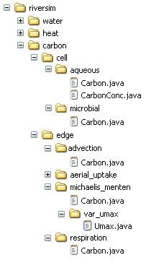
A) Model
B) Illustrative code
Model
public class Carbon extends Dynam {
private StateVal conc, water;
public double initialize() {
conc = fromCell.getStateVal(“CarbonConc”);
water = myEdge.getStateVal(“Water”);
return 0.0; }
public double calculate() {
return conc * water; } }
Packages
4
public class Carbon extends Dynam {
private StateVal k, u_max, conc, biomass;
public double initialize() {
k = myholon.getStateVal(“K”);
u_max = myEdge.getStateVal(“u_max”);
conc = fromCell.getStateVal(“CarbonConc”);
biomass = toCell.getStateVal(“Carbon”);
return 0.0; }
public double calculate() {
return u_max * (k / (k + conc)) * biomass; } }
Holons
5
Behaviors
1
3
public class Carbon extends Dynam {
private StateVal r, biomass;
public double initialize() {
r = myEdge.getStateVal(“r”);
biomass = fromCell.getStateVal(“Carbon”);
return 0.0; }
public double calculate() {
return -r * biomass; } }
1
2
Deviant
2

Slide 19
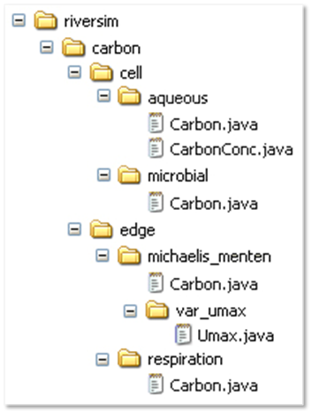

Slide 20
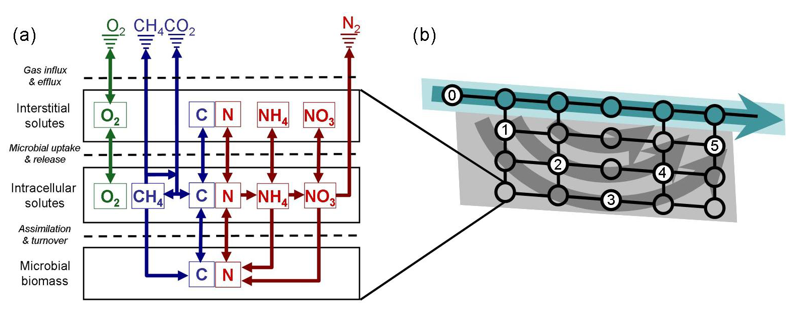
Ecosystems aS Multi-Currency Flux Nets
Model of solute transport/processing (currencies are water, heat, carbon, nitrogen, oxygen) within a linked hydro-biological system (network)
Helton et al. Accepted

Slide 21
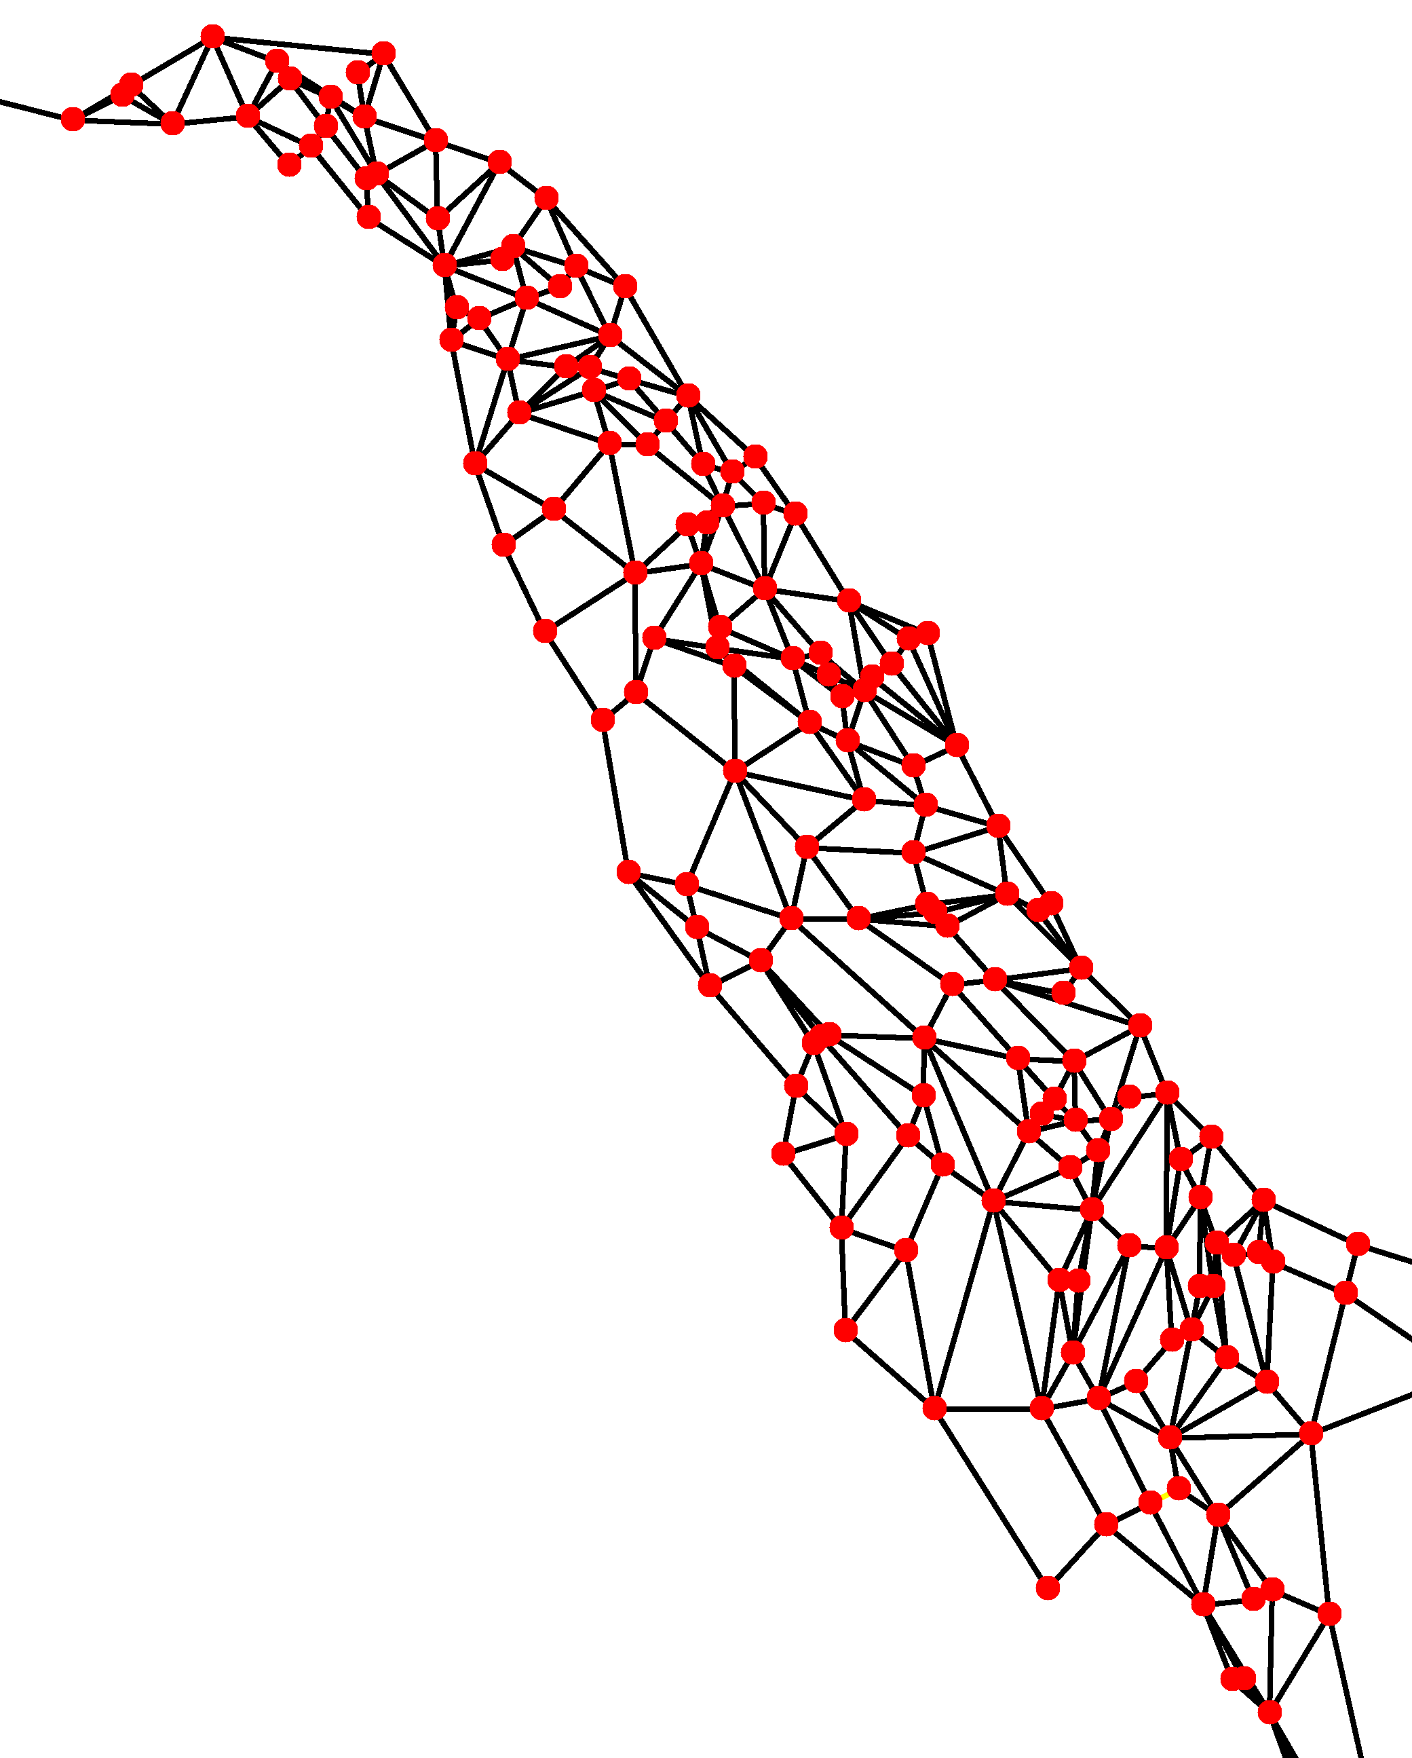
PHYSICAL SYSTEMS as Flux networks
Surface and ground water (currency) flux across and through the Nyack Floodplain, Middle Fork Flathead River (network)
Poole et al. 2006

Slide 22
Biotic communities as Flux networks
Baxter et al. 2005
Food web (network) representing carbon (currency) flux

