Slide 1
Layout of Page Elements
September 28th, 2009

Slide 2
Patterns
Common ways to use the Layout Elements of Visual Hierarchy, Visual Flow, Grouping and Alignment, and Dynamic Displays

Slide 3
Patterns
Element 1: Visual Hierarchy of Entire Screen
Visual Framework
Center Stage
Element 2: Visual Flow
Right/Left Alignment
Diagonal Balance
Element 3: Grouping Content within a Screen
Titled Sections
Card Stack
Closable Panels
Movable Panels
Element 4: Dynamic Layout
Responsive Disclosure
Responsive Enabling
Liquid Layout
Other
Property Grid

Slide 4
Visual Hierarchy Patterns
Common ways to use the Layout Elements of Visual Hierarchy

Slide 5
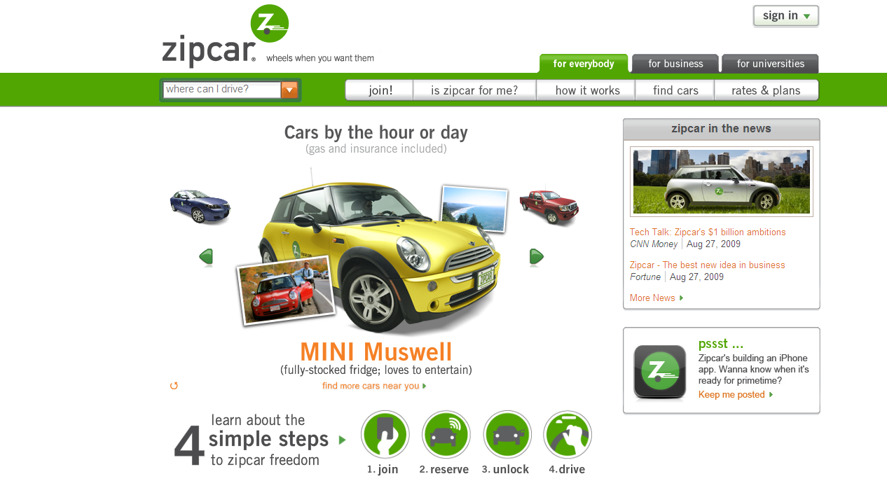
Visual Framework

Slide 6
Visual Framework
Use the same basic layout, colors, and stylistic elements across all screens
Design should have enough flexibility to handle varying screen content
Best used in any application or web site that has multiple windows or screens that should mesh together
Makes the user comfortable. Typically is easier to navigate and know context

Slide 7
Visual Framework - Considerations
Colors, backgrounds, text and accent colors
Fonts: title, subtitles, ordinary text and minor text
Writing style and grammar
Signposts: Titles, Logos, Breadcrumbs, Card Stacks
Navigation: Standard links, buttons, back/forward
Spacing and Alignment: margins, line spacing, padding, text and label justification
Overall Layout: placement of things in page, rows, columns, other?

Slide 8
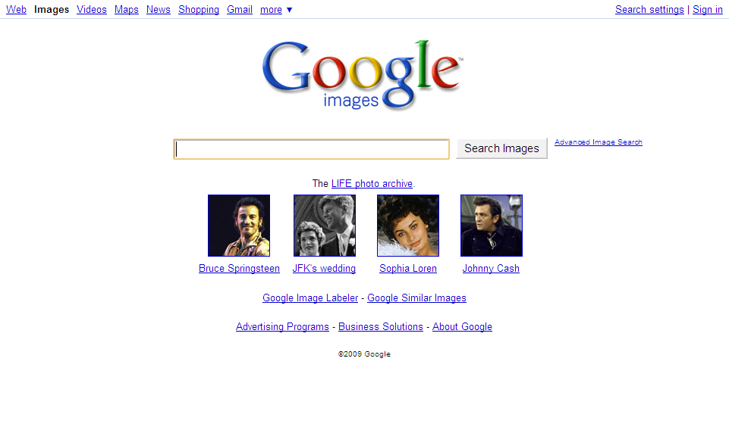
Visual Framework - Example

Slide 9
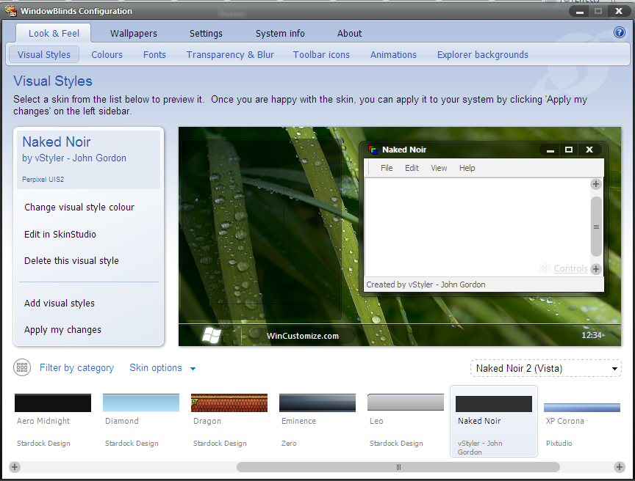
Visual Framework - Example

Slide 10
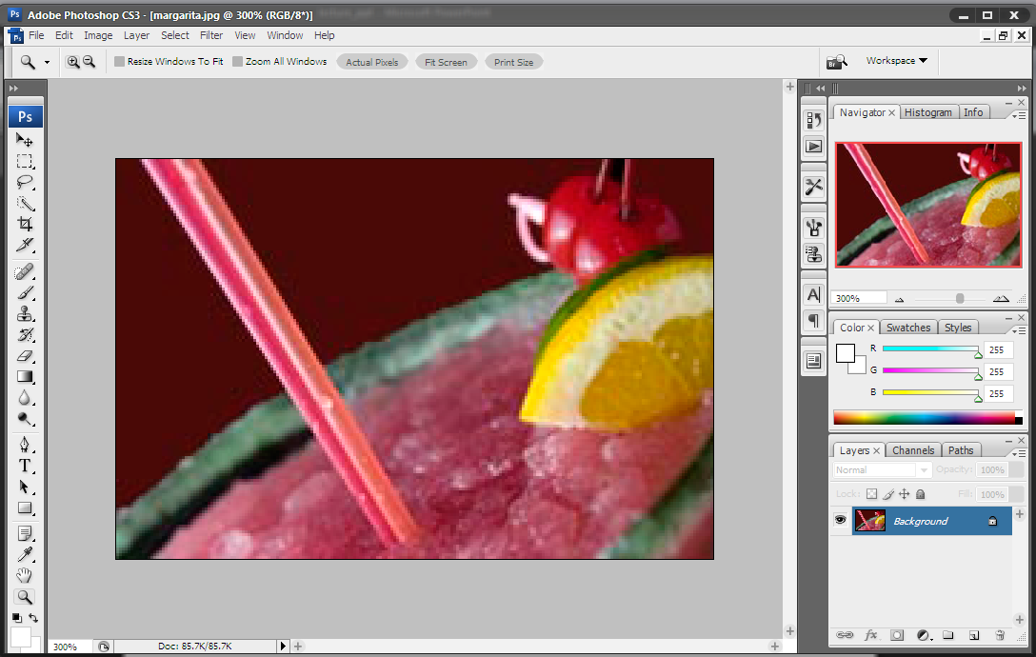
Center Stage

Slide 11
Center Stage
Place the most important UI element into the largest subsection of the window
Arrange secondary content and tools around it in smaller panels
Best used when the application’s primary job is to edit a document or object, perform a certain task or show coherent information
Examples: Spreadsheets, Graphical Editors, Document Editors, etc

Slide 12
Center Stage - Example

Slide 13
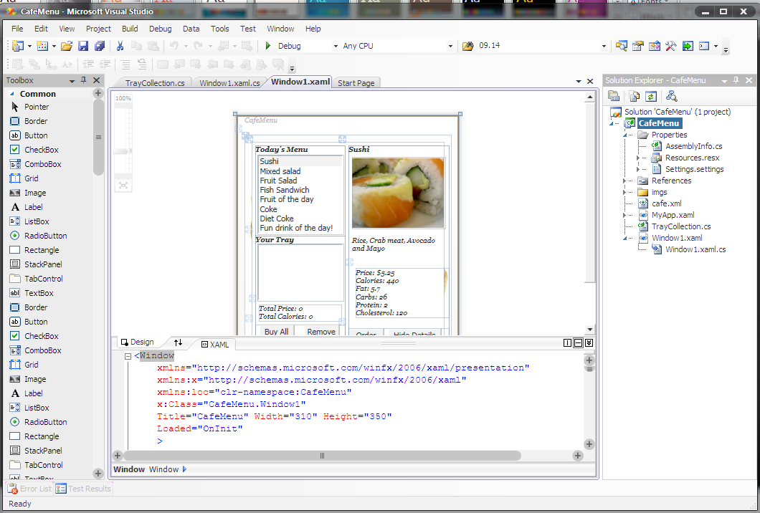
Center Stage - Example

Slide 14
Visual Flow Patterns
Common ways to use the Layout Elements of Visual Flow

Slide 15
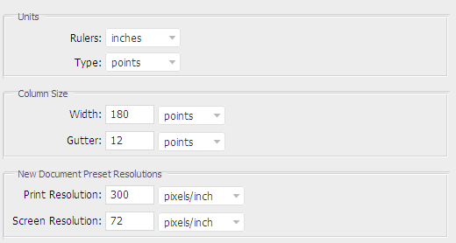
Right/Left Alignment

Slide 16
Right/Left Alignment
In two column tables (or portions of tables), right align labels on the left, and left-align the items on the right
Putting text next to the item it labels creates a strong perceptual grouping of that pair
Exceptions to this rule can exist if the labels vary significantly in length, but Items should almost always be left aligned
Adheres to multiple Gestalt principles

Slide 17
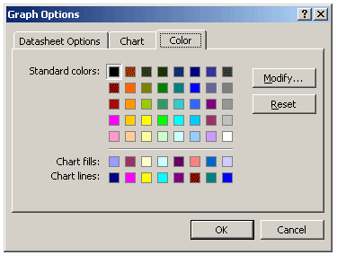
Diagonal Balance

Slide 18
Diagonal Balance
Arrange page elements asymmetrically, balancing by putting strong visual weight in the upper left and lower right corners
Best used the content has strong titles and actions, is short enough not to scroll and desires a strong visual flow
Easy flow for user’s eyes - comfortable

Slide 19
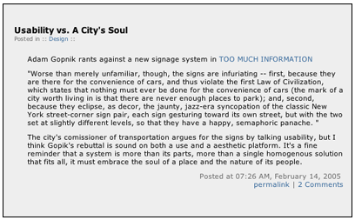
Diagonal Balance - Example

Slide 20
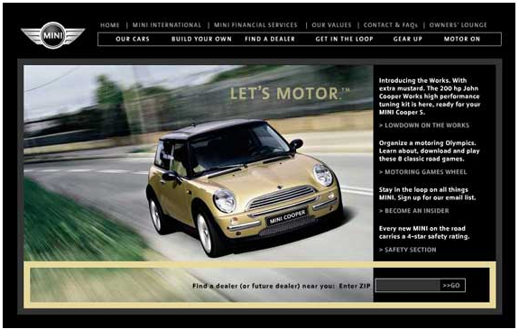
Diagonal Balance - Example

Slide 21
Grouping and alignment Patterns
Common ways to use the Layout Elements of Grouping and Alignment

Slide 22
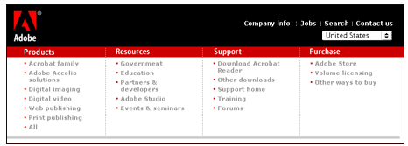
Titled Sections

Slide 23
Titled Sections
Define separate sections of content by:
Giving each a visual strong title
Organized sections, often uniform in size
Laying them all out on one page, often adjacent
Best used when you have a lot of content to choose from and you want to make it easy for the user to scan and conceptually group
This is neat and comfortable for a user
Human will look for patterns regardless, so why not use them?!

Slide 24
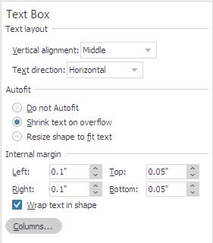
Titled Sections - Example

Slide 25
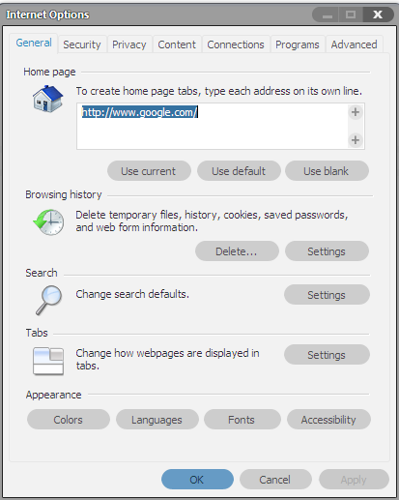
Card Stack

Slide 26
Card Stack
Group content into separate overlaying panels, only one is visible at a time
Best used when too much content exists to display on one page.
And when user’s do not need to see all of the content at one time.
Common Types: Tabs, Vertical Tabs, Column of Names, Drop-Down or alternative selector

Slide 27
Card Stack – Example

Slide 28
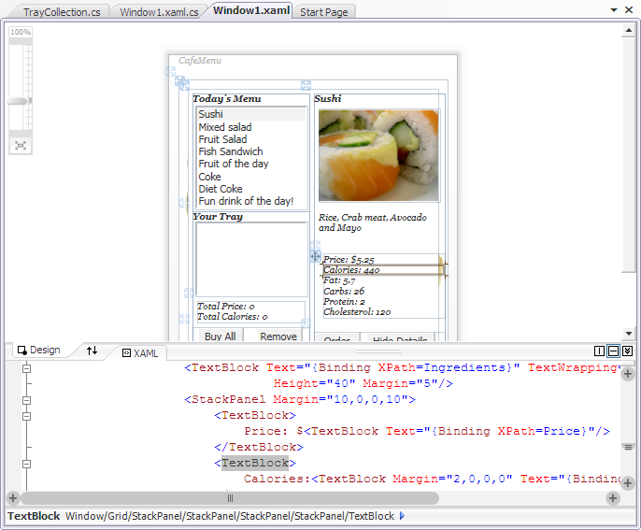
Card Stack - Example

Slide 29
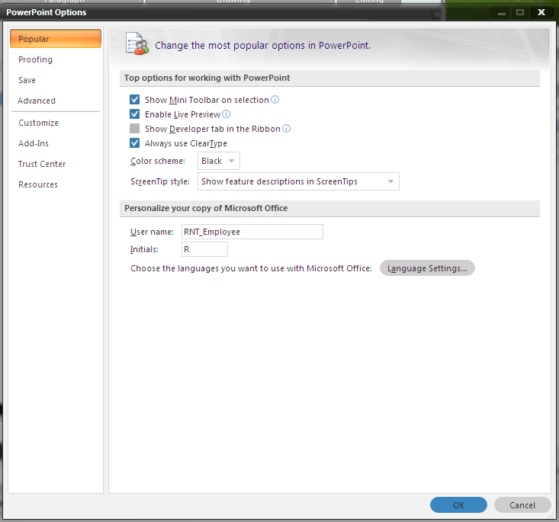
Card Stack - Example

Slide 30
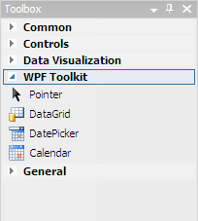
Closable Panels

Slide 31
Closable Panels
Group content into separate overlaying panels that the user can expand/collapse
Different than a card stack in that multiple panels can be open at once
Best used when a card stack would not be optimal because users would likely like to see multiple sections of content simultaneously

Slide 32
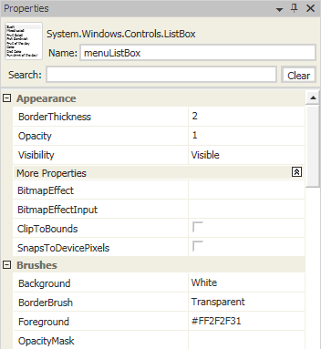
Closable Panels - Example

Slide 33
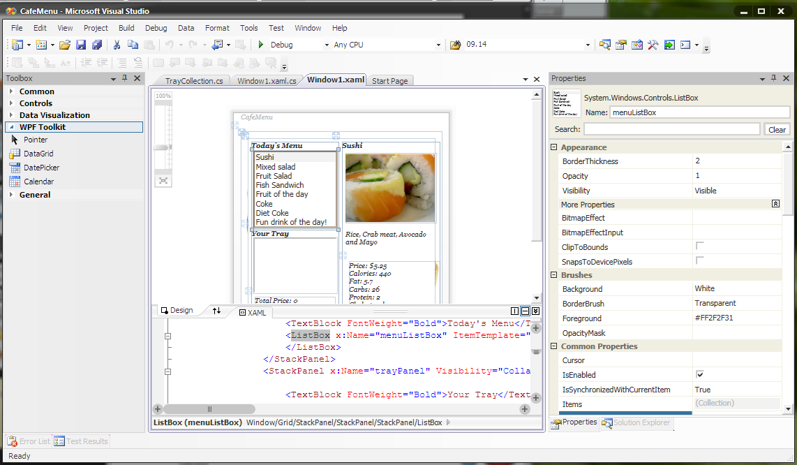
Movable Panels

Slide 34
Moveable Panels
Group content into separate panels that the user can move around to customize their view of the application
Best used when content is easily associated into individual groups that do not require spatial recognition to aid the user
Typically used in more complex applications (i.e. power users), however can be used effectively in simple apps

Slide 35
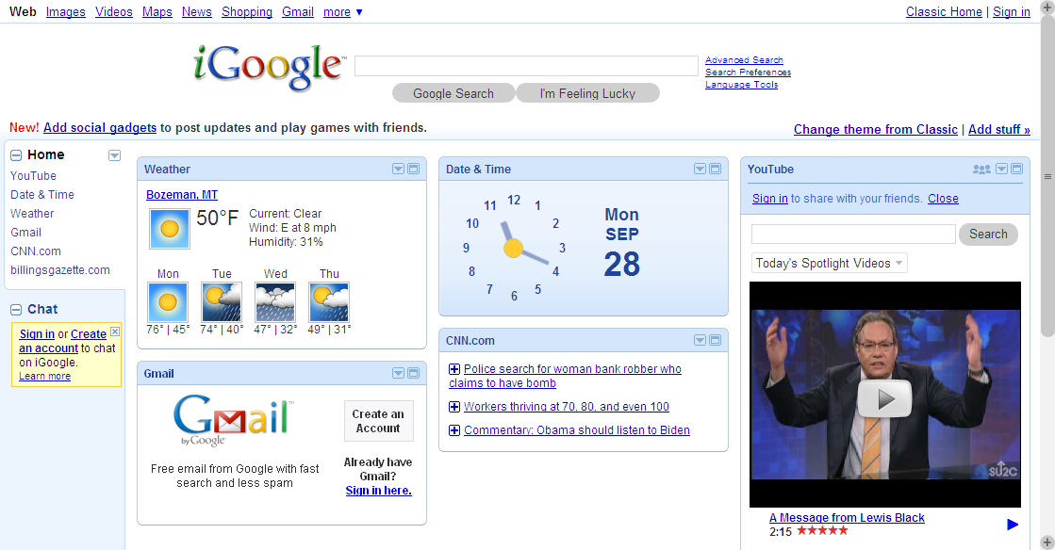
Movable Panels - Example

