Slide 1
Delay-bounded Routing in Vehicular Ad-Hoc Networks
CS541
April 1st 2009
Michael Running Wolf

Slide 2
Outline
Reference
Introduction
Assumptions
Problem Definition
Assumptions
Proposed Algorithms
Evaluation

Slide 3
Reference
Skordylis, A., & Trigoni, N. (2008). Delay-Bounded routing in vehicular ad-hoc networks. In Proceedings of the 9th ACM international symposium on mobile ad hoc networking and computing.

Slide 4
Introduction
VANET Applications
Collision avoidance
Traffic Congestion
Parking Availability
Virtual traffic signs
Safety alerts
Application Traffic Categories
Multicasting in a nearby geographic region
Emergency
Multi-hop Point to point/area communication
Targeted advertisement

Slide 5
Ambient Traffic Sensor Application
Second category of applications
Vehicles have sensors
Accidents
Road faults
Traffic congestion
“Interesting events”
Messages, interesting events, forwarded to Aps
Messages prioritized according to urgency of event

Slide 6
Expected Congestion
Spectrum
802.11 proliferation
Expect high network utilization
Multi-Media

Slide 7
Assumptions
Very limited AP placement at intersections
Node/User
802.11b
Transmission range of 250m
Knows and broadcasts GPS
Has map of region
Directed graph, G(V,E)
Updated statistics on area roads available
Rough average node density and speed
Dissemination and gathering not covered
No cache size restrictions

Slide 8
Problem Definition
In a densely populated area, with high congestion and node movement, propose algorithms that are:
Minimize network utilization, transmitted bits
Meet delivery time constraint, TTL
Delay tolerant
Utilize traffic statistics

Slide 9
Proposed Algorithms
Delay bounded
successfully transmit before delay threshold, TTL
Delay Tolerant
‘Carry-and-forward’
Unicast
Message have expiration
Two algorithms
D-Greedy
D-MinCost

Slide 10
Forwarding strategies, Algorithm cont.
Multi-hop forwarding
Forward to vehicles closer to intersection
Data Mulling
Cache message until next intersection
Default method if no vehicle in range

Slide 11
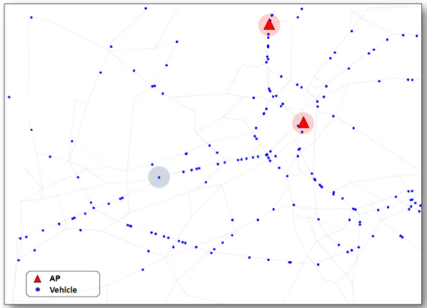
Directed Edges Graph
For any two intersections a and b,
(a, b) ∈ G iff road connects a to b and
cars can travel from a to b.
Based off real-world data from Zurich Switzerland
Populated by actual car tracking data
Directed graph
Vertices are intersections
Edges one way road connections between edges

Slide 12
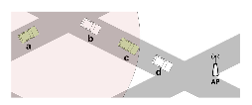
Delay-bounded Greedy Forwarding (D-Greedy)
Hopes shortest path to nearest AP taken
Beacons update neighbor list
id
distToAP – Shortest distance to AP
dijkstra
Segments assigned time budget
Each edge allocated delay budget proportional to length.
While a segment is within its budget, Data Mulling is used.

Slide 13
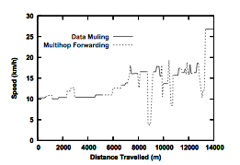
D-Greedy Details
distToInt – distance to intersection
u – average speed of node during k-second period
Del – available time budget for segment
Del_{DM} Expected delay if Data Mulling used
If use Data Mulling, otherwise start forwarding
If node is moving away from AP , use Muli-Hop Forward
Cache, ‘Data Mull’, if no suitable neighbors
Node periodically re-calculates heuristic.
Initially Data Mulling is favored in slow cars by intentionally overestimating TTL
Hope that shortest path taken

Slide 14
Delay-bounded Min-Cost Forwarding (D-MinCost)
Requires knowledge of global traffic conditions.
Two cost metrics weigh edges
C – cost, representing number of hops along edge
Del – delay, time required to move message along edge
For each segment, only one strategy used along entire edge length
Metrics affected by which strategy used for segment
Graph G(V,E) modified into G’(V,E’)
Predetermined path calculated

Slide 15
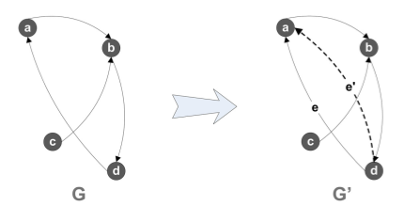
D-MinCost, Graph G’(V,E’)
|E’| = 2|E|
For each directed edge e ∈ G that connects two vertices, create a new sibling edge e′ ∈ G connecting same vertices
e: assigned cost for Data Mulling
e’: Multi-hop forwarding cost

Slide 16
D-MinCost Graph weighing
l – segment length
- average node speed along edge
R - wireless range
q – time to check neighbor list and find next best hop
Edges, e, assigned Data Mulling strategy assigned costs:
Edges, e’, assigned:
Multi-hop available option if l > R and vehicle density > l / R
_{u}

Slide 17
D-MinCost Path Selection
Delay-constrained least-cost routing problem is NP-Complete
Delay Scaling Algorithm heuristic used
Calculate path
Least costly AP
Cost of and path calculated by heuristic to AP
Strategy to use for each edge in path
If a path infeasible, new path calculated by current message carrier

Slide 18
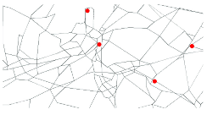
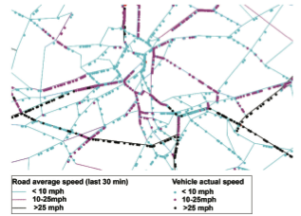
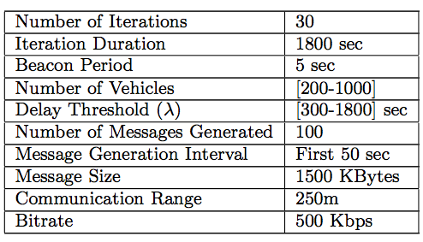
Evaluation
Simulated in 20km × 10 km region of Zurich
Parameters
TTL : 5 - 30minutes!

Slide 19
Comparison Algorithms
MinCost – VADD (Vehicle Assisted Data Delivery) based path determined by delay
Epidemic – Message multi-cast throughout network

Slide 20
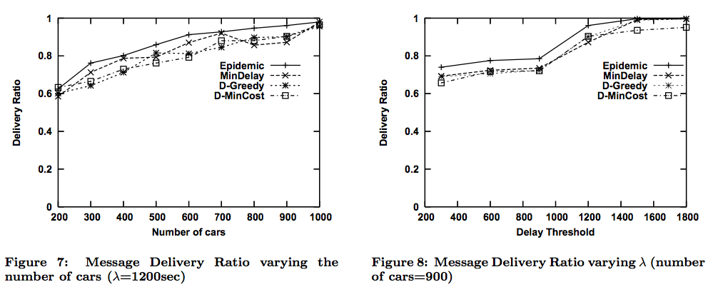
Message Success, Results
TTL 1,200 = 20 Minutes

Slide 21
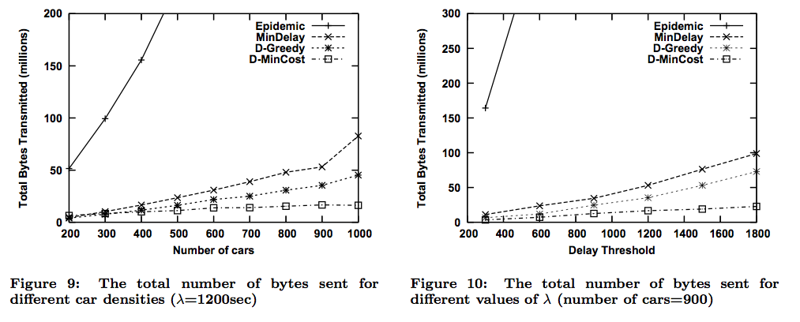
Network use/bytes sent, Results cont.

Slide 22
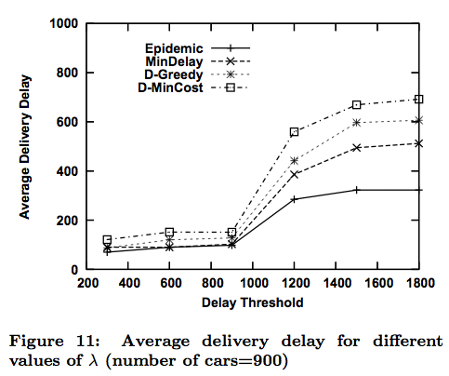
Delay, Results cont.

Slide 23
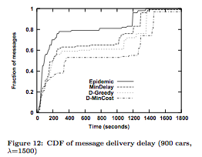
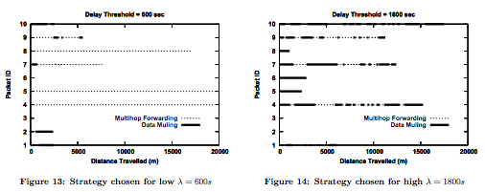
Other Results

Slide 24
Conclusion
D-MinCost
Computationally expensive route calculation
Must distribute global network state to all nodes
High latency
What if messenger node parks car in middle of edge?
D-Greedy
On par excluding transmission requirements
Better latency

