Slide 1
Ant Colony Optimization Algorithms for TSP: 3-6 to 3-8
Timothy Hahn
February 13, 2008
Notes:
Introduction
Section 3.6 is how ACO Algorithms Behave with Certain Parameters
Section 3.7 is how local search can benefit ACO Algorithms
Section 3.8 gives implementation details on ACO Algorithms

Slide 2
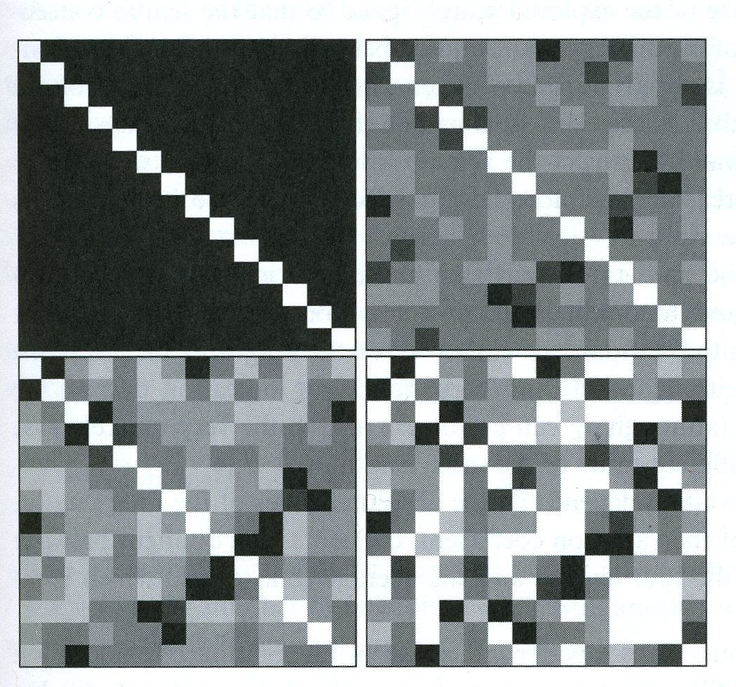
3.6.1 Behavior of ACO Algorithms
TSPLIB instance burma14
Grayscale image
  White (No pheromone)
  Black (High pheromone)
After various instances
  0 (top left)
  5 (top right)
  10 (botton left)
  100 (bottom right)
Notes:
At beginning, all black (high pheromone) except for diagonal (white…low pheromone)
Diagonal is white because the distance to a city from itself is zero….no reason to take such and edge in the TSP problem
At the 5 and 10 iterations, most of the squares are gray showing that the ants are exploring new areas
At the 100 iteration, more the square are either white or black showing that a particular edge is either really good or really bad…i.e. it is converging to a solution
Notice the symmetry…this is due to the fact that this is a symmetric TSP problem, i.e. the distance from A to B is the same as the distance from B to A

Slide 3
3.6.1 Behavior of ACO Algorithms
Stagnation – all ants follow the same path and same solution
Methods of measuring stagnation
  Standard Deviation (σ_{L})
  Variation Coefficient (σ_{L})/μ_{L})
  Average distance between paths
    dist(T,T’) = number of arcs in T but not in T’
  Average Branching Factor
    τ_{ij} ≥ τ^{i}_{min} + λ(τ^{i}_{max} - τ^{i}_{min})
  Average Entropy
Notes:
Standard deviation is bad measure…ant could be following two or more unique paths with the same length, showing a stagnation of zero that isn’t accurate. Also does not take the path length into account. A deviation of 10 in a 1,000 path average is much different than a deviation of 10 in a 50 path average
Average distance between paths is complicated to calculate O(n^2), so not feasible in practice
Average branching factor is dependant upon the choice of lamba….ACO has enough variables without the need to add additional ones
Average entropy is probably the best choice for most implementations

Slide 4
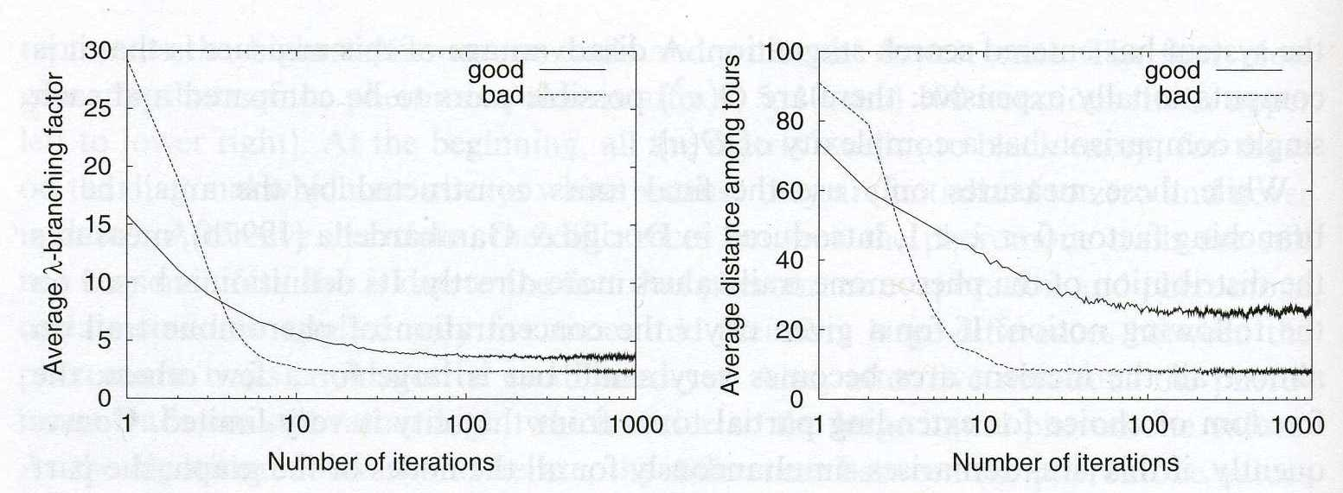
Behavior of Ant Systems
Average Branching Factor
Average Distance
Notes:
Good behavior has alpha = 1 and beta = 2; bad behavior has alpha = 5 and beta = 0
Strong bias towards alpha in bad example results in stagnation (pheromone levels are low so not included much)
Reverse can also be true, a strong bias towards beta can result the heuristic being over emphasized and good tours aren’t found
Goal: find a balance between narrowing search space and weak guidance (i.e. excessive exploration)

Slide 5
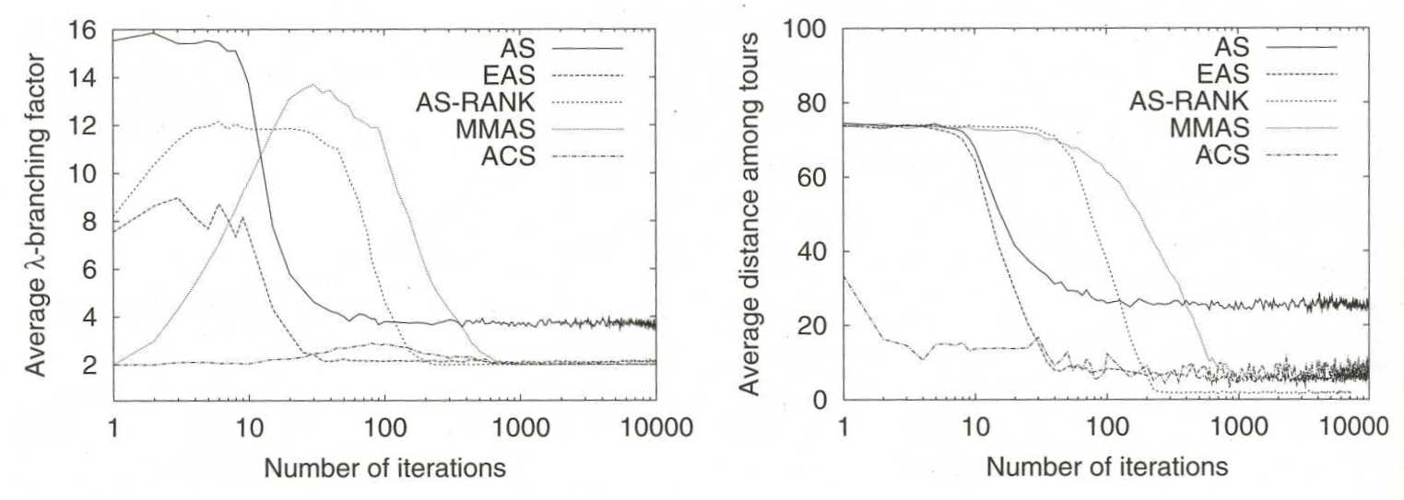
Behavior of Extensions of AS
Average Branching Factor
  .
Average Distance
Notes:
Most algorithms have high branching at first, then converge. ACS has low branching throughout
All but AS converge to minimal branching factor of 2…AS extensions needs to consider stagnation
MMAS takes the longest to converge
AS-Rank stagnates
Parameters are important, varying them can easily come up with a scenario when one approach beats the rest. Need to find a good approach for all.

Slide 6
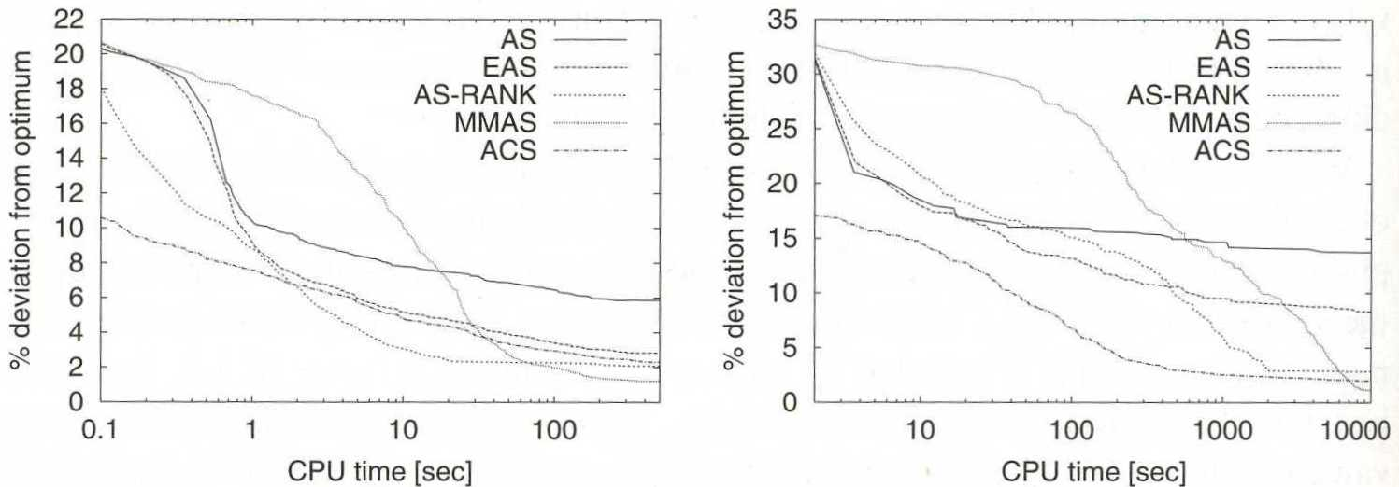
Behavior of Extensions of AS
d198 instance
  .
rat783 instance
Notes:
MinMax AS takes longest to convege due to initial estimate of Tmax and low evaporation rate, but does converge in the end to the best solution.
Extensions of AS all perform significantly better than the AS
ACS is aggressive and has the best solution in the short run, but MMAS is best for longer runs

Slide 7
ACO Plus Local Search
Basic idea: When an ant finds a solution, use a local search technique to find a local optimum
2-opt and 2.5-opt have O(n²) complexity, while 3-opt has O(n³) complexity
Tradeoff between spending more time on local search and less time on ant exploration versus less time on local search and more time on ant exploration
  532² = 283,024 comparisons
  532³ = 150,568,768 comparisons
Using nearest neighbor lists and reduce the number of required comparisons

Slide 8
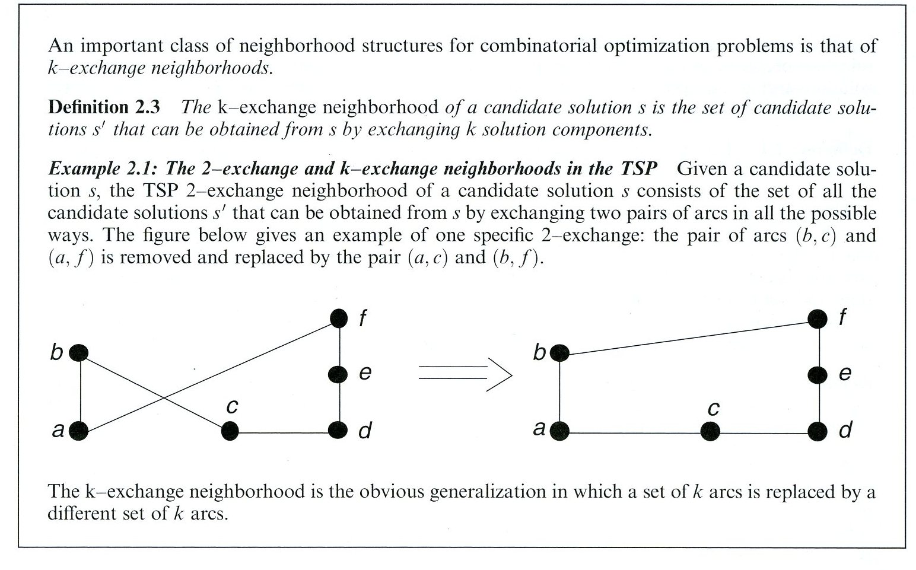
2-opt Local Search

Slide 9
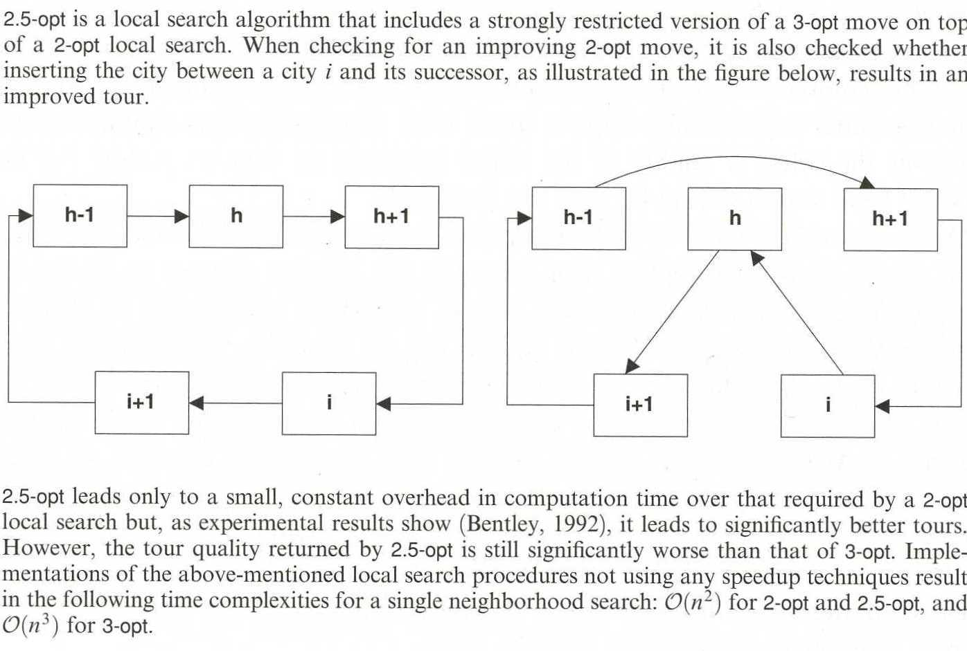
2.5-opt Local Search

Slide 10
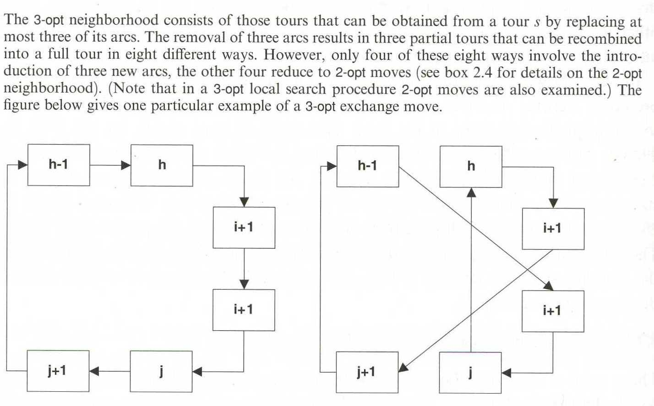
3-opt Local Search

Slide 11
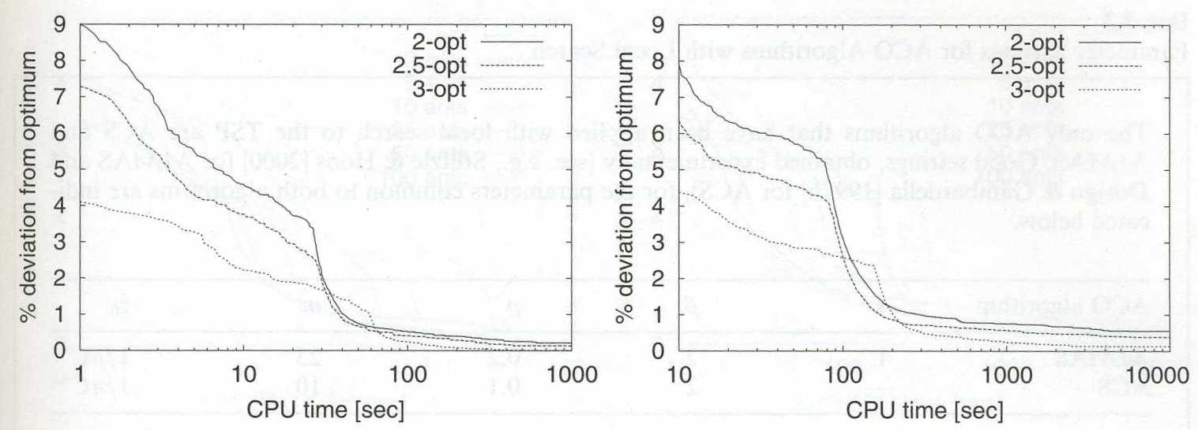
Local Search Results
pcb1173 instance
  .
pr2392 instance
Notes:
3 opt is best except for brief time
Reason is that there is a brief period of time where 2 and 2.5 are in exploitation phase and 3 is still in exploration phase due to time complexity

Slide 12
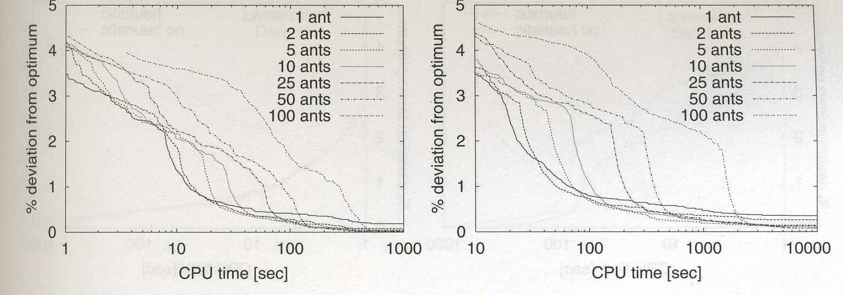
Number of Ants Results
pcb1173 instance
  .
pr2392 instance
Notes:
Larger numbers of ants take longer to converge, but in the end, they find the best solution

Slide 13
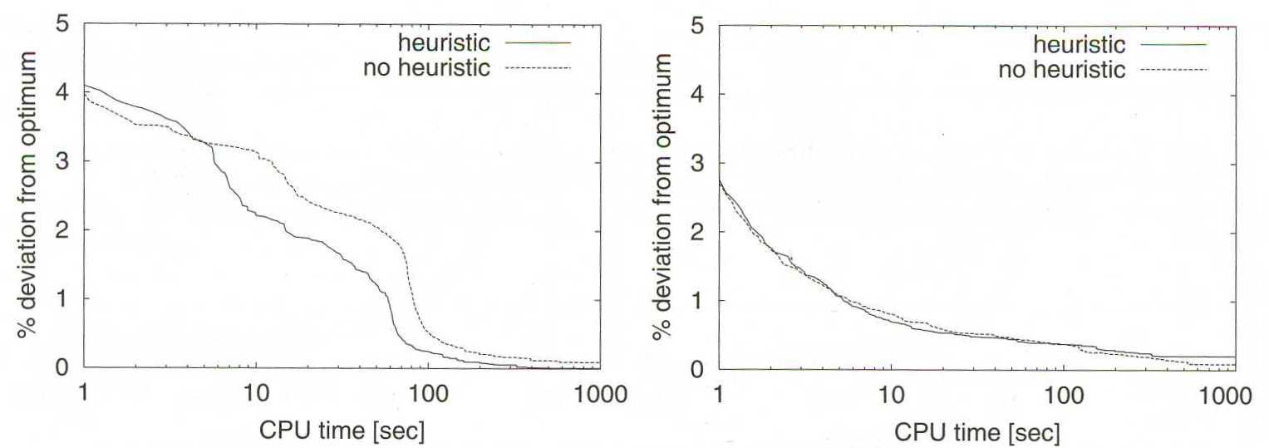
Heuristic Information Results
MMAS
  .
ACS
Notes:
Heuristic information is added to help ants build acceptable solutions from the beginning.
With the addition of local search, the importance of this heuristic information is reduced
No heuristic helps in ACS, but hurts in MMAS.
Both differences are minor

Slide 14
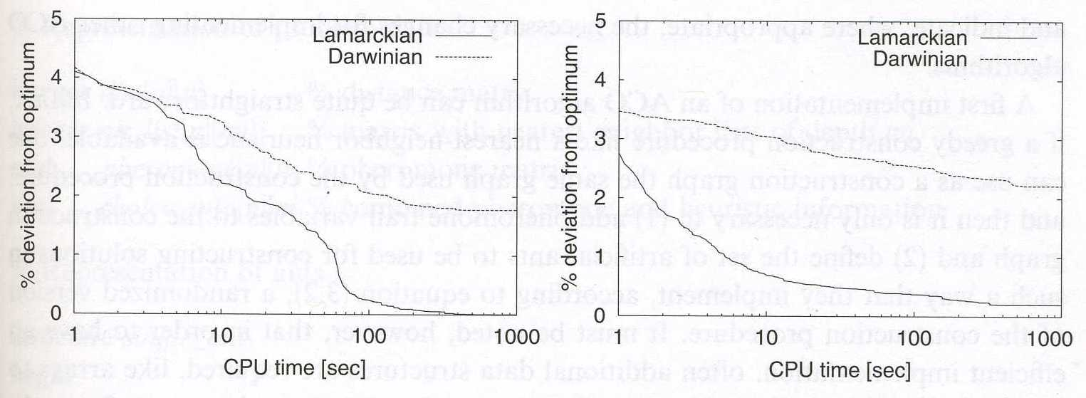
Pheromone Update Results
MMAS
  .
ACS
Notes:
Two ways to update pheromones
Lamarckian: Use the pheromones corresponding to the final tour (improved by local search)
Darwinian: Use the pheromones corresponding to the initial tour (before local search)
Obvious result is that Lamarckian is the best method
This is probably true for all combinatorial problems
This shows how local search helps ACO

Slide 15
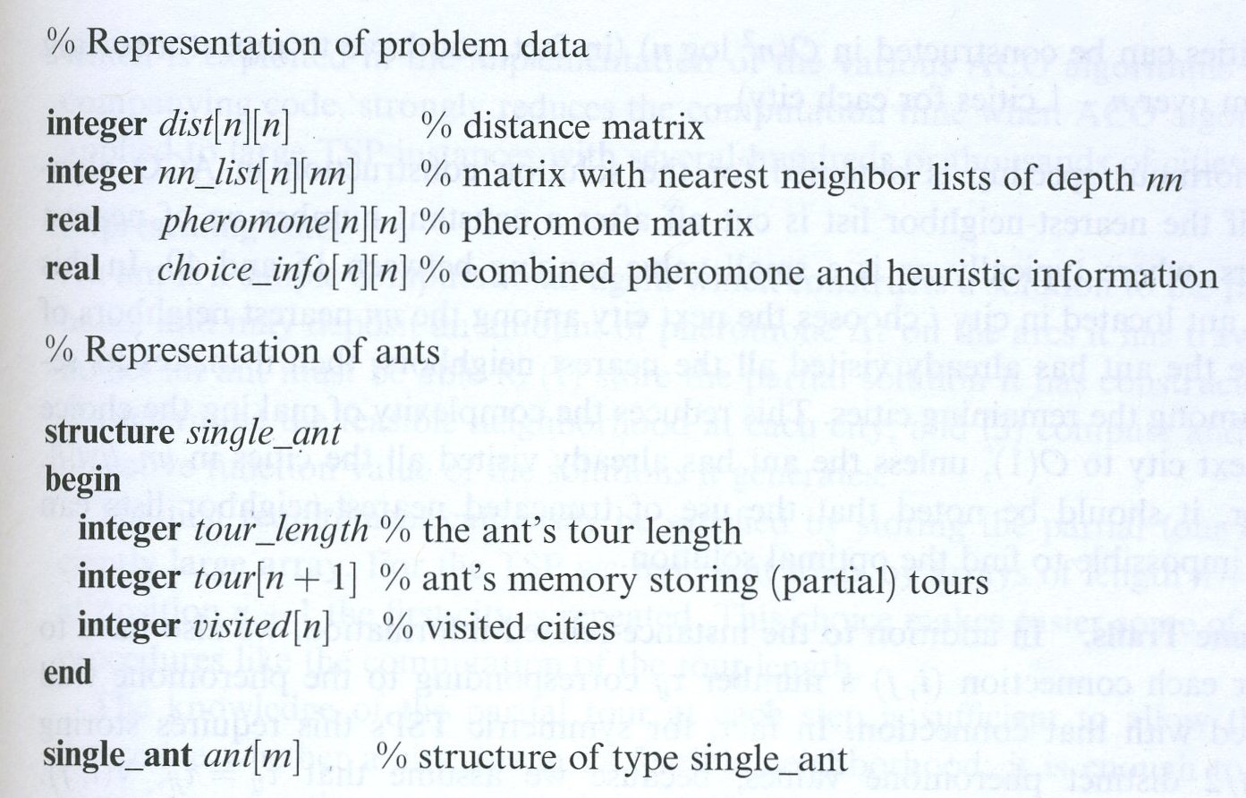
Data Representation
Notes:
Single Ant
Tour_length = 2
Tour = 2 * 533 = 1066
Visited = 2 * 532 = 1064
TOTAL ANT = 2132
Number of Ants = 532
TOTAL ANT MEMORY = 2132 * 532 = 1,134,224
Problem Data
Distance = 532 * 532 * 2 = 566,048
NN_List = 532 * 532 * 532 * 2 = 301,137,536
Pheromone = 532 * 532 * 4 = 1,132,096
Choice_Info = 532 * 532 * 4 = 1,132,096
Total Problem Data = 303,967,776
TOTAL MEMORY = 305,102,000

Slide 16
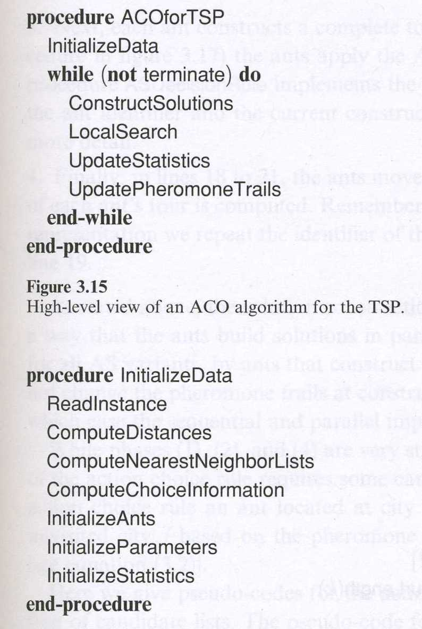
Basic Algorithm

Slide 17
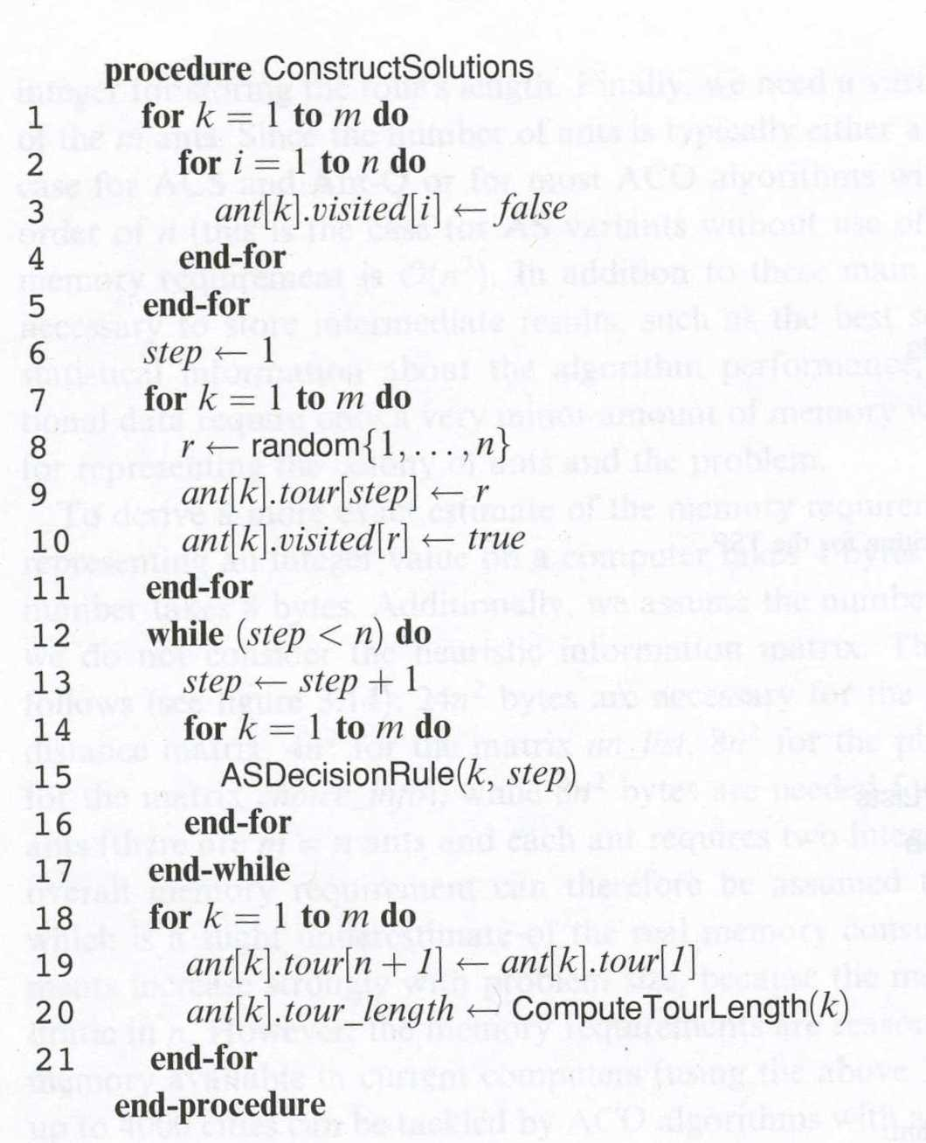
Constructing Solutions

Slide 18
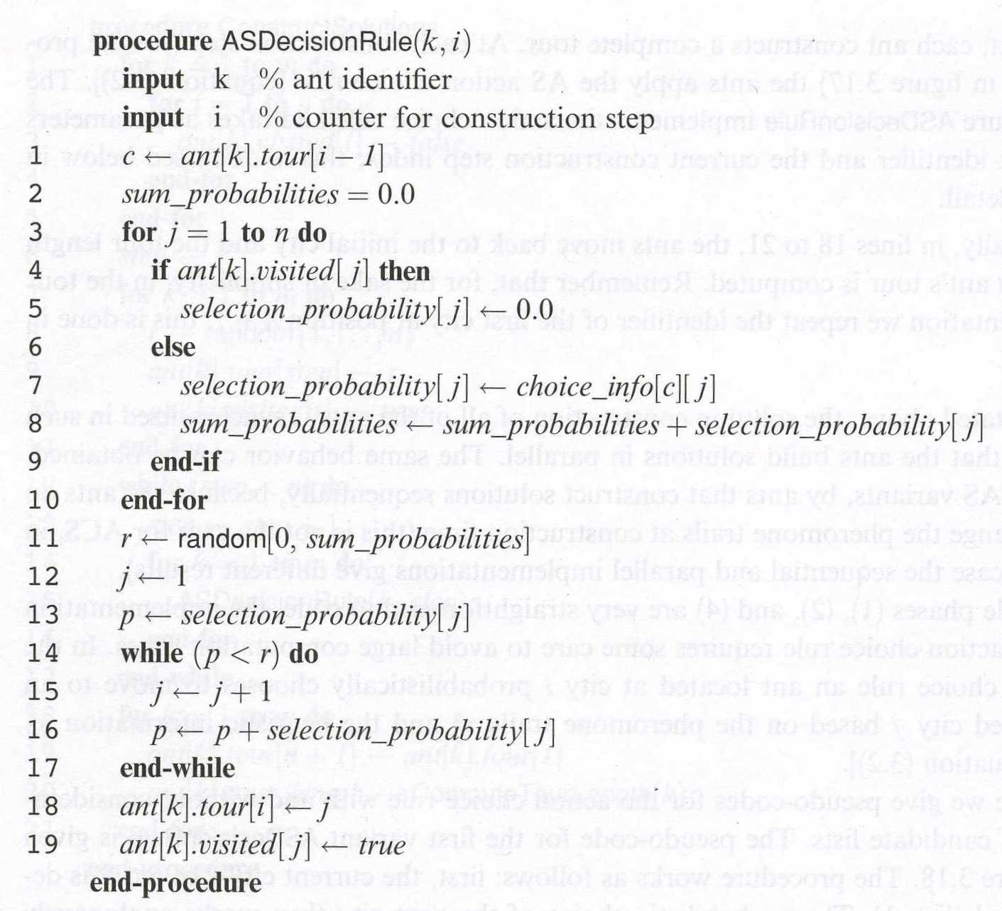
AS Decision Rule

Slide 19
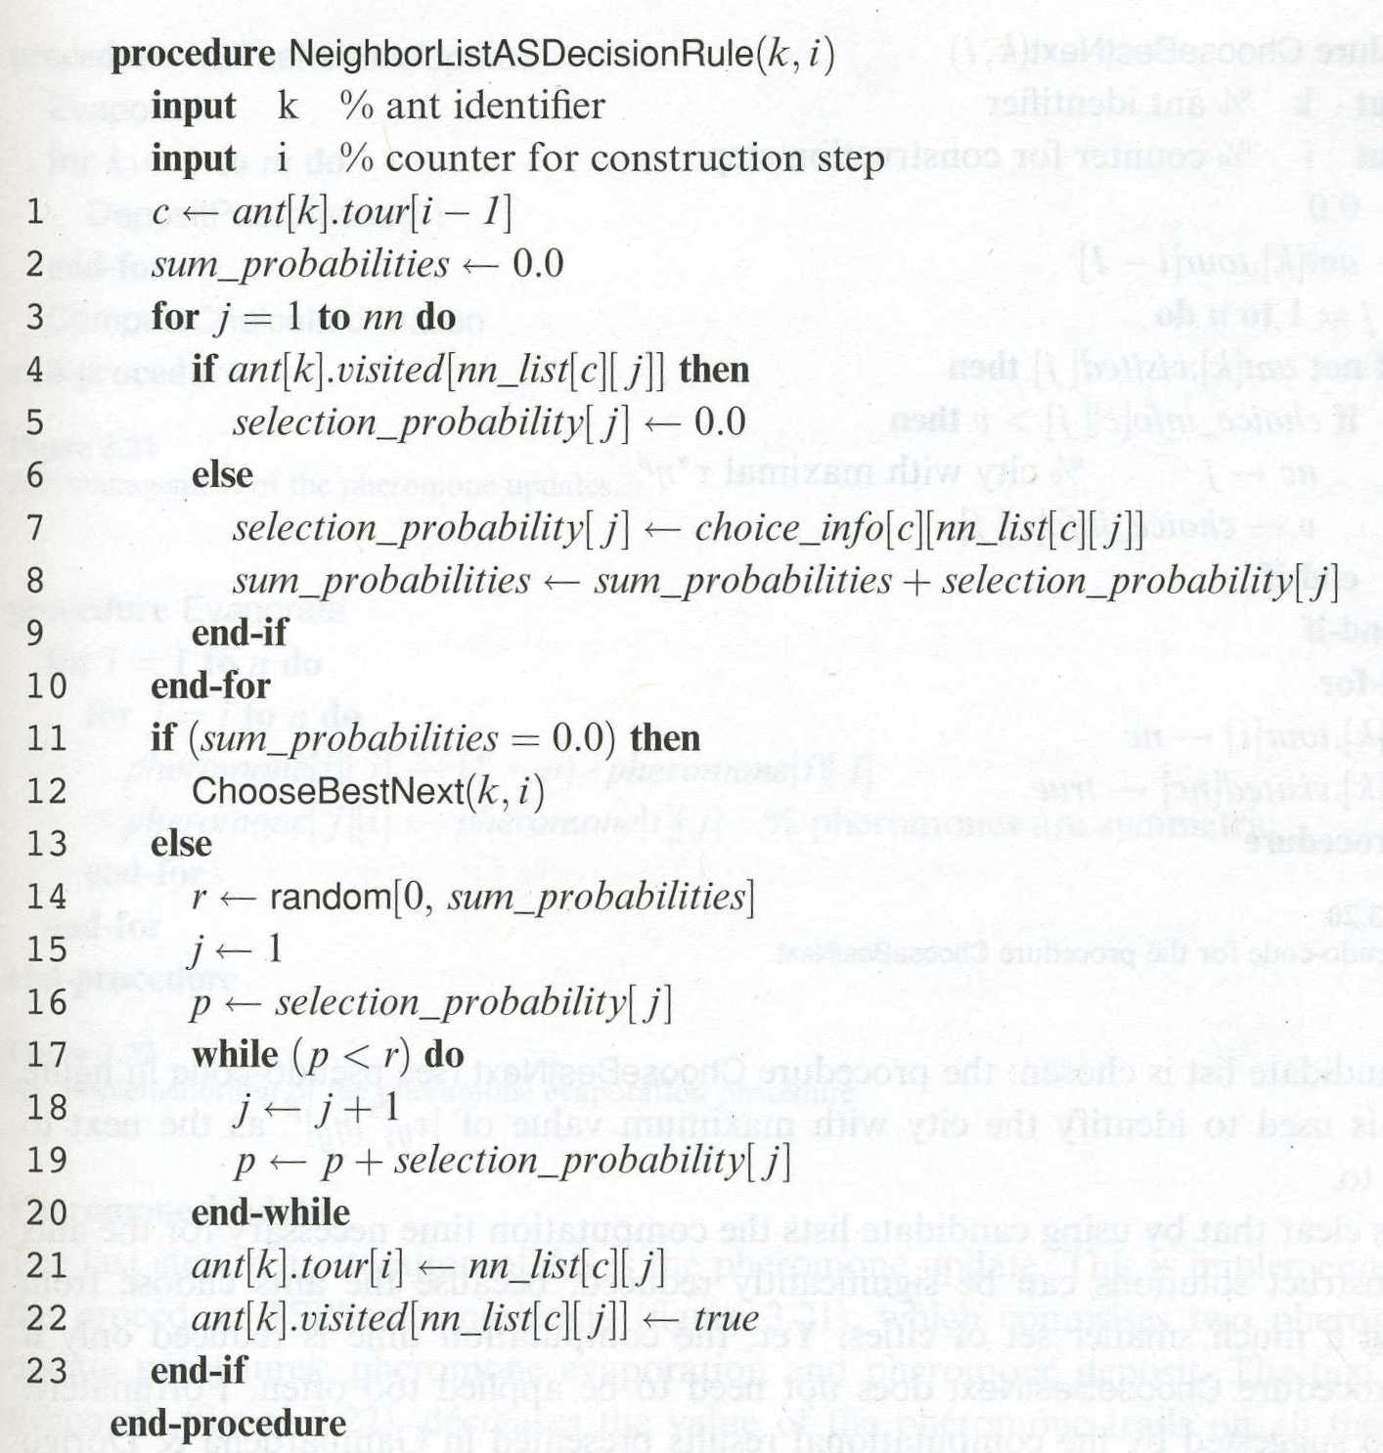
NeighborListASDecisionRule

Slide 20
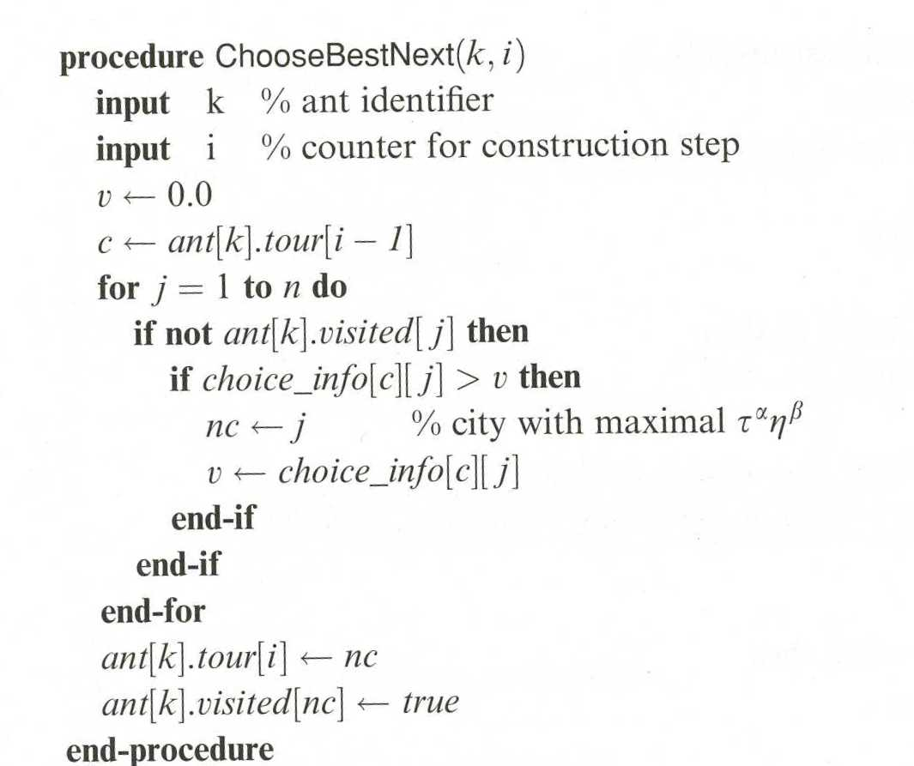
ChooseBestNext

Slide 21
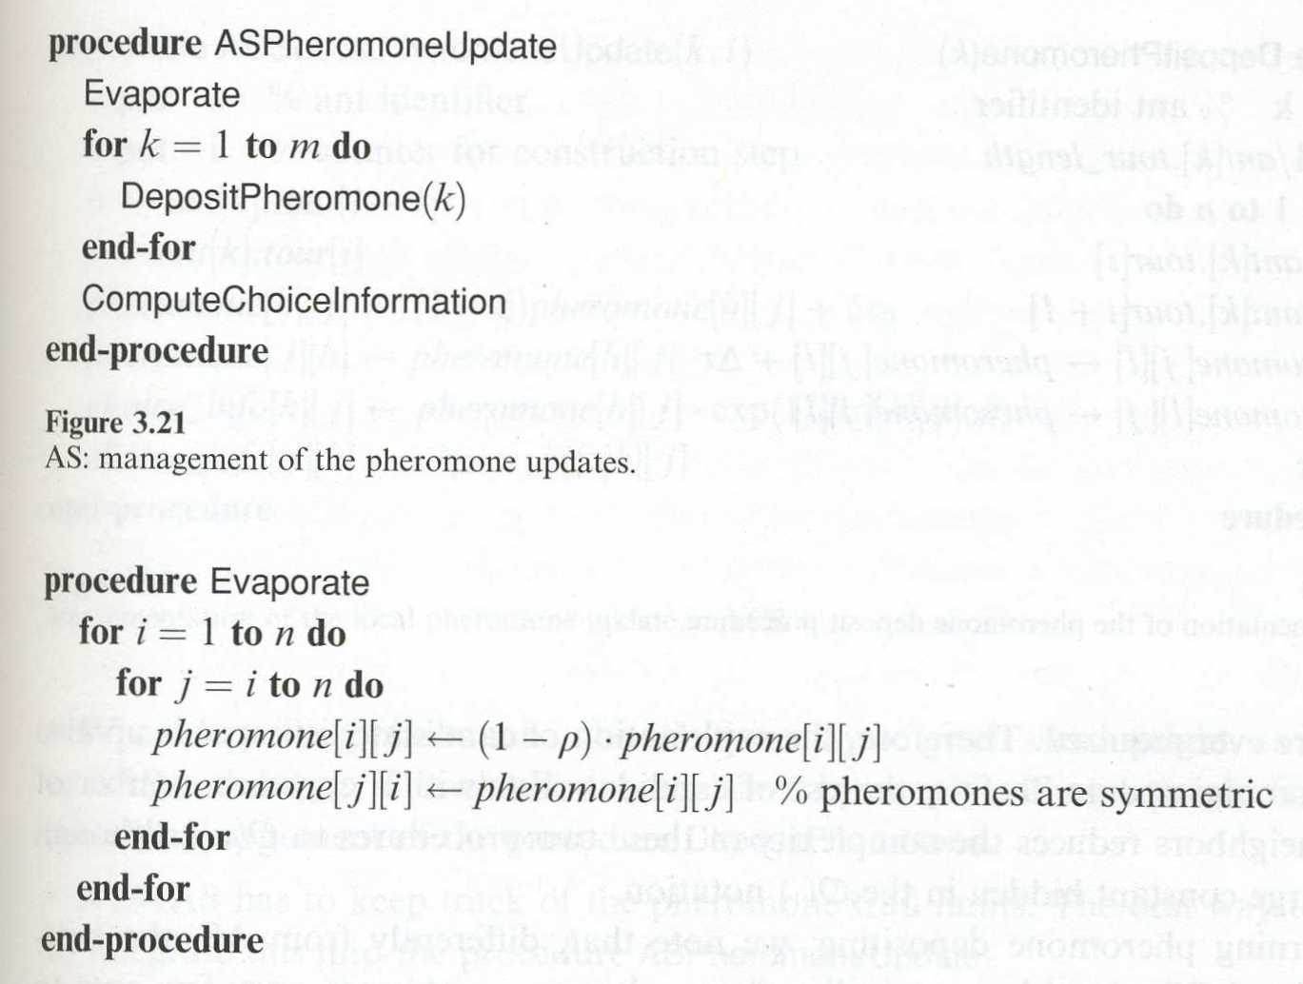
Updating Pheromones

Slide 22
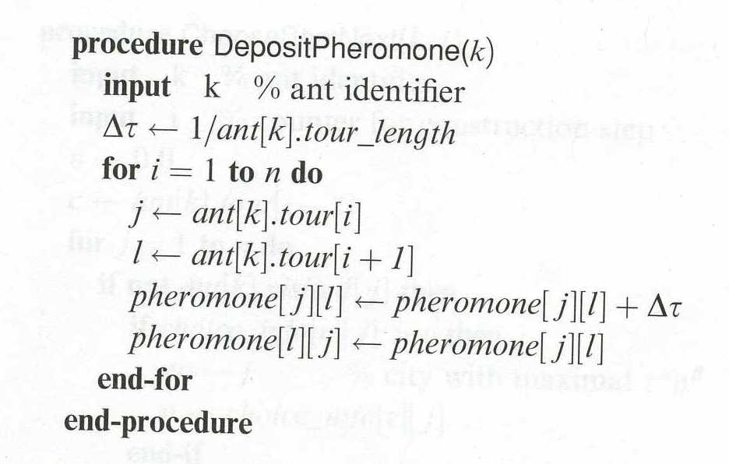
AS: Deposit Pheromone

Slide 23
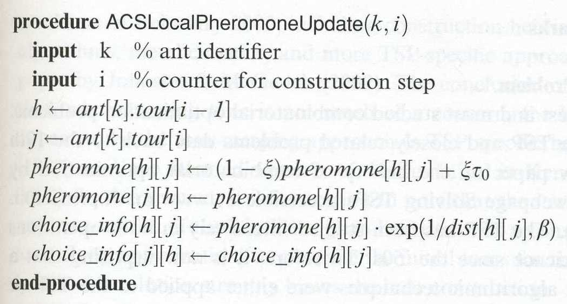
ACS: Deposit Pheromone

Slide 24
3.9 Bibliographical Remarks
TSP is among the oldest (1800s) and most studied combinatorial optimization problems
Algorithms have been developed capable of solving TSP with over 85,900 cities
ACO algorithms are not competitive with current approximation methods for TSP (solutions to millions of cities within a reasonable time that are 2-3% of optimal)
ACO algorithms work very well on other NP Complete problems

