Slide 1
Delay-bounded Routing in Vehicular Ad-Hoc Networks
CS541
April 1st 2009
Michael Running Wolf

Slide 2
Outline
Reference
Introduction
Assumptions
Problem Definition
Assumptions
Proposed Algorithms
Evaluation

Slide 3
Reference
Skordylis, A., & Trigoni, N. (2008). Delay-Bounded routing in vehicular ad-hoc networks. In Proceedings of the 9th ACM international symposium on mobile ad hoc networking and computing.

Slide 4
Introduction
VANET Applications
  Collision avoidance
  Traffic Congestion
  Parking Availability
  Virtual traffic signs
  Safety alerts
Application Traffic Categories
  Multicasting in a nearby geographic region
    Emergency
  Multi-hop Point to point/area communication
    Targeted advertisement

Slide 5
Ambient Traffic Sensor Application
Second category of applications
Vehicles have sensors
  Accidents
  Road faults
  Traffic congestion
  “Interesting events”
Messages, interesting events, forwarded to Aps
  Messages prioritized according to urgency of event

Slide 6
Expected Congestion
Spectrum
  802.11 proliferation
Expect high network utilization
  Multi-Media

Slide 7
Assumptions
Very limited AP placement at intersections
Node/User
  802.11b
  Transmission range of 250m
  Knows and broadcasts GPS
  Has map of region
    Directed graph, G(V,E)
Updated statistics on area roads available
  Rough average node density and speed
  Dissemination and gathering not covered
No cache size restrictions

Slide 8
Problem Definition
In a densely populated area, with high congestion and node movement, propose algorithms that are:
  Minimize network utilization, transmitted bits
  Meet delivery time constraint, TTL
  Delay tolerant
  Utilize traffic statistics

Slide 9
Proposed Algorithms
Delay bounded
  successfully transmit before delay threshold, TTL
Delay Tolerant
  ‘Carry-and-forward’
Unicast
Message have expiration
Two algorithms
  D-Greedy
  D-MinCost

Slide 10
Forwarding strategies, Algorithm cont.
Multi-hop forwarding
  Forward to vehicles closer to intersection
Data Mulling
  Cache message until next intersection
  Default method if no vehicle in range

Slide 11
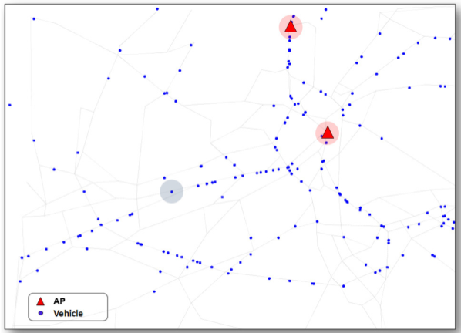
Directed Edges Graph
For any two intersections a and b,
(a, b) ∈ G iff road connects a to b and
cars can travel from a to b.
Based off real-world
data from Zurich
Switzerland
  Populated by actual
  car tracking data
Directed graph
  Vertices are intersections
  Edges one way road connections between edges

Slide 12
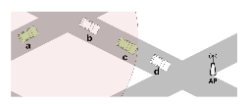
Delay-bounded Greedy Forwarding
(D-Greedy)
Hopes shortest path to
nearest AP taken
Beacons update neighbor list
  id
  distToAP – Shortest distance to AP
    dijkstra
Segments assigned time budget
  Each edge allocated delay budget proportional to length.
While a segment is within its budget, Data Mulling is used.

Slide 13
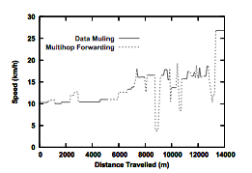

D-Greedy Details
distToInt – distance to intersection
u – average speed of node
during k-second period
Del – available time budget for segment
Del_{DM} Expected delay if Data Mulling used
If use Data Mulling, otherwise start forwarding
  If node is moving away from AP , use Muli-Hop Forward
  Cache, ‘Data Mull’, if no suitable neighbors
Node periodically re-calculates heuristic.
Initially Data Mulling is favored in slow cars by intentionally
overestimating TTL
  Hope that shortest path taken

Slide 14
Delay-bounded Min-Cost Forwarding
(D-MinCost)
Requires knowledge of global traffic conditions.
Two cost metrics weigh edges
  C – cost, representing number of hops along edge
  Del – delay, time required to move message along edge
For each segment, only one strategy used along entire edge length
  Metrics affected by which strategy used for segment
Graph G(V,E) modified into G’(V,E’)
Predetermined path calculated

Slide 15
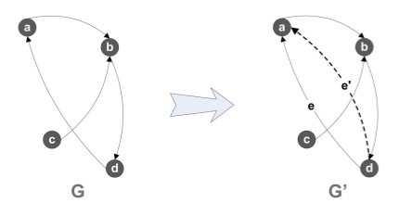
D-MinCost, Graph G’(V,E’)
|E’| = 2|E|
For each directed edge e ∈ G that connects two vertices, create a new sibling edge e′ ∈ G connecting same vertices
e: assigned cost for Data
Mulling
e’: Multi-hop forwarding
cost

Slide 16
D-MinCost Graph weighing
l – segment length
- average node speed along edge
R - wireless range
q – time to check neighbor list and find next best hop
Edges, e, assigned Data Mulling strategy
assigned costs:
Edges, e’, assigned:
  Multi-hop available option if l > R and
  vehicle density > l / R
_{u}

Slide 17
D-MinCost Path Selection
Delay-constrained least-cost routing problem is NP-Complete
  Delay Scaling Algorithm heuristic used
Calculate path
  Least costly AP
  Cost of and path calculated by heuristic to AP
  Strategy to use for each edge in path
If a path infeasible, new path calculated by current message carrier

Slide 18
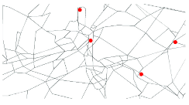
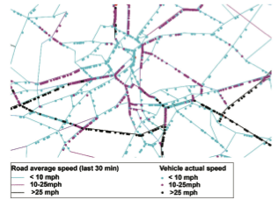
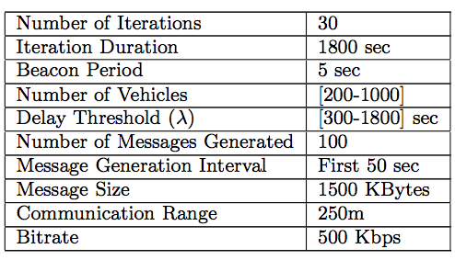
Evaluation
Simulated in 20km × 10 km region of Zurich
Parameters
  TTL : 5 - 30minutes!

Slide 19
Comparison Algorithms
MinCost – VADD (Vehicle Assisted Data Delivery) based path determined by delay
Epidemic – Message multi-cast throughout network

Slide 20
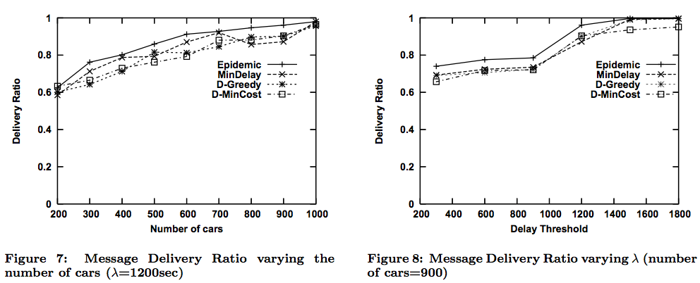
Message Success, Results
    TTL 1,200 = 20 Minutes

Slide 21
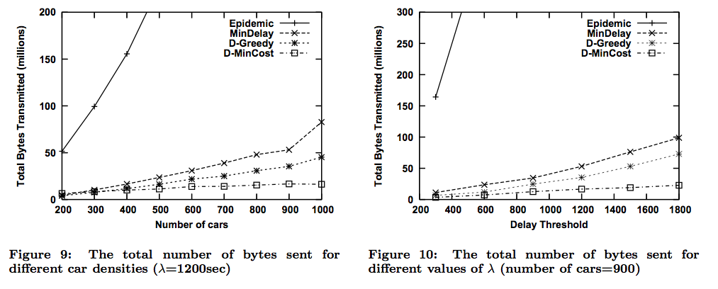
Network use/bytes sent, Results cont.

Slide 22
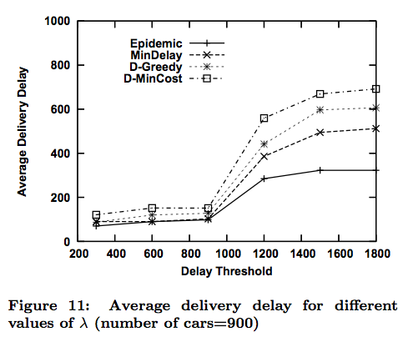
Delay, Results cont.

Slide 23
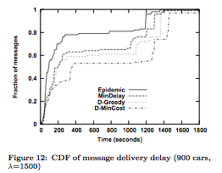
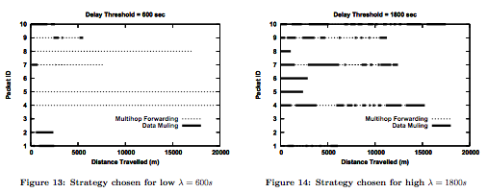
Other Results

Slide 24
Conclusion
D-MinCost
  Computationally expensive route calculation
  Must distribute global network state to all nodes
  High latency
  What if messenger node parks car in middle of edge?
D-Greedy
  On par excluding transmission requirements
  Better latency

