Slide 1
Routing in Ad-hoc Networks with MIMO links Karthikeyan Sundaresan and Raghupathy Sivakumar
presented by
Neeraj Gurdasani

Slide 2
Outline
Identify the capabilities of MIMO links and capture their relevance to routing layer protocols.
Analyze the relative tradeoffs of exploiting the different capabilities of MIMO links.
Propose a routing protocol called MIR for ad-hoc networks with MIMO link
Simulations

Slide 3
Types of directive antennas
Simple switched beams
Switched beam antennas have predetermined beam patterns.
Advantage
simple in the transceiver complexity.
They provide significant performance improvement in strong line of sight (LOS) environments where they increase the spatial reuse in the network owing to directional transmissions.
Disadvantage
They suffer significantly in rich multipath environments where signal scattering and fading causes loss of energy in the received beam.

Slide 4
Adaptive Arrays
Adaptive array antennas are more sophisticated than the switched beam, since they are capable of adapting their beam pattern in response to channel conditions to improve the quality of the link, i.e. maximize the signal to noise (SNR) of the link.
To be able to effectively optimize the link capacity and quality, one needs to know the channel state information (CSI) at both the transmitter and receiver.
Adaptive Arrays merely mitigate the impacts of fading

Slide 5
Multiple Input Multiple Output
A MIMO link consists of multiple element arrays at both ends of the link.
MIMO systems exploit rich scattering and multipath fading to provide high spectral efficiencies that comes at the cost of no increased power or bandwidth.
These high spectral efficiencies can be obtained even without the knowledge of CSI at the transmitter.

Slide 6
MIMO properties
Spatial Multiplexing (rate links)
They can be used to provide increased capacities on the link which is referred to as spatial multiplexing
Diversity (diversity links)
They can be used to increase the reliability of the link by exploiting diversity to decrease the bit-error rate or increasing Range

Slide 7
Spatial Multiplexing (MUX)
This gain can be achieved when the transmit array transmits multiple independent streams of data, with each stream being transmitted out of a different antenna with equal power, at the same frequency, same modulation format, and in
the same time slot.
At the receiver array, each antenna receives a superposition of all of the transmitted data streams. However, each stream generally has a different spatial signature due to rich multipath, and these differences are exploited by the receiver signal processor to separate the streams.
This multiplexing gain can provide a linear increase (in the number of elements) in the asymptotic link capacity, which is given by the following equation
C=min(M,N)log(1+p)
M,N are the number of transmitter & receiver antenna elements
P=SNR

Slide 8

Diversity
The rich multipath helps the transmitter data streams fade independently at the receiver probability of all the data streams experiencing a poor channel at the same time is significantly reduced, thereby increasing the communication reliability.
the data streams transmitted from the different antenna elements must be dependent. Space-time block codes (STBC) are used for this purpose Lossy channel(more variance in channel)
Diversity Gain is proportional to diversity order(d)
In practical Lossy channels, diversity can help significantly reduce the bit error rate (BER) on the link.
At high SNR, this reduction in BER (p) as a function of the diversity order (d) can be given as ,
P= 1/snr^d
P=BER
d=MN

Slide 9
Reduce BER(p) on the link(DIV-BER)
for a required p on the link, the increased reliability provided by diversity can be translated to an increase in the SNR, which can then be used for increasing the communication range of the link (DIV-RANGE)
for a given and SNR requirement, the transmit power consumption can be minimized

Slide 10
MUX vs Diversity
Mux increases capacity by increasing rate.
Diversity Decreases BER(DIV-BER)- increases reliability, high SNR
Diversity Increases SNR, hence range(DIV-RANGE)
Diversity decreases rate hence decreases capacity

Slide 11
Routing Approaches
In MUX, the routing protocol uses omni-directional communication range for route discovery, resulting in routes with all omni-links on which spatial multiplexing is performed (referred to as “rate” links) during data transfer.
In DIV-RANGE, diversity and hence SNR gain is exploited by the routing protocol in route discovery itself, resulting in routes composed of links with larger communication ranges (“range” links).
In DIV-BER, omni-directional communication range is first used to obtain routes with omni links, with diversity being exploited later on for data transfer, thereby reducing the BER on the link (“reliable” links).
The area of inhibition due to a transmission is lesser in DIV-BER than in DIV-RANGE. While the same transmit power is used in both cases, since the links are much shorter in DIV-BER (higher SNR), the probability of capturing a packet at the receiver is much larger in DIV-BER, thereby providing better spatial reuse.

Slide 12
Density
Partitions are a possibility in ad-hoc networks
In cases of mobility, there is a finite probability for the partition to be bridged back again due to node mobility itself. However, the case of partitions in static sparse networks is much more severe since it disrupts communication permanently
While MUX can increase throughput, it cannot increase the communication range this leads to a degradation in aggregate network throughput
DIV-BER suffers from the same problem as MUX
DIV-RANGE on the other hand, has the potential to bridge partitions through its increased communication range. However, it suffers from the reduced spatial reuse resulting from the increased communication range

Slide 13
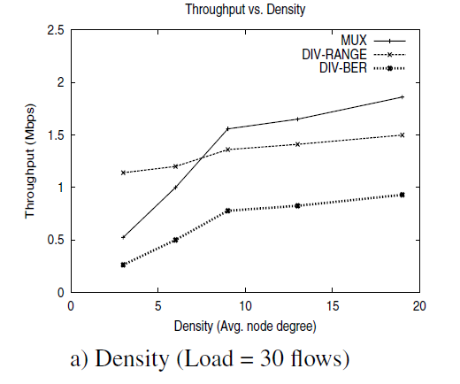
the optimal strategy would be to use DIV-RANGE at lower network densities and MUX at higher network densities
DIV-RANGE must be used only by those nodes that would not be able to deliver the packet to the next hop towards the destination using MUX

Slide 14
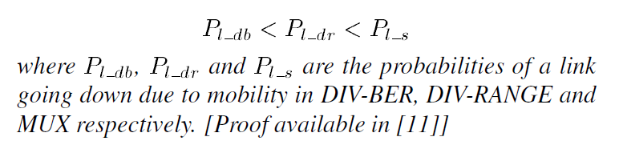
Mobility
This implies that the impact of mobility is greatest on MUX at higher speeds followed by DIV-RANGE and DIV- BER.

Slide 15
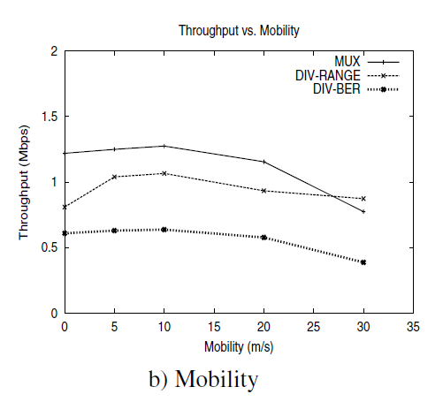
the links are considered to be non-lossy, DIV-BER suffers a degradation in rate compared to MUX. However, the increase in reliability helps sustain the links longer during mobility, but then results in routes with increased range per hop (number of hops remaining unaltered), thereby resulting in highly sub-optimal routes.
These sub-optimal routes tend to degrade performance more than the case wherein route failures occur

Slide 16
MUX outperforms DIV-RANGE for most of the mobilities. This is because the region silenced by a transmission is more in DIV-RANGE due to the increased communication range. This in turn increases the number of contending nodes to any node and hence increases the number of collisions due to distributed MAC operations
MUX performing the best under most mobility conditions, is the optimal base strategy of operation. However, the ability to provide increased communication ranges using diversity should be used in tandem with MUX

Slide 17
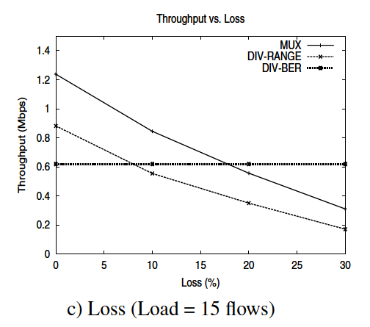
Link Quality
It can be seen that both MUX and DIV-RANGE suffer degradation
Appropriate strategy would be to use MUX as long as packet error rates are negligible, and have mechanisms to detect persistent channel errors and switch to DIV-BER to increase reliability

Slide 18
MIR Routing Protocol
MIR is thus an on-demand (reactive) adaptive routing protocol that adapts between the different strategies based on the network conditions.

Slide 19
MAC Layer Support
MAC protocol that is responsible for communicating the decision to the PHY layer and ensuring that the communication takes place using the appropriate strategy being used by the transmitter. Only then will it be able to decode
Irrespective of the strategy employed, the PHY layer receiver must be aware of the strategy
The MAC transmitter always transmits the preamble of the packet using diversity (STBC) in which it conveys the strategy to be employed for the actual packet transmission
When a packet is transmitted through DIV-RANGE using k elements, it can reach upto K hops. However, at the end of the packet, the node adds short preambles, each being transmitted-received at unity rate similar to the packet but using lesser number of elements ([1,K-1]) and hence lower diversity order. These preambles correspond to the different K-1 range extensions and carry the respective extension information in them. Only a node within the i^{th} hop will be able to decode the preamble that was transmitted-received using i

Slide 20
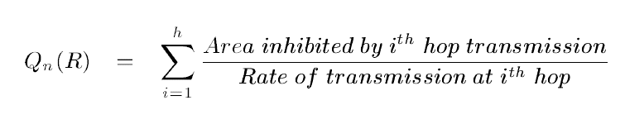

Routing Metric
“quality” routes is calculated through a careful use of the different strategies irrespective of the density in the network.
We define “quality” of a route as its ability to allow for maximum spatial reuse in the network while at the same time incurring low multi-hop relaying burden and providing high rate for the flow itself.
Hence, we consider a two-tuple route metric Q(R)=(Q_{n}(R),Q_{f}(R)) for a route R as the combination of network (Q_{n}(R)) and flow (Q_{f}(R)) metrics .
We consider Q_{f}(R) to be the minimum of the rates ,Q_{f}(R) can be captured by the total area inhibited (along with duration of inhibition)
where f_{i} and r_{i} are the range extension factor and rate of transmission at the ith hop of a h hop route respectively

Slide 21
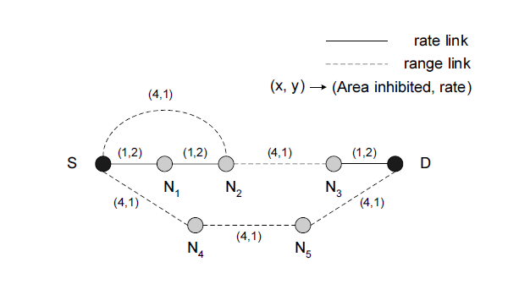

If the network metrics are the same, a high flow metric is used
Optimizing Q_{n}(R) indirectly means that the number of range links as well as the number of hops in the route should be kept low
For the simple topology in Figure 2 where two elements (extension factor of two) are used, we have three possible routes from source S to destination D , namely,
The two-tuple metric for the 3 routes are (5.5,1), (8.5,1) and (12,1) respectively. Hence, while several routes exist, the routing protocol should identify the route with the best metric (minimal impact from range links), namely

Slide 22
Route Request
Every node on receiving a route request packet, goes ahead and propagates the request on the maximum range possible using DIV-RANGE. Whenever a route request is transmitted using DIV-RANGE, it is done on all elements (K), and can thus reach upto K hops. With support from the MAC layer through the use of short preambles, each node keeps track of the minimum range extension ([1,K]) with which the request was received from the upstream node
Time weighted – ΦiT to bridge from range links to rate links.
i is the range extension factor

Slide 23
Route response
When a route reply finds its way back to the source using the information on the source route along with the extension factors to be used on the different links, it is checked by every intermediate node along the path. If the locally cached route to the source has a better route metric than that currently being used, then it replaces the portion of the route from itself to the source with the locally stored route
Worst case time T[l+k-1]
T[l-1] -> propagation to destination node
TK -> weighting time at destination to bridge the range to rate links.

Slide 24
Route Failure
The MAC in MIR addresses this challenge by switching from MUX to diversity after four trials of the RTS packet (RTS has a maximum retry limit of seven in IEEE 802.11b).
When switching to diversity, the number of elements used towards diversity is initially two, since in most cases the range extension or increased reliability resulting from a diversity order of four is easily sufficient to sustain the link from breaking even at high speeds
This keeps the reduction in rate and spatial reuse due to diversity to a minimum and exploits the remaining elements to increase the rate of transmission through MUX
If the link is already operating in diversity, then an increase in number of elements exploited for diversity by one will still serve the purpose

Slide 25
If the increased communication range or reliability due to diversity is able to get the packet across, then there are two possible cases: (i) receiver was actually moving away and/or the channel quality was bad; or (ii) neither the receiver was moving away nor the channel quality was bad.
Implies, it was a false alarm, which can be corrected easily
Else “proactive” route error can be generated

Slide 26
Route Maintenance
Once the link failure due to mobility or persistent channel errors has been “proactively” detected, the routing protocol at the node is informed.
MIR at the detection node recognizes the proactive link failure and hence does not purge packets from the queue that are using the link.
It generates a proactive route error to the source. The intermediate nodes delete routes from their caches (but do not purge packets) that contain the detected link as in a normal route error so that they do not respond back to the new proactive route discovery process with the stale route.
Once the source receives the proactive route error, it initiates a new route request for the destination to obtain a better route with minimal impact from range links through the route discovery component. However, it does not purge the routes that contain the detected link until a new route is obtained or an official route error is received and uses the existing route for sending the packets currently in its buffer.
a “route error cancel” notification is released if it receives a preamble at the same diversity order.

Slide 27
Performance Evaluation
Ns2 simulator
Φ=5
2 antenna elements
Represent density of the network by the average node degree parameter p. p is varied from 3 (sparse networks, 100 nodes in 2500m*2500m) to as high as 19 (dense networks, 100 nodes in 1000m*1000m) with the transmission range being 250m.
Mobility and link loss rates are varied upto 30 m/s and 30% respectively.
The default values of load, mobility and loss rate are 30, 0 m/s and 0%.
Each flow uses CBR as the traffic generating application at a rate of 100 Kbps on a 2 Mbps channel
packet size of 1 KB and UDP serving as the transport protocol
time-correlated Rayleigh fading

Slide 28
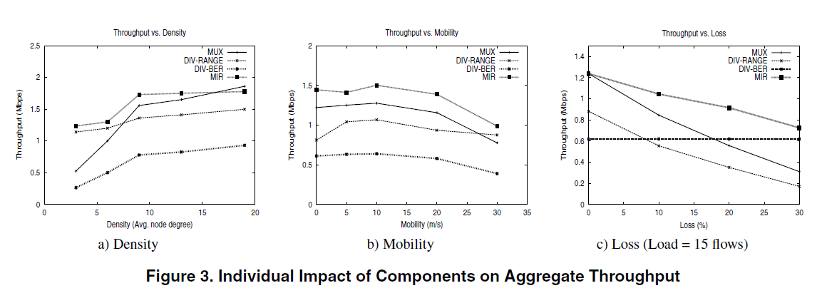
Performance Evalucation

Slide 29
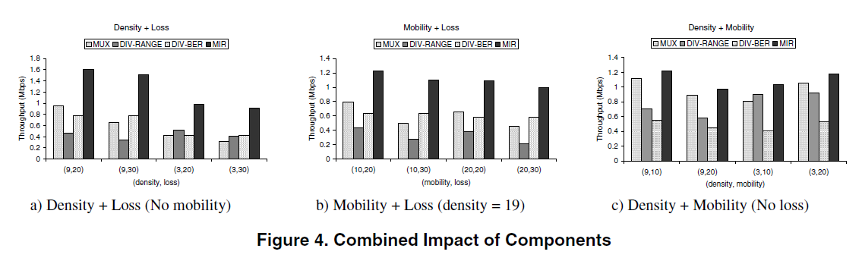

Slide 30
Questions?

