Slide 1
CS-541 Advanced Networking
DMesh: Incorporating Practical Directional Antennas in Multichannel Wireless Mesh Networks
Vishwanath Annavarapu
April 13th, 2009

Slide 2
Outline
References
Key Factors
DMesh
Problem Definition
Physical Tree Formation
Routing Protocol
Distributed Directional Channel Assignment
Performance Evaluation
Testbed Evaluation
Conclusion

Slide 3
References
DMesh: Incorporating Practical Directional Antennas in Multichannel Wireless Mesh Networks
Saumitra M. Das, Student Member, IEEE, Himabindu Pucha, Student Member, IEEE, Dimitrios Koutsonikolas, Student Member, IEEE, Y. Charlie Hu, Member, IEEE, and Dimitrios Peroulis, Member, IEEE

Slide 4
Key Factors
High Throughput
Cost-effectiveness
Ease of deployment

Slide 5
DMesh: A Directional Mesh
Typical WMN has single-channel, single-interface, omni-directional antenna
DMesh is used to enhance the performance of the existing network.
Additional ‘k’ interfaces with directional antennas, omni-directional interface is used as CONTROL interface
High throughput routing trees rooted at gateways
DMesh extends OLSR protocol → DOLSR

Slide 6
Problem Definition
A WMN architecture that combines :
spatial separation from directional antennas
with
frequency separation from orthogonal channels
Achieves :
High Throughput
cost-effective
Ease of deployment
Utilizing practical directional antenna

Slide 7
Physical Tree Formation
Starts with single-channel, single interface mode
Listens Host and Network Association (HNA) messages on omni-interface
Willingness to Host others
PARENT node is selected by CHILD node
Pointing IP address (PIP)
READY msg triggers routing state
Now, this CHILD becomes a part of network and can also Host other nodes.

Slide 8
Routing Protocol
READY msg: PARENT → CHILD
JOIN msg: CHILD → PARENT
DOLSR sets up forwarding entries
Node with Gateways as a PARENT → SUPERPARENT
PARENT multicasts ROUTE_SETUP
Multicasts proceeds until a Gateway is reached
Each node can reach a Gateway now!

Slide 9
Distributed Directional Channel Assignment
At this stage after routing, one degree of separation is achieved
→ Spatial separation
Directional Channel Assignment achieves second degree of separation
→ Frequency separation
ASSIGN msg: PARENT → CHILD
Channel assignment is periodically reevaluated (say, 300 secs)

Slide 10
Channel Assignment Schemes
Omni/No Channel Assignment (ONOCA)
Omni/Channel Assignment (OCA)
Directional/No Channel Assignment (DNOCA)
Directional/Channel Assignment (DCA)

Slide 11
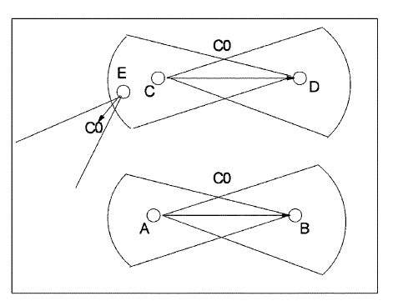
Channel Assignment Scenario

Slide 12
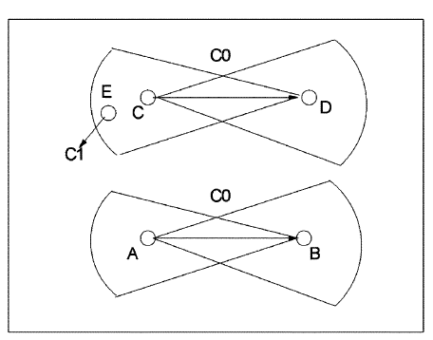
Channel Assignment Schemes
Conservative DCA (C-DCA)
Node X selects a channel ‘c’ if no node in cones of interference (of X and its CHILD) is using ‘c’.
If no such channel exists, select least loaded channel ‘c’.
Takes into account the interference from
  Sidelobes on receiving node’s antenna
  Transmission power from neighboring node antenna’s sidelobes

Slide 13
Channel Assignment Schemes
Aggressive DCA (A-DCA)
Assigns channels in similar way
Aggressive nature: X is in cone of interference of Y, if both X and Y lie in each other’s cone
Reduced Channel Usage, more channel reuse
More Interference
Uses a “guard angle” to accommodate interference

Slide 14
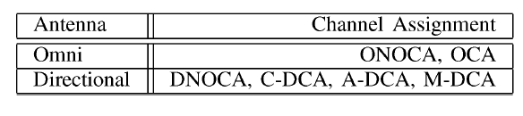
Channel Assignment Schemes
Measurement-based DCA ( M-DCA)
Uses only measurements instead of geometry to infer interference between two nodes
Summarizing the various WMN architecture choices:

Slide 15
Distributed Algorithm for
OCA/C-DCA/A-DCA/M-DCA
M-DCA:
  Each node monitors its directional interfaces for non-CHILD data arrival
OCA/C-DCA/A-DCA :
  Channel Usage Information is exchanged using the omni CONTROL interface
    Channel vector C
    Rate vector R
    Destination vector D (only for A-DCA/ C-DCA)
  Broadcasted for two hops, to cover interference range
  Final channel map from state vectors(<C,R,D>)
  CHILD sends PARENT computed list of channels
  Assignment algorithm is implemented for new CHILD or on periodic basis.

Slide 16
Metrics
  Packet delivery ratio (PDR)
  Delay
  Average source throughput (AST)

Slide 17
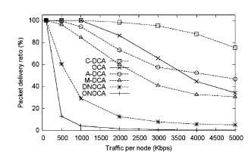
Performance Evaluation
Overall Performance Comparison --- PDR

Slide 18
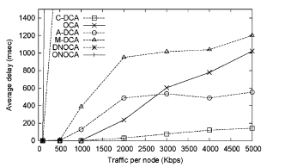
Performance Evaluation
Overall Performance Comparison --- Delay

Slide 19
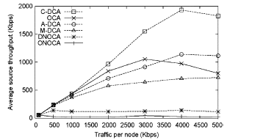
Performance Evaluation
Overall Performance Comparison --- AST
C-DCA improves throughput by 231% vs OCA!

Slide 20
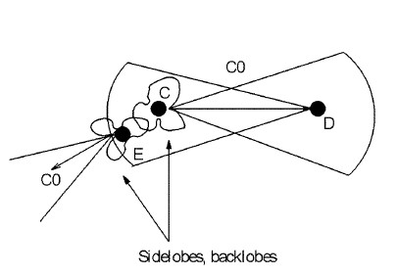
A-DCA sidelobes interference

Slide 21
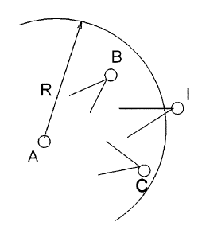
M-DCA worse than A-DCA and OCA!
M-DCA estimation problem

Slide 22
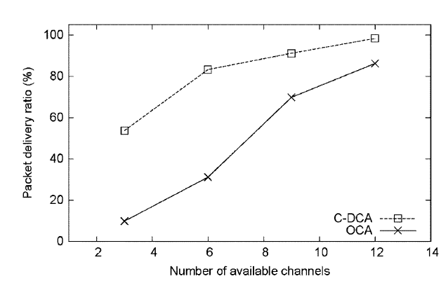
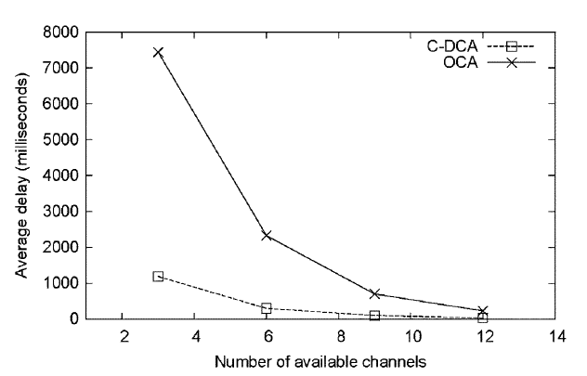
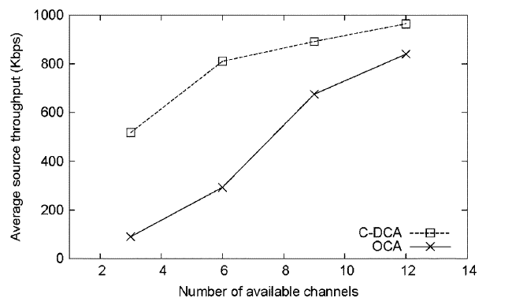
Impact of Available Physical Channels

Slide 23
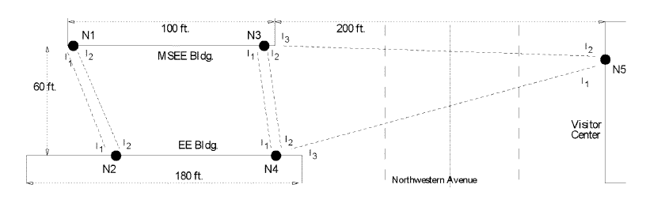
Testbed Evaluation
Setup

Slide 24
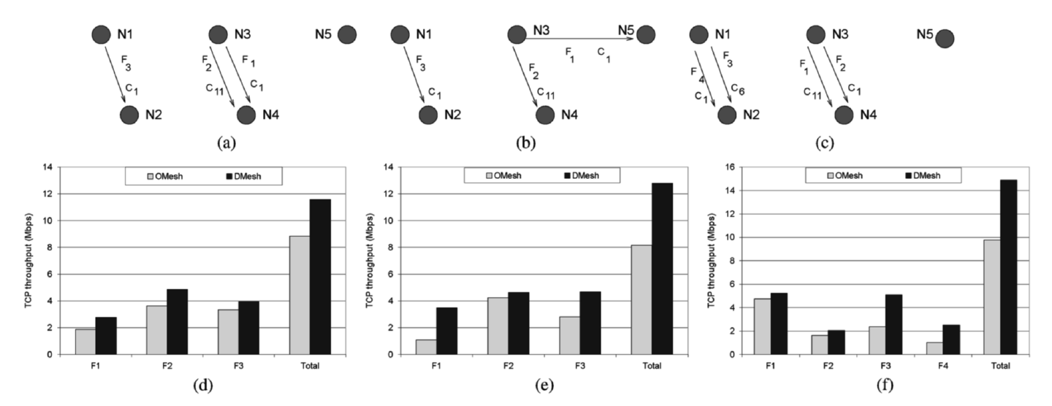
Testbed Evaluation
Exploiting Multiple Channels
Evaluating the Gain From DMesh
DMesh provides 31% - 57% TCP throughput gain over OMesh!

Slide 25
Conclusion
DMesh
  Multiradio
  Multichannel
  Practical Directional antenna
Distributed algorithm for routing and channel assignment
Spatial separation and Frequency separation
Allows more concurrent transmission
Improves PDR and lowers Delay
Higher throughput
Remains cost-effective
Easy to deploy
DMesh can be used to naturally extend the current widely deployed single radio Wireless Mesh Networks.

Slide 26
Questions?

Slide 27
Thank you!!!

