Slide 1
Programming in Go: Concurrency
Goroutines, Synchronization, Channels, and more!

Slide 2
Before we start coding, we need to answer some questions…
1). What is concurrency?
2). Why would we want to implement concurrency in our programs?

Slide 3
So far in this class (and for most of our college careers), we’ve been dealing with sequential programs
The order of executing instructions is based on their textual ordering

Slide 4
So far in this class (and for most of our college careers), we’ve been dealing with sequential programs
The order of executing instructions is based on their textual ordering
Overlap or interruption to execute another instruction is not allowed

Slide 5
So far in this class (and for most of our college careers), we’ve been dealing with sequential programs
The order of executing instructions is based on their textual ordering
Overlap or interruption to execute another instruction is not allowed
Cannot proceed to next instruction until current instruction is finished

Slide 6
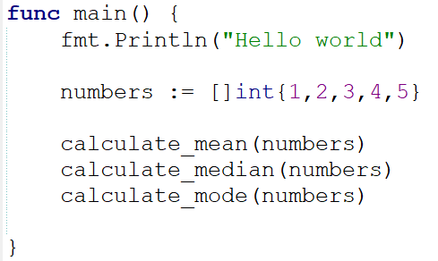
A typical order of execution in a Go program (Control Flow)
1
2
3
4
5
PROGRAM TERMINATES (This is important to remember later on)

Slide 7
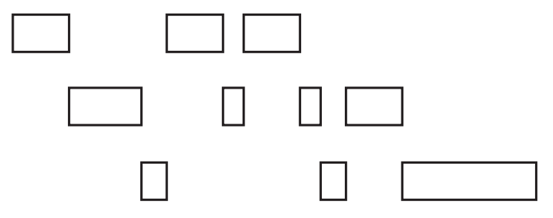
Makes sense…. so what is concurrency?
Concurrency is all about dealing with many things at once, often doing so by executing tasks “out of order”
In Go, this grants the ability for functions to run independent of each other.
Functions are able to interleave & overlap each other during execution.
Concurrent Functions Possible Execution
Function 1
Function 2
Function 3

Slide 8
Concurrent vs Sequential Comparison
Suppose you have to following tasks to do in a day:
Write a letter
Listen to an audiobook
Go grocery shopping
Go for a run
Watch 5 Netflix Episodes
Book flight tickets
Pay your bills
In a sequential execution, you would do these tasks in order 1-7 with no interruption from the other tasks
For example, you cant start listening to the audiobook until you’ve finished writing the letter

Slide 9
Concurrent vs Sequential Comparison
Suppose you have to following tasks to do in a day:
Write a letter
Listen to an audiobook
Go grocery shopping
Go for a run
Watch 5 Episodes of a Netflix Show
Book flight tickets
Pay your bills
If you were to execute these tasks concurrently, here is one possible order:
Watch 2 Netflix Episodes
Go for a run
Write 1/3 of the letter
Listen to half an audiobook
Go Grocery Shopping
Listen to other half of audiobook
Write 1/3 of the letter
Book flight tickets
Write 1/3 of the letter
Pay your bills
Watch 3 Netflix Episodes
A few things to note about these tasks:
The order of completion doesn’t really matter
Tasks are independent of one another
Some tasks don’t need to be completed in a single sitting

Slide 10
Day Schedule of Concurrent Tasks
Write a letter
2. Listen to an audiobook
3. Go grocery shopping
4. Go for a run
Watch 5 Netflix Episodes
6. Book flight tickets
7. Pay your bills
1/3
1/3
1/3
1/2
1/2
2 Episodes
3 Episodes

Slide 11
A quick note on concurrency
Concurrency does not mean we are executing two instructions at the same time (parallelism)
Concurrency ≠ Parallelism
In order to achieve Parallelism, you need to have adequate hardware (multi-core processor) and modify some settings in your Go environment (Maybe a possible idea for a student project?)
Concurrent Functions Possible Execution
Execution using Parallelism
Function 1
CPU Core 1
Function 1
Function 2
Function 2
CPU Core 2
Function 3
Function 3
CPU Core 3

Slide 12
A quick note on concurrency
Concurrency does not mean we are executing two instructions at the same time (parallelism)
Concurrency ≠ Parallelism
In order to achieve Parallelism, you need to have adequate hardware (multi-core processor) and modify some settings in your Go environment (Maybe a possible idea for a student project?)
The Focus of today’s lecture
Concurrent Functions Possible Execution
Execution using Parallelism
Function 1
CPU Core 1
Function 1
Function 2
Function 2
CPU Core 2
Function 3
Function 3
CPU Core 3

Slide 13
Why and when would you use concurrency?
CPU-Bound
A workload that is constantly making calculations and spends no time waiting for I/O
Example: Calculating Factorials, Merge Sort, Matrix Multiplication
NOTE: In order to handle CPU-Bound workloads with concurrency, parallelism is required
IO-Bound
A workload that causes functions (goroutines) to naturally enter into waiting states
Example: Shell/Terminal, Video Games, Word Processors
A workload can be both CPU-Bound and IO-Bound depending on the situation

Slide 14
Implementing Concurrency in Go
Time to code!
In go, we implement a concurrent program using the go keyword before evoking a function
This will turn the function into a goroutine

Slide 15
Channels
Channels provide a way for two goroutines to communicate with one another
If you send a message on a channel, the goroutine sending the message is “frozen” (blocked) until the other goroutine is ready to receive the message (and vice-versa)

Slide 16
Channels
Channels provide a way for two goroutines to communicate with one another
If you send a message on a channel, the goroutine sending the message is “frozen” (blocked) until the other goroutine is ready to receive the message (and vice-versa)
Goroutine 1
Goroutine 2
<line of code>
<line of code>
<line of code>
<line of code>
<line of code>
msg := <- c
<line of code>
<line of code>
<line of code>
<line of code>
<line of code>
c <- “hello world”
<line of code>
<line of code>
<line of code>
<line of code>

Slide 17
Channels
Channels provide a way for two goroutines to communicate with one another
If you send a message on a channel, the goroutine sending the message is “frozen” (blocked) until the other goroutine is ready to receive the message (and vice-versa)
Goroutine 1
Goroutine 2
<line of code>
<line of code>
<line of code>
<line of code>
<line of code>
msg := <- c
<line of code>
<line of code>
<line of code>
<line of code>
<line of code>
c <- “hello world”
<line of code>
<line of code>
<line of code>
<line of code>

Slide 18
Channels
Channels provide a way for two goroutines to communicate with one another
If you send a message on a channel, the goroutine sending the message is “frozen” (blocked) until the other goroutine is ready to receive the message (and vice-versa)
Goroutine 1
Goroutine 2
<line of code>
<line of code>
<line of code>
<line of code>
<line of code>
msg := <- c
<line of code>
<line of code>
<line of code>
<line of code>
<line of code>
c <- “hello world”
<line of code>
<line of code>
<line of code>
<line of code>

Slide 19
Channels
Channels provide a way for two goroutines to communicate with one another
If you send a message on a channel, the goroutine sending the message is “frozen” (blocked) until the other goroutine is ready to receive the message (and vice-versa)
Goroutine 1
Goroutine 2
<line of code>
<line of code>
<line of code>
<line of code>
<line of code>
msg := <- c
<line of code>
<line of code>
<line of code>
<line of code>
<line of code>
c <- “hello world”
<line of code>
<line of code>
<line of code>
<line of code>

Slide 20
Channels
Channels provide a way for two goroutines to communicate with one another
If you send a message on a channel, the goroutine sending the message is “frozen” (blocked) until the other goroutine is ready to receive the message (and vice-versa)
Goroutine 1
Goroutine 2
<line of code>
<line of code>
<line of code>
<line of code>
<line of code>
msg := <- c
<line of code>
<line of code>
<line of code>
<line of code>
<line of code>
c <- “hello world”
<line of code>
<line of code>
<line of code>
<line of code>

Slide 21
Channels
Channels provide a way for two goroutines to communicate with one another
If you send a message on a channel, the goroutine sending the message is “frozen” (blocked) until the other goroutine is ready to receive the message (and vice-versa)
Goroutine 1
Goroutine 2
<line of code>
<line of code>
<line of code>
<line of code>
<line of code>
msg := <- c
<line of code>
<line of code>
<line of code>
<line of code>
<line of code>
c <- “hello world”
<line of code>
<line of code>
<line of code>
<line of code>

Slide 22
Channels
Channels provide a way for two goroutines to communicate with one another
If you send a message on a channel, the goroutine sending the message is “frozen” (blocked) until the other goroutine is ready to receive the message (and vice-versa)
Goroutine 1
Goroutine 2
<line of code>
<line of code>
<line of code>
<line of code>
<line of code>
msg := <- c
<line of code>
<line of code>
<line of code>
<line of code>
<line of code>
c <- “hello world”
<line of code>
<line of code>
<line of code>
<line of code>

Slide 23
Channels
Channels provide a way for two goroutines to communicate with one another
If you send a message on a channel, the goroutine sending the message is “frozen” (blocked) until the other goroutine is ready to receive the message (and vice-versa)
Goroutine 1
Goroutine 2
<line of code>
<line of code>
<line of code>
<line of code>
<line of code>
msg := <- c
<line of code>
<line of code>
<line of code>
<line of code>
<line of code>
c <- “hello world”
<line of code>
<line of code>
<line of code>
<line of code>

Slide 24
Channels
Channels provide a way for two goroutines to communicate with one another
If you send a message on a channel, the goroutine sending the message is “frozen” (blocked) until the other goroutine is ready to receive the message (and vice-versa)
Goroutine 1
Goroutine 2
<line of code>
<line of code>
<line of code>
<line of code>
<line of code>
msg := <- c
<line of code>
<line of code>
<line of code>
<line of code>
<line of code>
c <- “hello world”
<line of code>
<line of code>
<line of code>
<line of code>
Blocked

Slide 25
Channels
Channels provide a way for two goroutines to communicate with one another
If you send a message on a channel, the goroutine sending the message is “frozen” (blocked) until the other goroutine is ready to receive the message (and vice-versa)
Goroutine 1
Goroutine 2
<line of code>
<line of code>
<line of code>
<line of code>
<line of code>
msg := <- c
<line of code>
<line of code>
<line of code>
<line of code>
<line of code>
c <- “hello world”
<line of code>
<line of code>
<line of code>
<line of code>
Blocked

Slide 26
Channels
Channels provide a way for two goroutines to communicate with one another
If you send a message on a channel, the goroutine sending the message is “frozen” (blocked) until the other goroutine is ready to receive the message (and vice-versa)
Goroutine 1
Goroutine 2
<line of code>
<line of code>
<line of code>
<line of code>
<line of code>
msg := <- c
<line of code>
<line of code>
<line of code>
<line of code>
<line of code>
c <- “hello world”
<line of code>
<line of code>
<line of code>
<line of code>
Blocked

Slide 27
Channels
Channels provide a way for two goroutines to communicate with one another
If you send a message on a channel, the goroutine sending the message is “frozen” (blocked) until the other goroutine is ready to receive the message (and vice-versa)
Goroutine 1
Goroutine 2
<line of code>
<line of code>
<line of code>
<line of code>
<line of code>
msg := <- c
<line of code>
<line of code>
<line of code>
<line of code>
<line of code>
c <- “hello world”
<line of code>
<line of code>
<line of code>
<line of code>
“hello world”

Slide 28
Channels
Channels provide a way for two goroutines to communicate with one another
If you send a message on a channel, the goroutine sending the message is “frozen” (blocked) until the other goroutine is ready to receive the message (and vice-versa)
Goroutine 1
Goroutine 2
<line of code>
<line of code>
<line of code>
<line of code>
<line of code>
msg := <- c
<line of code>
<line of code>
<line of code>
<line of code>
<line of code>
c <- “hello world”
<line of code>
<line of code>
<line of code>
<line of code>
msg = “hello world”

Slide 29
Channels
Channels provide a way for two goroutines to communicate with one another
If you send a message on a channel, the goroutine sending the message is “frozen” (blocked) until the other goroutine is ready to receive the message (and vice-versa)
Goroutine 1
Goroutine 2
<line of code>
<line of code>
<line of code>
<line of code>
<line of code>
msg := <- c
<line of code>
<line of code>
<line of code>
<line of code>
<line of code>
c <- “hello world”
<line of code>
<line of code>
<line of code>
<line of code>
msg = “hello world”

Slide 30
A few more interesting points
How does Go determine which goroutine will be worked on?

Slide 31
A few more interesting points
How does Go determine which goroutine will be worked on?
Code inside Goroutine is executed by processor
One Goroutine is selected to be worked on
?
?
?
?
?
?
Goroutine 1
Goroutine 2
Goroutine 3
Goroutine 4

Slide 32
A few more interesting points
How does Go determine which goroutine will be worked on?
Code inside Goroutine is executed by processor
One Goroutine is selected to be worked on
?
?
?
?
?
?
Goroutine 1
Goroutine 2
Goroutine 3
Goroutine 4
https://medium.com/@ankur_anand/illustrated-tales-of-go-runtime-scheduler-74809ef6d19b

Slide 33
A few more interesting points
How does Go determine which goroutine will be worked on?
Code inside Goroutine is executed by processor
Goroutine management is all handled by the Go runtime scheduler. The Go runtime scheduler’s algorithm determines which goroutine will run and works together with your operating system to execute it
One Goroutine is selected to be worked on
Each goroutine has information inside of it to help the scheduler make decisions
The “state” of the goroutine (Currently Running, Runnable, Blocked)
Goroutine 1
Goroutine 2
Goroutine 3
Goroutine 4
Very informative and interesting article about Go’s scheduler: https://rakyll.org/scheduler/
https://medium.com/@ankur_anand/illustrated-tales-of-go-runtime-scheduler-74809ef6d19b

Slide 34
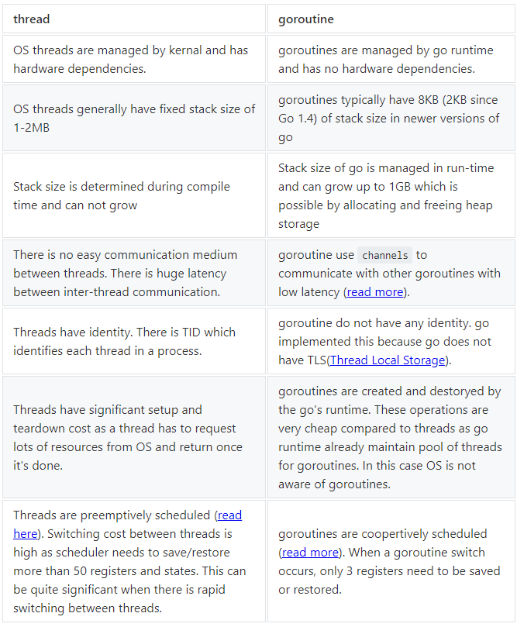
Goroutine vs Thread
A goroutine is not the same as a thread in other programming languages.
If it helps you understand the topic better, you can think of a goroutine as a “lightweight thread”, but please note there are some major differences between the two
https://medium.com/rungo/achieving-concurrency-in-go-3f84cbf870ca

Slide 35
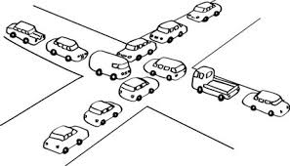
Potential issues with multiple Goroutines
Deadlock – the permanent blocking of a set of goroutines. Deadlock usually occurs when every goroutine in a set is blocked awaiting for an event to happen that will never happen
For example, a goroutine is stuck waiting to receive a message over a channel when all other goroutines are finished
Go is able to detect deadlock at runtime, but not at compile time (This is true until the halting problem gets solved ☺)
There are several algorithms and strategies to avoid deadlock. Deadlock is important to consider when designing a concurrent/parallel computing system!

Slide 36
Main
User_solve
Reciever
computer_solve
chan2
chan1

Slide 37
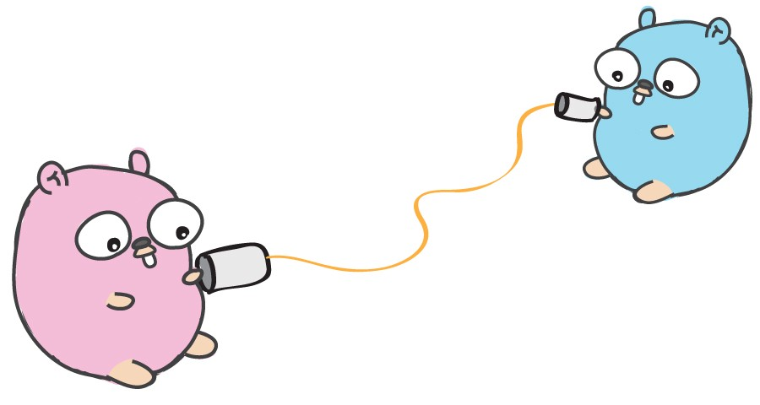
Your turn!
Restaurant service simulation using goroutines

Slide 38
Main
channel
channel
monitor_orders
channel
channel
cook_order
cook_order
channel
cook_order
cook_order
cook_order

