Slide 1
JBD Dictionaries
Ryan Bockmon

Slide 2
Dictionaries
Topics Covered
Adding/Removing
Grabbing Keys
Grabbing values
Printing a dictionary cleanly

Slide 3
Dictionaries
Functions used :
.pop(‘key’)
.keys()
.values()

Slide 4
Dictionaries
You can create an empty dictionary by using
In this example we are creating a dictionary to keep track of your keys and what they go to.
Keychain = { }

Slide 5
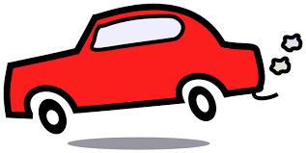
Dictionaries
Congratulations you got a new car! Lets add its key to your keychain.
Because it is the first key I will mine “key1”, you can use any name that makes sense for you.
Keychain[“key1”] = “car”
Prints :
{'key1': 'car'}

Slide 6
Dictionaries
Note : Variables left of the colon are called keys
Variables right of the colon are called values
Key Value
{“Key1” : “car”}

Slide 7
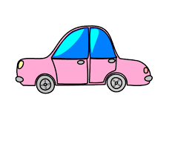
Dictionaries
Time moves quickly, you have moved out, gotten married.
You new spouse has gave you a key to their car as well.
Keychain[“key2”] = “apartment”
Keychain[“key3”] = “car2”
*Note a dictionary never holds the same order. So yours will most likely print out in a different order than the example.
Prints : {'key3': 'car2', 'key2': 'apartment', 'key1': 'car'}

Slide 8
Dictionaries
Keychain = {'key3': 'car2', 'key2': 'apartment', 'key1': 'car'}
Qeustion 1
‘Key2’ is a ____.
value
apartment
key
None of the above

Slide 9
Dictionaries
Keychain = {'key3': 'car2', 'key2': 'apartment', 'key1': 'car'}
Qeustion 1
‘Key2’ is a ____.
value
apartment
key
None of the above

Slide 10
Dictionaries
More time has past, and you are now on your sixth kid. You have to sell your car to get a mini Van.
You can do this in two ways.
You can delete the key and its value altogether or just update the key’s value.
Use the .pop(“key name”) to delete a key and its value
keychain.pop(“key1”)
Prints :
{'key2': 'apartment', 'key3': 'car2'}

Slide 11
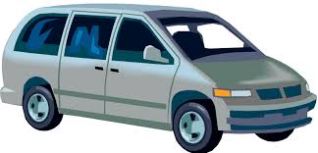
Dictionaries
{'key2': 'apartment', 'key1': 'car', 'key3': 'car2'}
You can also just update the key’s value the same way you added it.
keychain[“key1”] = “mini-van”
Prints :
{'key3': 'car2', 'key1': 'mini-van', 'key2': 'apartment'}

Slide 12
Dictionaries
One handy tool you can use if you forgot what a certain key goes to you can print out its value
print(keychain[“key2”])
Prints:
apartment

Slide 13
Dictionaries
There is a simple way grab all of the keys from the dictionary
To make this function useful you must also save it to a variable. You can name the variable whatever you want.
keys = keychain.keys()
The .keys() function will return a list.
Prints :
dict_keys(['key2', 'key1', 'key3'])

Slide 14
Dictionaries
You can do the same with the values.
values = keychain.values()
Will also return a list
Prints :
dict_values(['car', 'car2', 'apartment'])

Slide 15
Dictionaries
You might have noticed by now, but dictionaries don't print out nicely.
What tools have we learned that might help print out a dictionary to look like this :
key2 goes to apartment
key1 goes to mini-van
key3 goes to car2

Slide 16
Dictionaries
This can be done relatively simple by using the following :
keys = keychain.keys() saves keys to a list
For x in keys: loops through each key in the list
print(x, "goes to", keychain[x])
Name of key value of key

