Slide 1
Boolean Algebra
January 28, 2026
CSCI 246: Discrete Structures
Textbook Reference: Ch 1. Sec 7

Slide 2
Agenda
Lecture (~ 10 minutes)
Group Exercise (~30 minutes)
Discussion (~10 minutes)

Slide 3
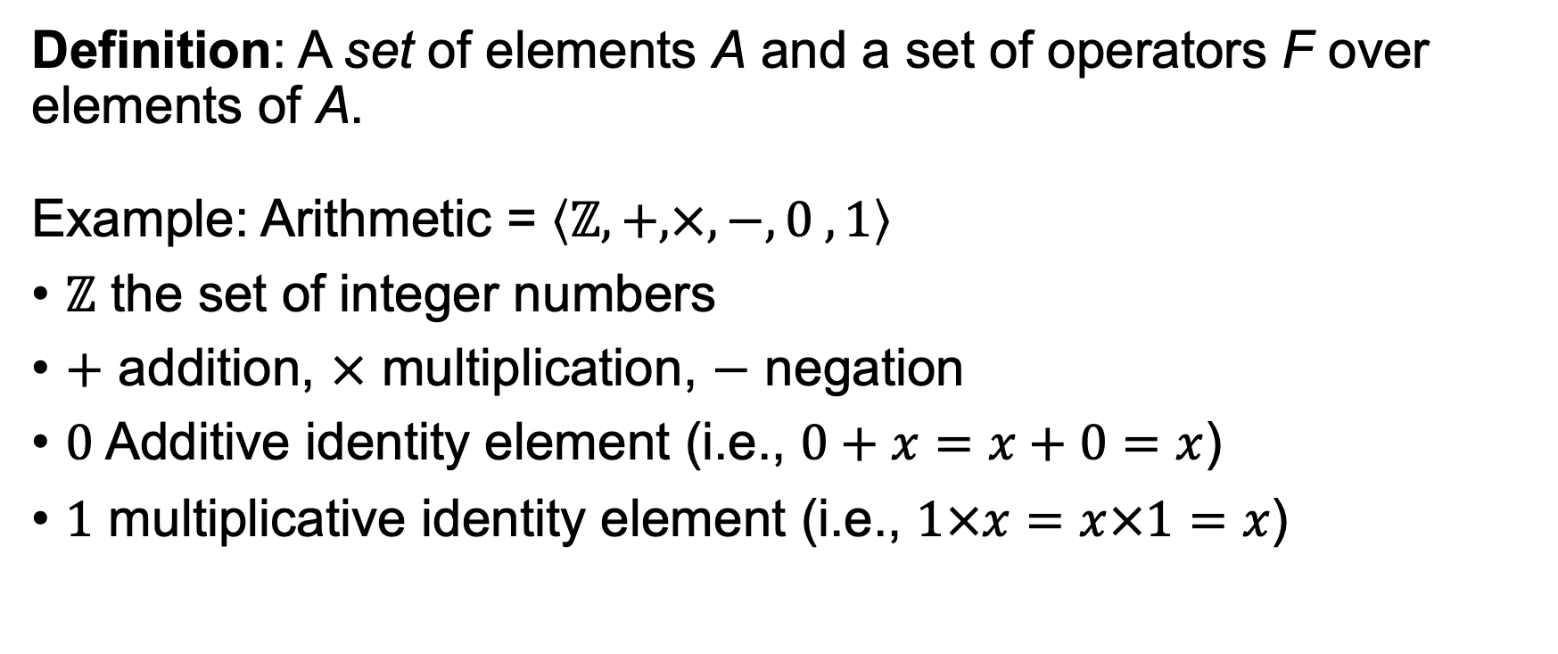
Algebra
Definition: A set of elements A and a set of operators F over elements of A.
Example: Arithmetic = $\left\langle ℤ, +, ×,−, 0 , 1\right\rangle$
$ℤ$ the set of integer numbers
$+$ addition, $×$ multiplication, $−$ negation
$0$ Additive identity element (i.e., $0+x=x+0=x$)
$1$ multiplicative identity element (i.e., $1×x=x×1=x$)

Slide 4
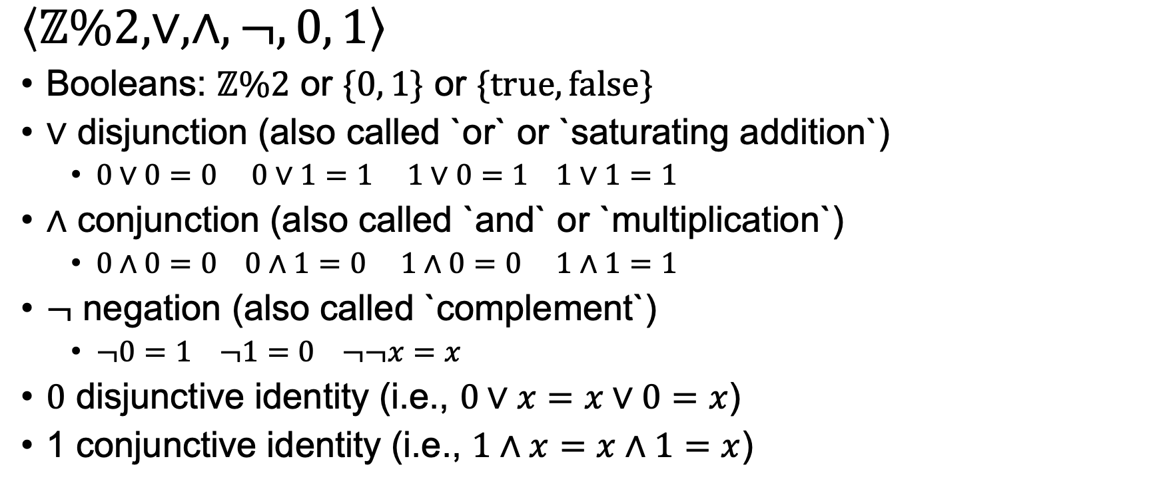
Boolean Algebra
$\left\langle ℤ\%2, ∨, ∧,¬, 0, 1\right\rangle$
Booleans: $ℤ\%2$ or $\{0, 1\}$ or $\{true, false\}$
$∨$ disjunction (also called `or` or `saturating addition`)
  $0∨0=0 0∨1=1 1∨0=1 1∨1=1$
$∧$ conjunction (also called `and` or `multiplication`)
  $0∧0=0 0∧1=0 1∧0=0 1∧1=1$
$¬$ negation (also called `complement`)
  $¬0=1 ¬1=0 ¬¬x=x$
$0$ disjunctive identity (i.e., $0∨x=x∨0=x$)
1 conjunctive identity (i.e., $1∧x=x∧1=x$)

Slide 5
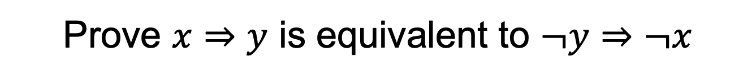
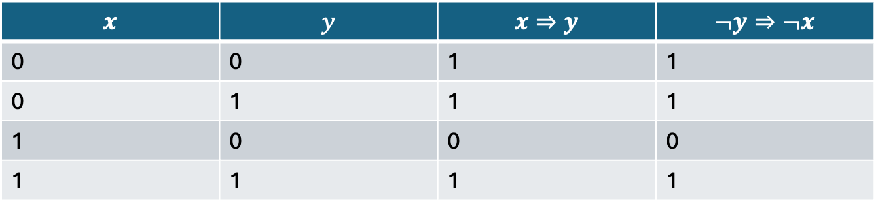
Proof by Truth Tables
Prove $x⇒y$ is equivalent to $¬y⇒¬x$
$$x$$ | $$y$$ | $$x⇒y$$ | $$¬y⇒¬x$$
0 | 0 | 1 | 1
0 | 1 | 1 | 1
1 | 0 | 0 | 0
1 | 1 | 1 | 1

Slide 6

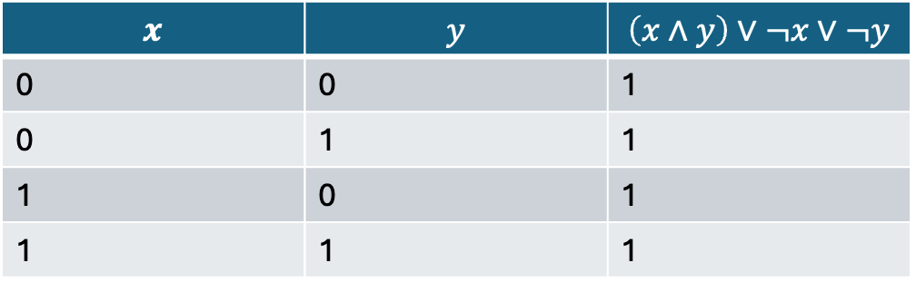
Proof by Truth Tables
Prove $\left(x∧y\right)∨¬x∨¬y$ is a tautology
$$x$$ | $$y$$ | $$\left(x∧y\right)∨¬x∨¬y$$
0 | 0 | 1
0 | 1 | 1
1 | 0 | 1
1 | 1 | 1

Slide 7
Group Exercises
Form groups of 3-4

