Slide 1
Proof Systems January 30, 2026
CSCI 246: Discrete Structures

Slide 2
Agenda
Lecture (~ 15 minutes)
Group Exercise (~25 minutes)
Discussion (~10 minutes)

Slide 3

Proof System
Definition: A proof system is a tuple $\left\langle ℒ, A, R\right\rangle$ where:
$ℒ$ is a formal language
$A⊆ℒ$is a set of axioms
$R⊆ℒ^{n}→ℒ$ is a set of inference rules

Slide 4
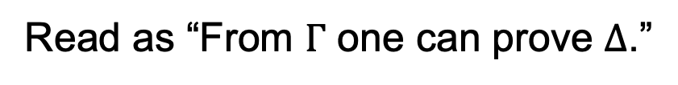

Proof System for Propositional Logic
Sequence of Propositions
Called a Sequent
$$Γ⊢Δ$$
Read as “From $Γ$ one can prove $Δ$.”

Slide 5
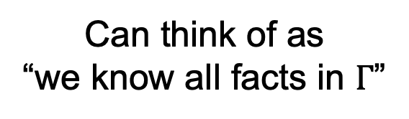
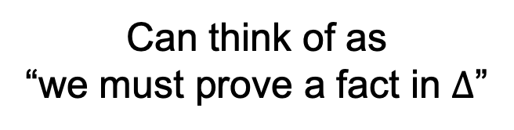
Sequent Calculus
$$Γ⊢Δ$$
Can think of as “we know all facts in $Γ$”
Can think of as “we must prove a fact in $Δ$”

Slide 6
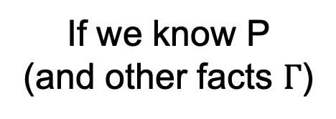
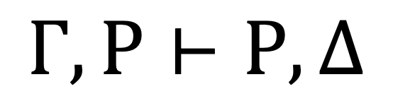
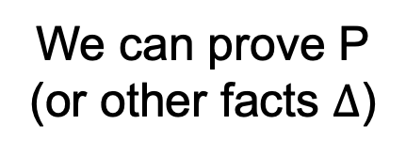
Sequent Calculus
Called an Axiom
id
$$Γ,P⊢P,Δ$$
We can prove P (or other facts $Δ$)
If we know P (and other facts $Γ$)

Slide 7
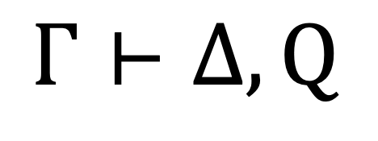
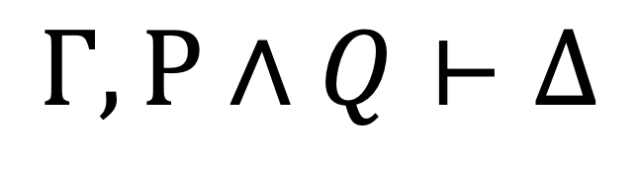
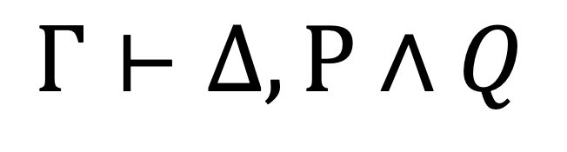
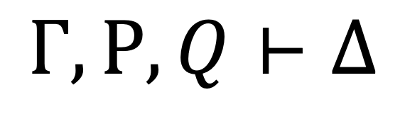
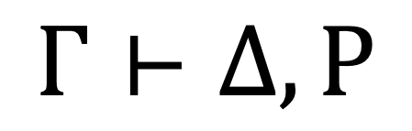
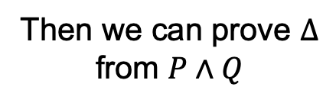

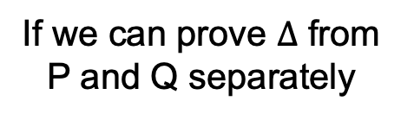

Sequent Calculus
If we can prove $Δ$ from P and Q separately
If we prove both
Called an Inference Rule
$$Γ,P,Q⊢Δ$$
$$Γ⊢Δ, P$$
$$Γ⊢Δ, Q$$
$$∧L$$
$$∧R$$
$$Γ,P∧Q⊢Δ$$
$$Γ⊢Δ,P∧Q$$
We can prove
Then we can prove $Δ$ from $P∧Q$

Slide 8
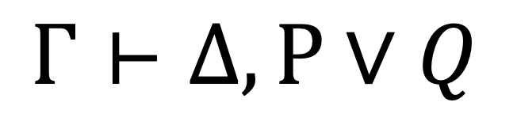
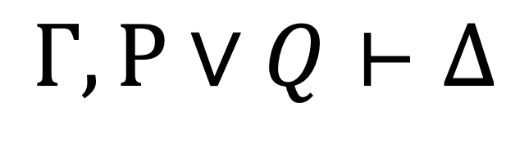
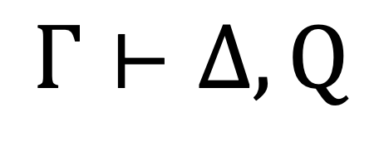

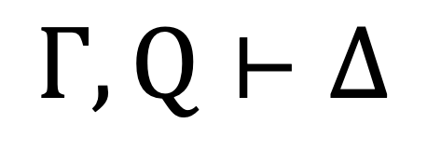

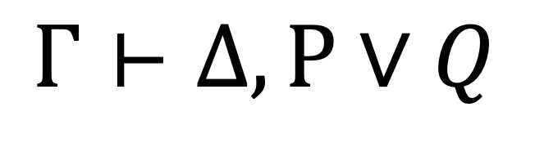

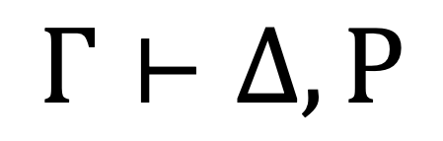

Sequent Calculus
$$Γ,P⊢Δ$$
$$Γ,Q⊢Δ$$
$$∨R$$
$$Γ,P∨Q⊢Δ$$
$$Γ⊢Δ, P$$
$$Γ⊢Δ, Q$$
$$∨L_{1}$$
$$∨L_{2}$$
$$Γ⊢Δ,P∨Q$$
$$Γ⊢Δ,P∨Q$$

Slide 9

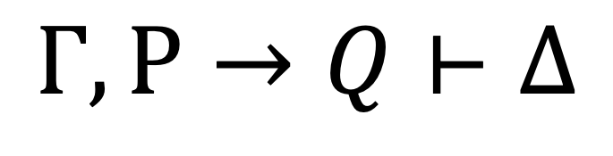

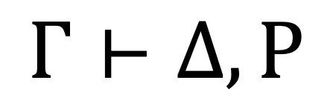
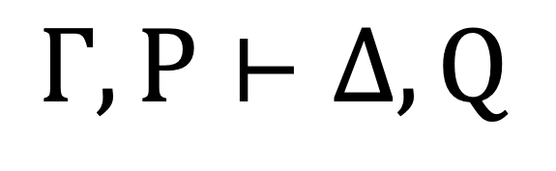
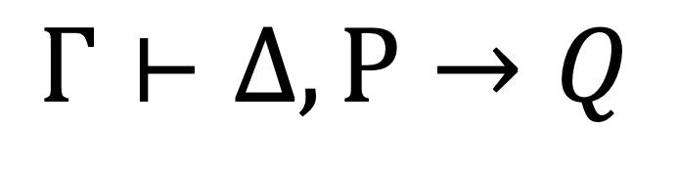
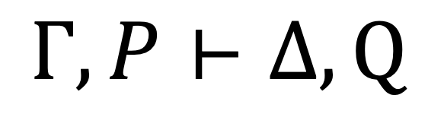
Sequent Calculus
$$Γ⊢Δ,P$$
$$Γ,P⊢Δ,Q$$
$$→L$$
$$Γ,P→Q⊢Δ$$
$$Γ,P⊢Δ, Q$$
$$→R$$
$$Γ⊢Δ,P→Q$$

Slide 10
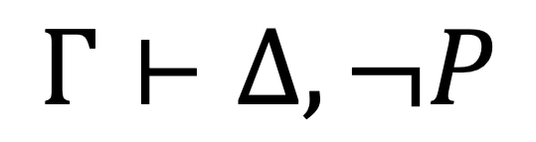

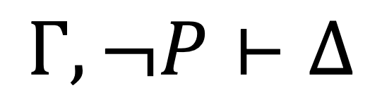

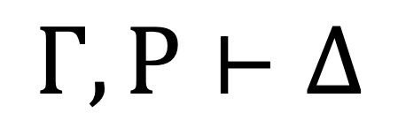
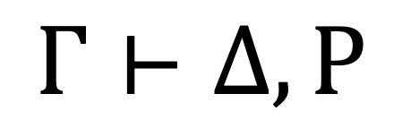
Sequent Calculus
$$Γ⊢Δ,P$$
$$¬L$$
$$Γ,¬P⊢Δ$$
$$Γ,P⊢Δ$$
$$¬R$$
$$Γ⊢Δ,¬P$$

Slide 11
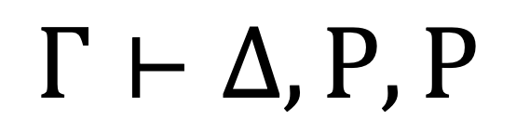

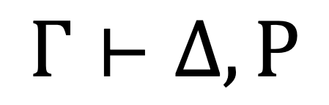



Sequent Calculus
$$Γ,P,P⊢Δ$$
$$Γ⊢Δ,P,P$$
$$CL$$
$$CR$$
$$Γ,P⊢Δ$$
$$Γ⊢Δ,P$$

Slide 12




Sequent Calculus
$$Γ⊢Δ$$
$$Γ⊢Δ$$
$$WL$$
$$WR$$
$$Γ,P⊢Δ$$
$$Γ⊢Δ,P$$

Slide 13
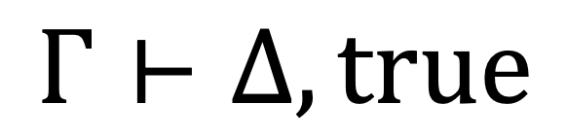
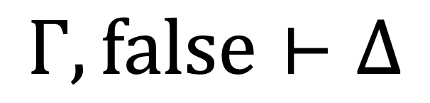
Sequent Calculus
$$Γ,false⊢Δ$$
$$Γ⊢Δ,true$$

Slide 14




$$A⊢A$$
$$A⊢A$$
$$A⊢(A∧A)$$
$$⊢A→(A∧A)$$

Slide 15
Group Exercises
Form groups of 3-4

