Slide 1
Lists
February 2, 2026
CSCI 246: Discrete Structures
Textbook Reference: Ch 2. Sec 8

Slide 2
Agenda
Lecture (~ 10 minutes)
Group Exercise (~40 minutes)

Slide 3

Lists
Definition: A list is an ordered collection of elements.
Example lists: $()$ $\left(0\right) \left(x, y\right) \left(a, b, a, a, b\right) (b, a, a, b,a)$
Empty list
Ordered Pair
Order Matters
Singleton list
containing 0
Duplicates Allowed

Slide 4
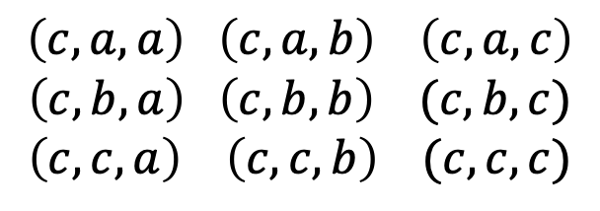

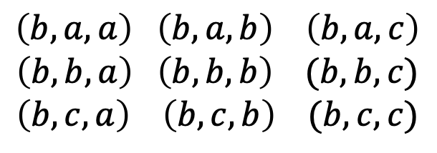
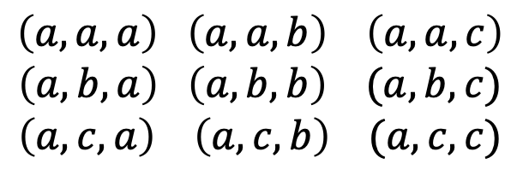
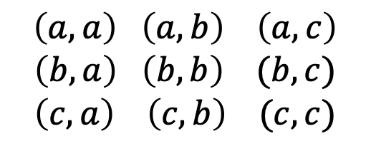

List Examples
Consider the set $A=\left\{a, b, c\right\}$. Write all lists up to length 3:
1 list of length 0
3 lists of length 1
9 lists of length 2
$$\left(a,a\right) \left(a,b\right) \left(a,c\right)$$
$$\left(b,a\right) \left(b,b\right) (b, c)$$
$$\left(c, a\right) \left(c,b\right) (c, c)$$
$$()$$
$$\left(a\right) \left(b\right) \left(c\right)$$
27 lists of length 3
$$\left(a,a,a\right) \left(a,a,b\right) \left(a,a,c\right)$$
$$\left(a,b,a\right) \left(a,b,b\right) (a,b, c)$$
$$\left(a,c, a\right) \left(a,c,b\right) (a,c, c)$$
$$\left(b,a,a\right) \left(b,a,b\right) \left(b,a,c\right)$$
$$\left(b,b,a\right) \left(b,b,b\right) (b,b, c)$$
$$\left(b,c, a\right) \left(b,c,b\right) (b,c, c)$$
$$\left(c,a,a\right) \left(c,a,b\right) \left(c,a,c\right)$$
$$\left(c,b,a\right) \left(c,b,b\right) (c,b, c)$$
$$\left(c,c, a\right) \left(c,c,b\right) (c,c, c)$$

Slide 5

Counting Lists
Theorem: For a set of elements $A$ with $n$ elements, there are $n^{k}$ lists of length $k$ containing elements from $A$.

Slide 6
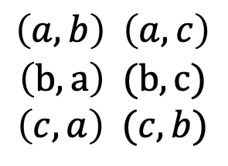
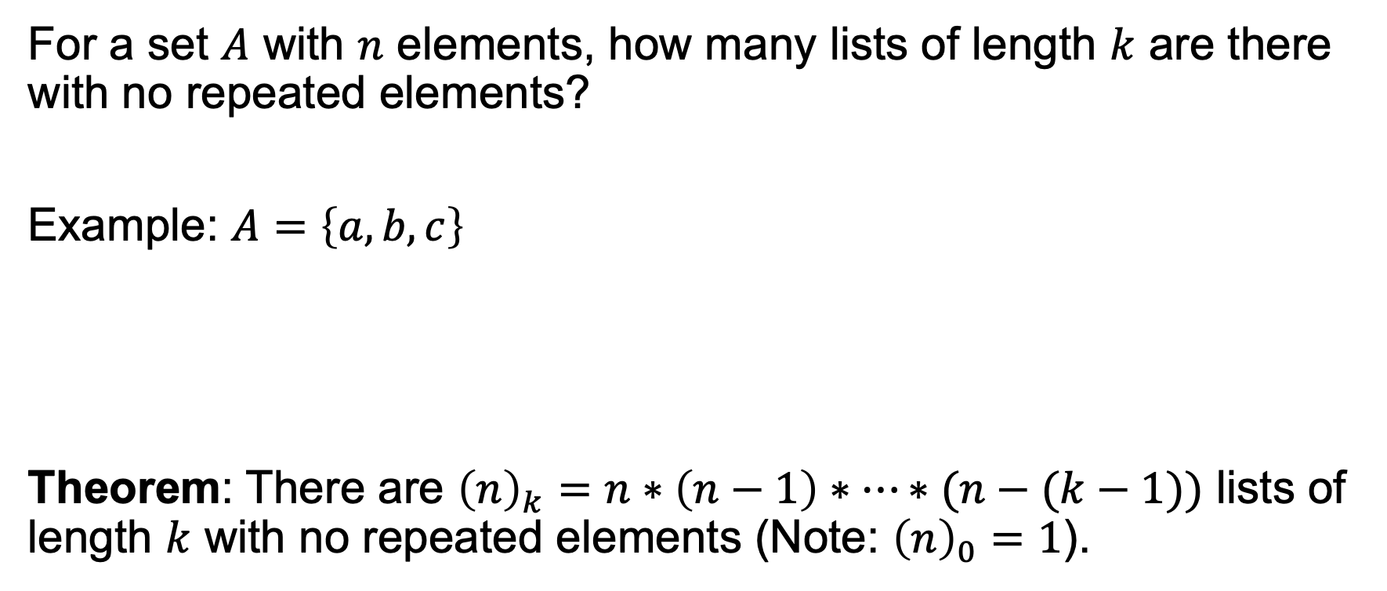

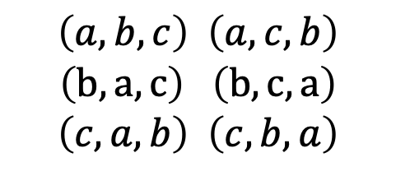

Counting Lists
For a set $A$ with $n$ elements, how many lists of length $k$ are there with no repeated elements?
Example: $A=\left\{a, b, c\right\}$
Theorem: There are ${\left(n\right)}_{k}=n∗\left(n−1\right)∗…∗(n−(k−1))$ lists of length $k$ with no repeated elements (Note: ${\left(n\right)}_{0}=1$).
$$\left(a\right)$$
$$\left(b\right)$$
$$\left(c\right)$$
$$\left(a, b\right) \left(a, c\right)$$
$$\left(b, a\right) (b, c)$$
$$\left(c, a\right) (c, b)$$
$$\left(a, b, c\right) \left(a, c, b\right)$$
$$\left(b, a, c\right) \left(b, c, a\right)$$
$$\left(c, a, b\right) \left(c, b, a\right)$$
$$()$$
1 of length 0
3 of length 1
6 of length 2
6 of length 3

Slide 7
Group Exercises
Form groups of 3-4

