Slide 1
Factorial
February 4, 2026
CSCI 246: Discrete Structures
Textbook Reference: Ch 2. Sec 9

Slide 2
Agenda
Lecture (~ 10 minutes)
Group Exercise (~40 minutes)

Slide 3
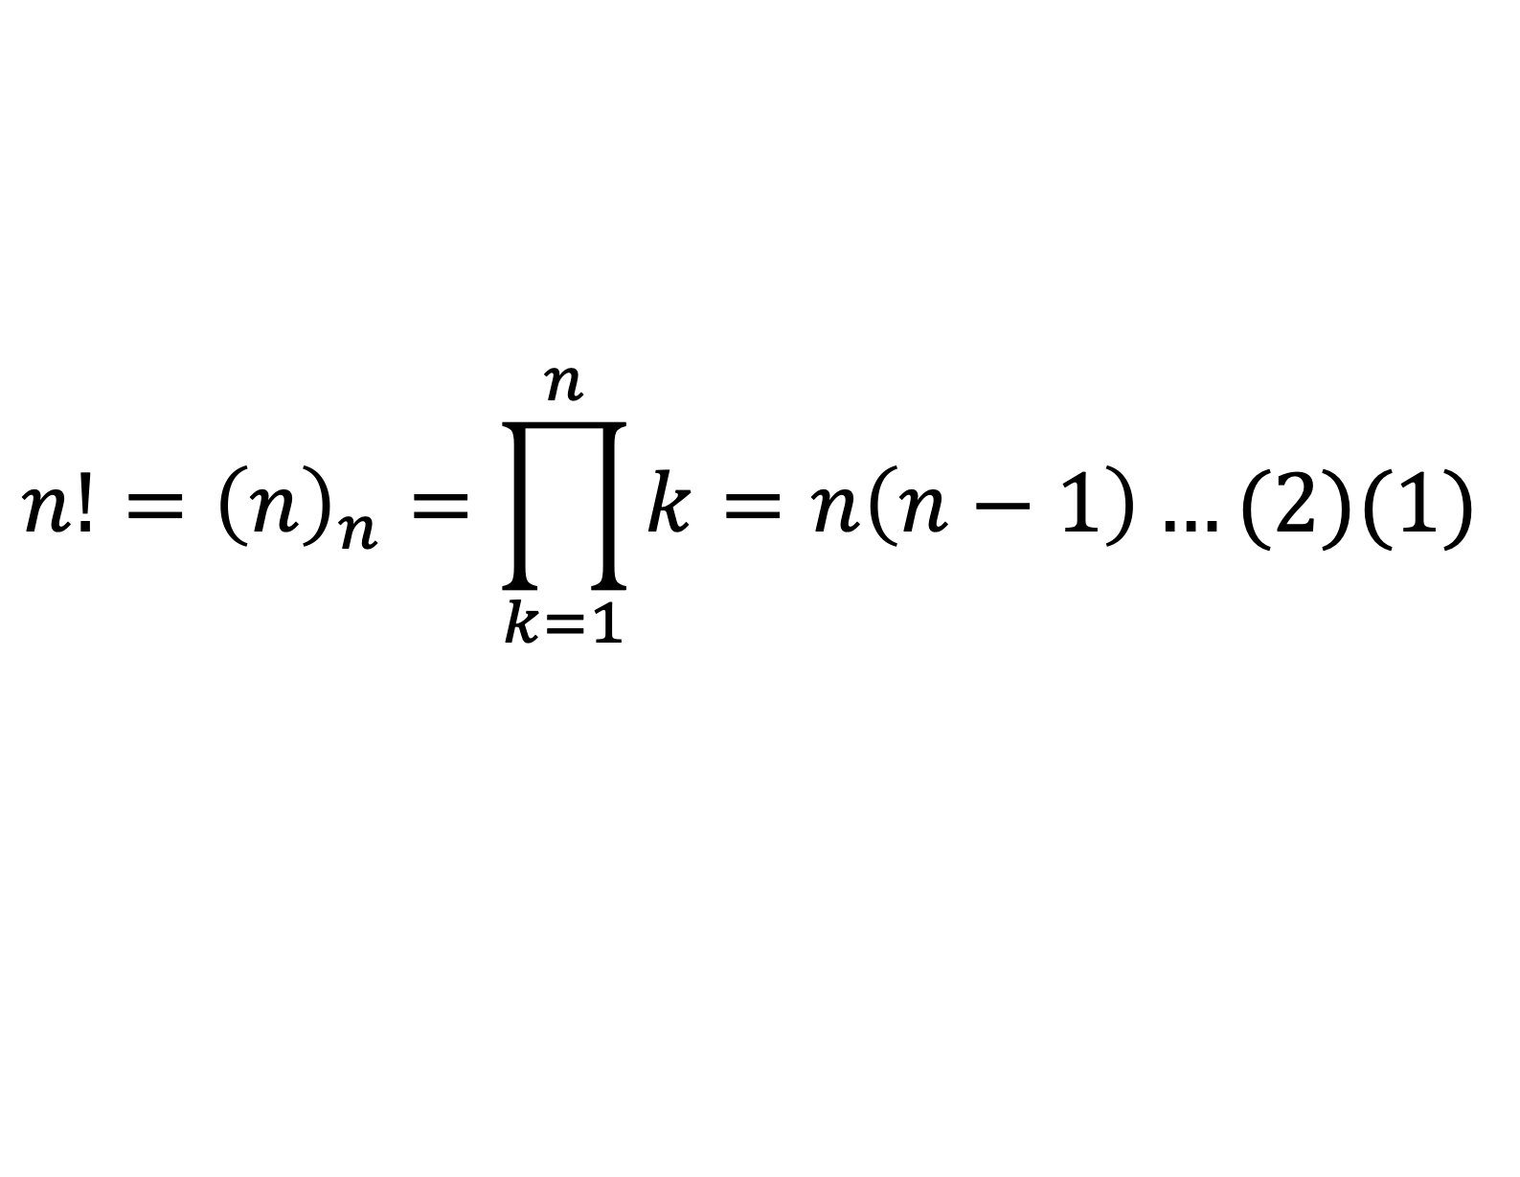
Factorial
$$n!={\left(n\right)}_{n}=\prod_{k=1}^{n}{k}=n\left(n−1\right)…(2)(1)$$

Slide 4
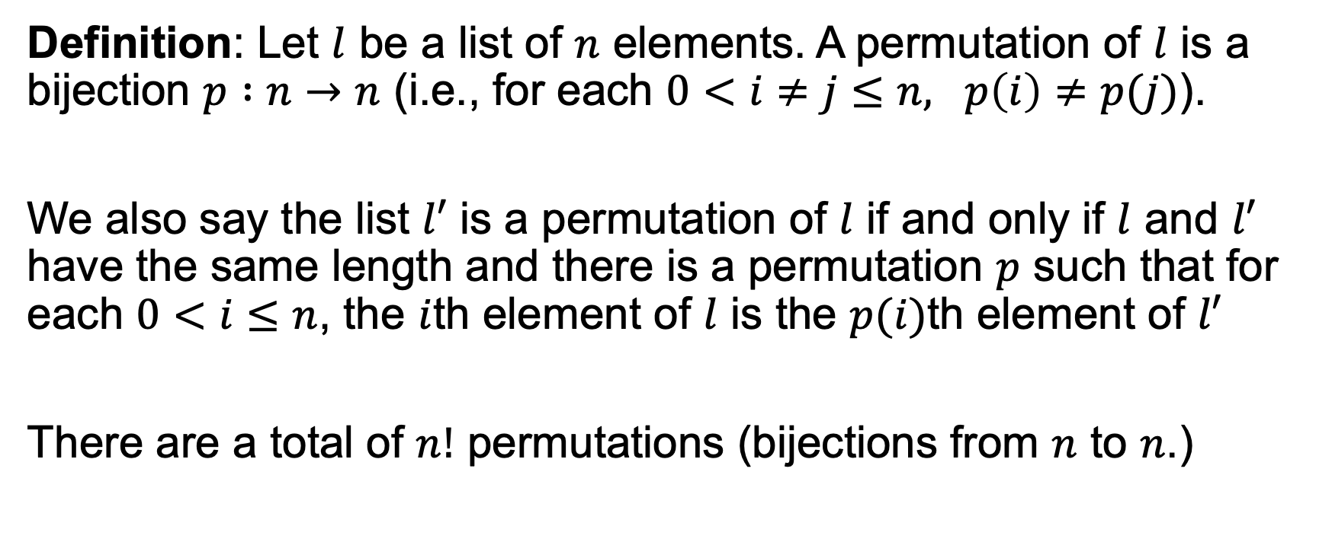
Permutation
Definition: Let $l$ be a list of $n$ elements. A permutation of $l$ is a bijection $p :n→n$ (i.e., for each $0<i≠j≤n, p\left(i\right)≠p(j)$).
We also say the list $l′$ is a permutation of $l$ if and only if $l$ and $l′$ have the same length and there is a permutation $p$ such that for each $0<i≤n$, the $i$th element of $l$ is the $p(i)$th element of $l′$
There are a total of $n!$ permutations (bijections from $n$ to $n$.)

Slide 5

Counting Lists
Theorem: For a set of elements $A$ with $n$ elements, there are $n!$ lists of length $n$ that do not repeat elements.
Corollary: There are $n!$ ways to arrange a set of $n$ elements.

Slide 6
Connection to Runtime Complexity
Suppose you are tasked to find a permutation of an input sequence of numbers that groups all equal numbers together.
It’s simple to check that a list satisfies this property. How long would it take to brute force the solution by enumerating each reordering and checking?
At least n! time steps in the worst case.
5! = 120
10! = 3.6 million
15! = 1.3 trillion

Slide 7
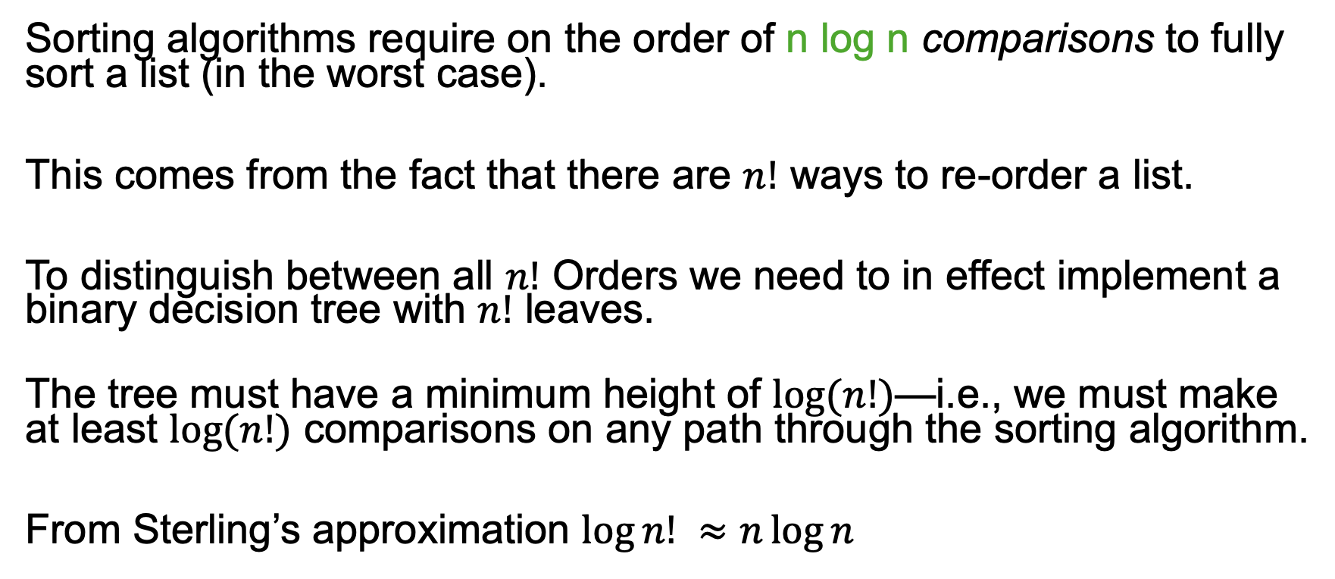
Connection to Sorting Complexity
Sorting algorithms require on the order of n log n comparisons to fully sort a list (in the worst case).
This comes from the fact that there are $n!$ ways to re-order a list.
To distinguish between all $n!$ Orders we need to in effect implement a binary decision tree with $n!$ leaves.
The tree must have a minimum height of $log⁡(n!)$—i.e., we must make at least $log⁡(n!)$ comparisons on any path through the sorting algorithm.
From Sterling’s approximation $\log{n!} ≈n\log{n}$

Slide 8
Group Exercises
Form groups of 3-4

