Slide 1
Sets February 6, 2026
CSCI 246: Discrete Structures
Textbook Reference: Ch 2. Sec 10

Slide 2
Agenda
Lecture (~ 10 minutes)
Group Exercise (~40 minutes)

Slide 3
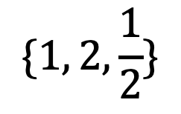



Set
Definition: A repetition-free, unordered collection of objects.
$$\{1, 2, \frac{1}{2}\}$$
$$∅=\{\}$$
$$\{…,−2, −1, 0, 1, 2, …\}$$
The Empty Set
$$\left\{1, 2\right\}=\left\{2,1\right\}=\{1,1,2,1,2\}$$
All equal regardless of order or repetition of elements

Slide 4



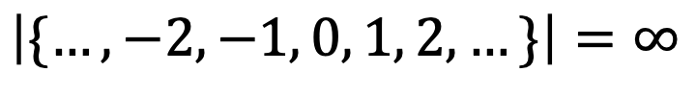
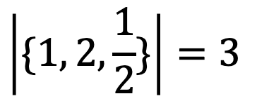
Cardinality
Definition: The cardinality of a set (or it size) is the number of elements within the set (denoted as $\left|A\right|$).
$$\left|\{1, 2, \frac{1}{2}\}\right|=3$$
$$|∅|=\left|\{\}\right|=0$$
$$\left|\{…,−2, −1, 0, 1, 2, …\}\right|=∞$$
$$\left|\left\{1, 2\right\}\right|=\left|\left\{2,1\right\}\right|=\left|\{1,1,2,1,2\}\right|=2$$

Slide 5
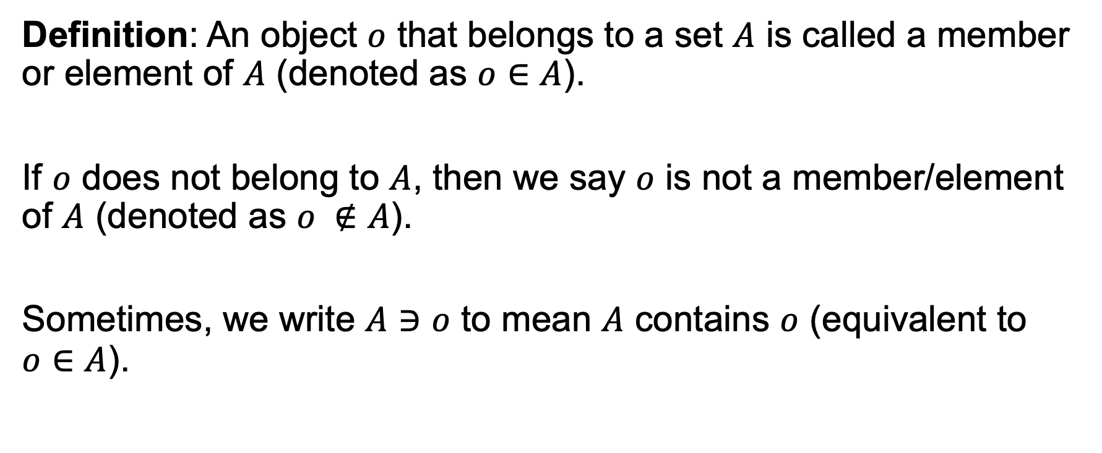
Set Membership
Definition: An object $o$ that belongs to a set $A$ is called a member or element of $A$ (denoted as $o∈A$).
If $o$ does not belong to $A$, then we say $o$ is not a member/element of $A$ (denoted as $o ∉A$).
Sometimes, we write $A∋o$ to mean $A$ contains $o$ (equivalent to $o∈A$).

Slide 6
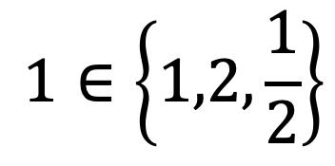

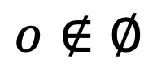
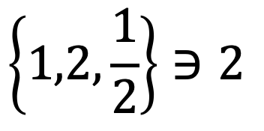
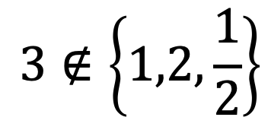
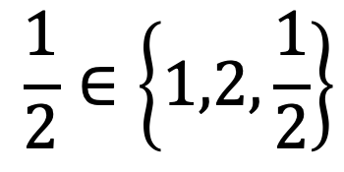
Set Membership
$$1∈\left\{1,2,\frac{1}{2}\right\}$$
$$\frac{1}{2}∈\left\{1,2,\frac{1}{2}\right\}$$
$$o∉∅$$
$$3∉\left\{1,2,\frac{1}{2}\right\}$$
$$\left\{1,2,\frac{1}{2}\right\}∋2$$
$$3∈ℤ$$
Often read as 3 is an integer

Slide 7
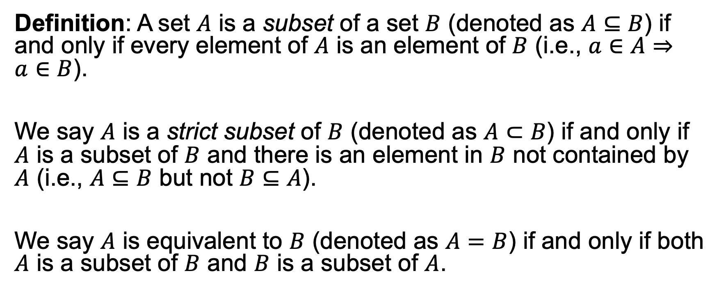
Subsets
Definition: A set $A$ is a subset of a set $B$ (denoted as $A⊆B$) if and only if every element of $A$ is an element of $B$ (i.e., $a∈A⇒a∈B$).
We say $A$ is a strict subset of $B$ (denoted as $A⊂B$) if and only if $A$ is a subset of $B$ and there is an element in $B$ not contained by $A$ (i.e., $A⊆B$ but not $B⊆A$).
We say $A$ is equivalent to $B$ (denoted as $A=B$) if and only if both $A$ is a subset of $B$ and $B$ is a subset of $A$.

Slide 8





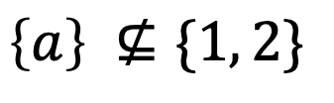

Subsets
$$∅⊆A$$
$$\left\{1\right\}⊆\{1, 2\}$$
$$\left\{1\right\}⊂\{1, 2\}$$
$$\left\{a\right\} ⊈\{1, 2\}$$
$$\left\{1,2\right\}=\{1, 2\}$$
$$ℕ⊂ℤ$$
$$ℤ=\{…,−2,−1,0,1, 2,…\}$$

Slide 9

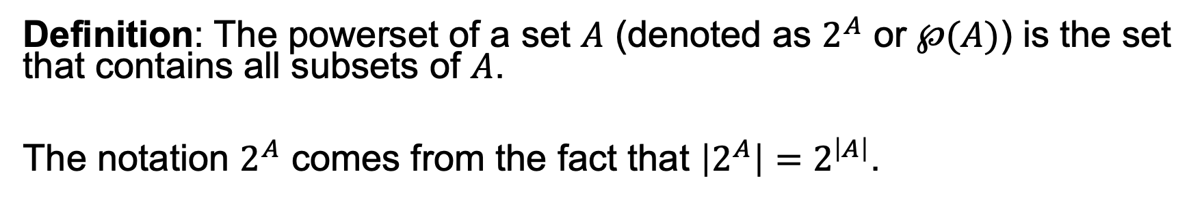
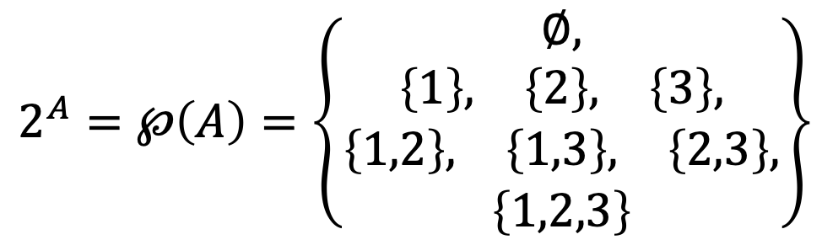
Power Set
Definition: The powerset of a set $A$ (denoted as $2^{A}$ or $℘(A)$) is the set that contains all subsets of $A$.
The notation $2^{A}$ comes from the fact that $\left|2^{A}\right|=2^{\left|A\right|}$.
$$2^{A}=℘\left(A\right)=\left\{\begin{matrix}∅, \\ \begin{matrix}\left\{1\right\}, & \left\{2\right\}, & \left\{3\right\}\end{matrix}, \\ \begin{matrix}\begin{matrix}\left\{1,2\right\}, & \left\{1,3\right\}, & \left\{2,3\right\},\end{matrix} \\ \left\{1,2,3\right\}\end{matrix}\end{matrix}\right\}$$
$$A=\left\{1,2,3\right\}$$

Slide 10
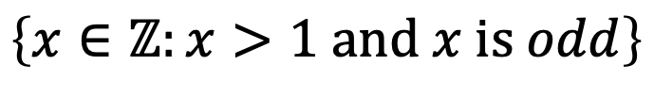
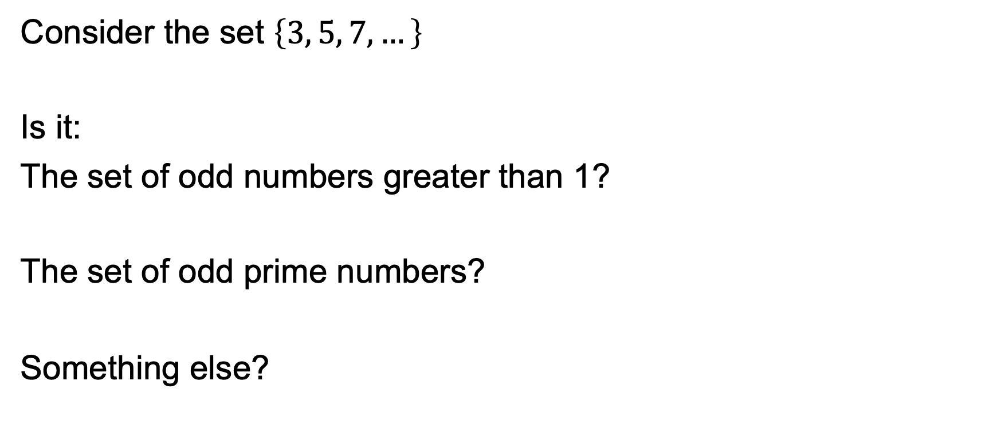
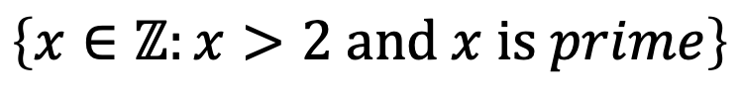
Set Builder Notation
Consider the set $\left\{3, 5, 7, …\right\}$
Is it:
The set of odd numbers greater than 1?
The set of odd prime numbers?
Something else?
Contains
any integer
that satisfies this condition
$$\left\{x∈ℤ:x>1 and x is odd\right\}$$
$$\left\{x∈ℤ:x>2 and x is prime\right\}$$

Slide 11
Group Exercises
Form groups of 3-4

