Slide 1
Quantifiers February 9, 2026
CSCI 246: Discrete Structures
Textbook Reference: Ch 2. Sec 11

Slide 2
Agenda
Lecture (~ 10 minutes)
Group Exercise (~40 minutes)

Slide 3
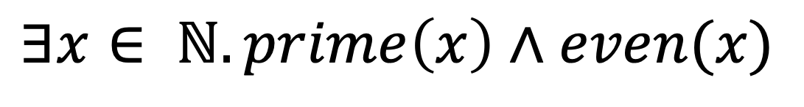

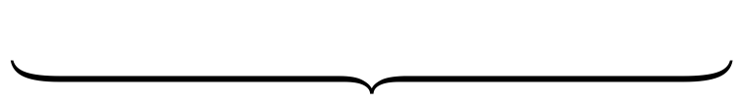

Existential Quantification $∃$
Quantifier Scope
Domain
$$∃x∈ ℕ. prime\left(x\right)∧even(x)$$
There exists There is …
Assertion over bound variable
Bound Variable
Dummy Variable

Slide 4
Existential Quantification $∃$
$$∃x∈ ℕ. prime\left(x\right)∧even(x)$$
There exists a natural number, $x$, such that $x$ is prime and $x$ is even
There is a natural number that is prime and even

Slide 5
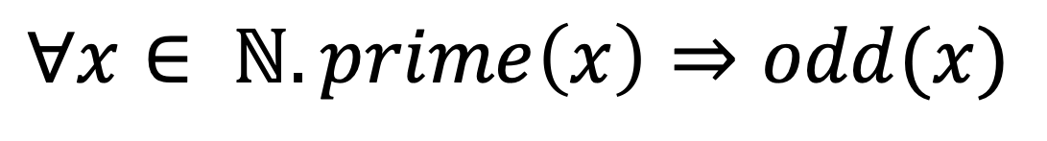

Universal Quantification $∀$
Quantifier Scope
Domain
$$∀x∈ ℕ. prime\left(x\right)⇒odd(x)$$
For all For each For arbitrary Every
…
Assertion over bound variable
Bound Variable
Dummy Variable

Slide 6
Universal Quantification $∀$
$$∀x∈ ℕ. prime\left(x\right)⇒odd(x)$$
For all natural numbers, $x$, if $x$ is prime, then $x$ is odd.
Every natural number that is prime is odd.

Slide 7
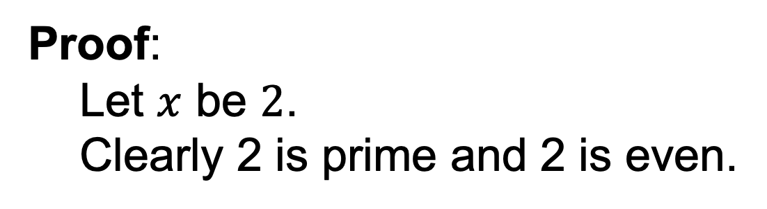
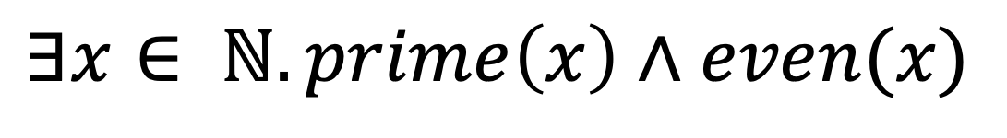
Proving Existentials
$$∃x∈ ℕ. prime\left(x\right)∧even(x)$$
Proof:
Let $x$ be $2$.
Clearly 2 is prime and 2 is even.
Introduce a specific
element of the domain
to substitute for the
quantified variable
QED
Prove assertions
for introduced
element

Slide 8
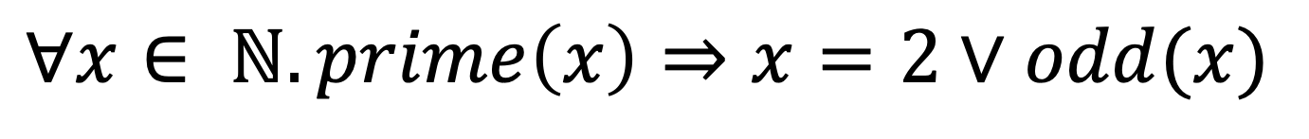
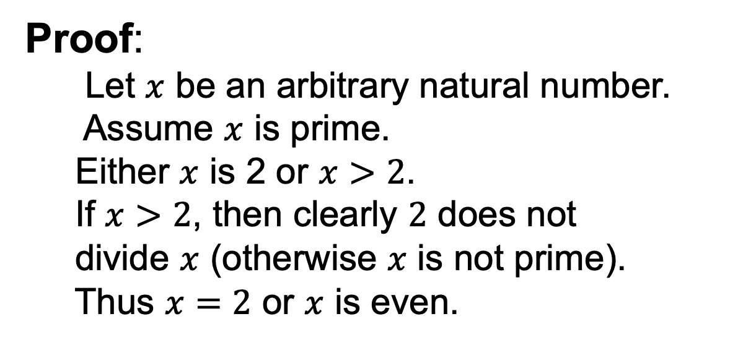
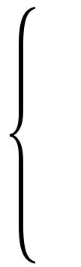
Proving Universals
$$∀x∈ ℕ. prime\left(x\right)⇒x=2∨odd(x)$$
Proof:
Let $x$ be an arbitrary natural number.
Assume $x$ is prime.
Either $x$ is 2 or $x>2$.
If $x>2$, then clearly $2$ does not
divide $x$ (otherwise $x$ is not prime).
Thus $x=2$ or $x$ is even.
Prove assertions
for introduced
element
Introduce an
arbitrary element
from the domain.
QED

Slide 9
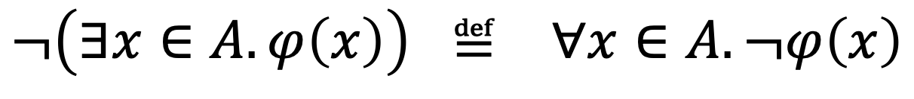
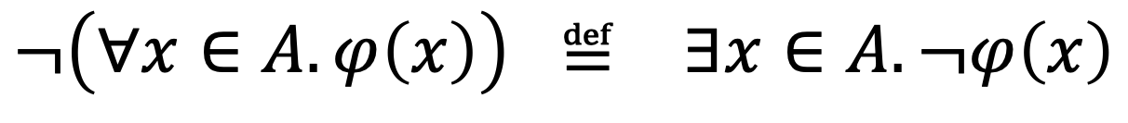
Negating Quantifiers
$$¬\left(∀x∈A. φ\left(x\right)\right) ≝ ∃x∈A. ¬φ\left(x\right)$$
$$¬\left(∃x∈A. φ\left(x\right)\right) ≝ ∀x∈A. ¬φ\left(x\right)$$

Slide 10
Group Exercises
Form groups of 3-4

