Slide 1
Set Operations February 11, 2026
CSCI 246: Discrete Structures
Textbook Reference: Ch 2. Sec 12-13

Slide 2
Agenda
Lecture (~ 15 minutes)
Group Exercise (~35 minutes)

Slide 3

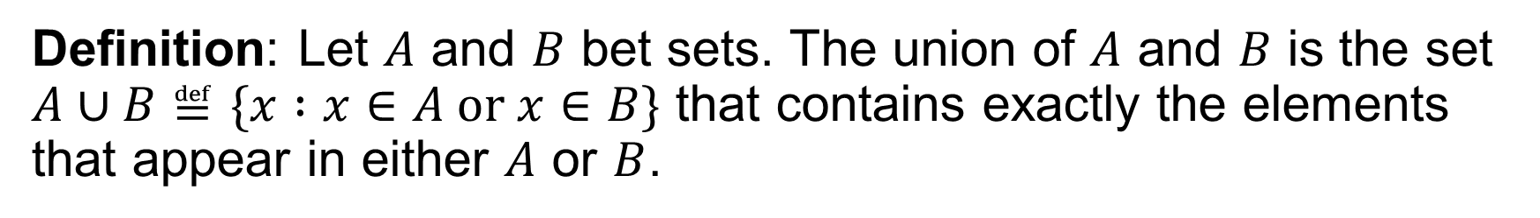
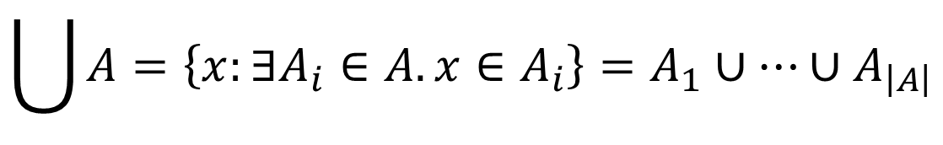

Set Union
Definition: Let $A$ and $B$ bet sets. The union of $A$ and $B$ is the set $A∪B≝\{x :x∈A or x∈B\}$ that contains exactly the elements that appear in either $A$ or $B$.
$$A∪∅=A$$
$$\left\{1,2\right\}∪\left\{2,3\right\}=\left\{1,2,3\right\}$$
$$\bigcup{A}=\left\{x:∃A_{i}∈A. x∈A_{i}\right\}=A_{1}∪…∪A_{\left|A\right|}$$

Slide 4




Set Union
$$A$$
$$A$$
$$B$$
$$B$$

Slide 5

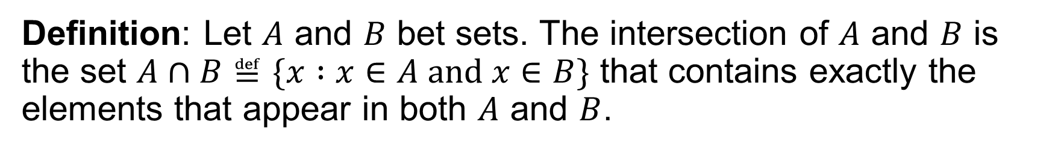
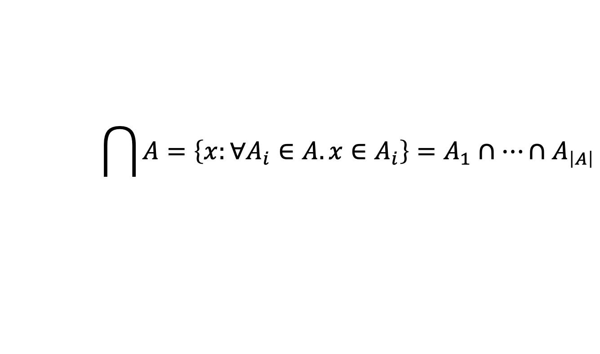

Set Intersection
Definition: Let $A$ and $B$ bet sets. The intersection of $A$ and $B$ is the set $A∩B≝\{x :x∈A and x∈B\}$ that contains exactly the elements that appear in both $A$ and $B$.
$$A∩∅=∅$$
$$\left\{1,2\right\}∩\left\{2,3\right\}=\left\{2\right\}$$
$$\bigcap{A}=\left\{x:∀A_{i}∈A. x∈A_{i}\right\}=A_{1}∩…∩A_{\left|A\right|}$$

Slide 6

Set Intersection
$$A$$
$$B$$

Slide 7
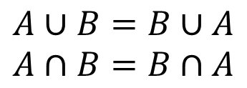

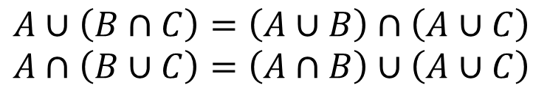

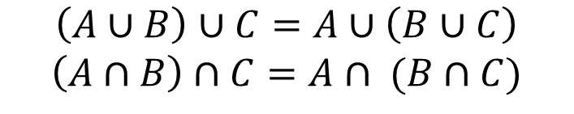
Set Union/Intersection Properties
Theorem: Let $A$, $B$, and $C$ be sets.
$$A∪B=B∪A$$
$$A∩B=B∩A$$
Commutativity
$$\left(A∪B\right)∪C=A∪\left(B∪C\right)$$
$$\left(A∩B\right)∩C=A∩ (B∩C)$$
Associativity
$$A∪∅=A$$
$$A∩∅=∅$$
Empty-Set
$$A∪\left(B∩C\right)=\left(A∪B\right)∩\left(A∪C\right)$$
$$A∩\left(B∪C\right)=\left(A∩B\right)∪\left(A∪C\right)$$
Distributivity

Slide 8
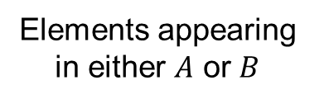

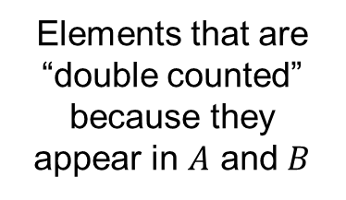
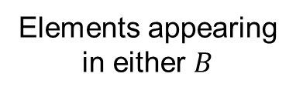
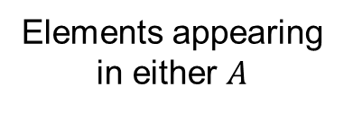
Set Union/Intersection Cardinality
Theorem: Let $A$ and $B$ be sets.
$$\left|A∪B\right|=\left|A\right|+\left|B\right|−\left|A∩B\right|$$
Elements appearing in either $A$ or $B$
Elements appearing in either $B$
Elements that are “double counted” because they appear in $A$ and $B$
Elements appearing in either $A$

Slide 9
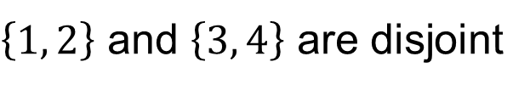
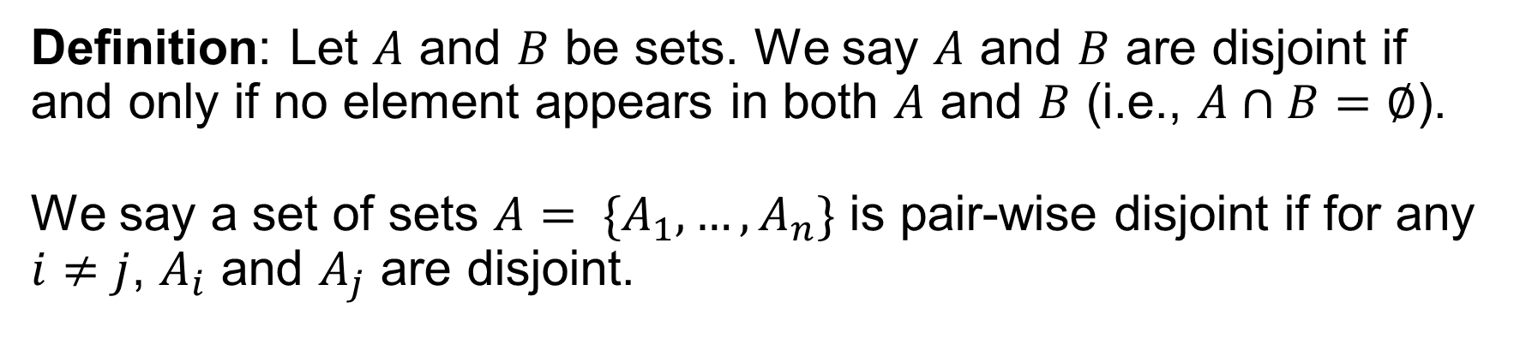
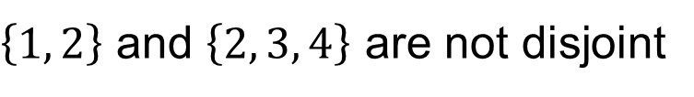
Disjoint
Definition: Let $A$ and $B$ be sets. We say $A$ and $B$ are disjoint if and only if no element appears in both $A$ and $B$ (i.e., $A∩B=∅$).
We say a set of sets $A= \{A_{1},…,A_{n}\}$ is pair-wise disjoint if for any $i≠j$, $A_{i}$ and $A_{j}$ are disjoint.
$\left\{1, 2\right\}$ and $\left\{3, 4\right\}$ are disjoint
$\left\{1, 2\right\}$ and $\left\{2, 3, 4\right\}$ are not disjoint

Slide 10

Set Union Cardinality
Theorem: Let $A_{1},…,A_{n}$ be pair-wise disjoint sets.
$$\left|\bigcup_{k=1}^{n}{A_{k}}\right|=\sum_{k=1}^{n}{\left|A_{k}\right|}$$

Slide 11

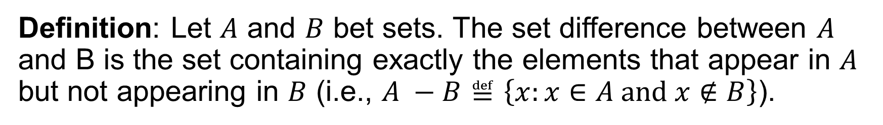



Set Difference
Definition: Let $A$ and $B$ bet sets. The set difference between $A$ and B is the set containing exactly the elements that appear in $A$ but not appearing in $B$ (i.e., $A −B≝\left\{x:x∈A and x∉B\right\}$).
$$A−A=∅$$
$$A−∅=A$$
$$\left\{1,2\right\}−\left\{3,4\right\}=\left\{1,2\right\}$$
$$\left\{1,2,3\right\}−\left\{3,4\right\}=\left\{1,2\right\}$$

Slide 12

Set Difference
$$A$$
$$A$$
$$A$$
$$B$$
$$B$$

Slide 13

Set Difference
Theorem: Let $A$, $B$, and $C$ bet sets.
$$A−\left(B∪C\right)=\left(A−B\right)∩(A−C)$$
$$A−\left(B∩C\right)=\left(A−B\right)∪(A−C)$$

Slide 14

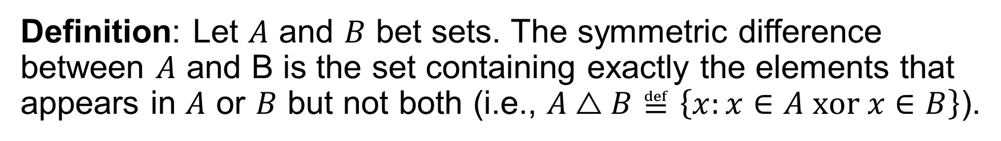



Symmetric Difference
Definition: Let $A$ and $B$ bet sets. The symmetric difference between $A$ and B is the set containing exactly the elements that appears in $A$ or $B$ but not both (i.e., $A△B≝\left\{x:x∈A xor x∈B\right\}$).
$$A△A=∅$$
$$A△∅=A$$
$$\left\{1,2\right\}△\left\{3,4\right\}=\left\{1,2,3,4\right\}$$
$$\left\{1,2,3\right\}△\left\{3,4\right\}=\left\{1,2,4\right\}$$

Slide 15

Symmetric Difference
$$A$$
$$A$$
$$B$$
$$B$$

Slide 16

Symmetric Difference
Theorem: Let $A$ and $B$ bet sets.
$$A△B=\left(A∪B\right)−(A∩B)$$

Slide 17

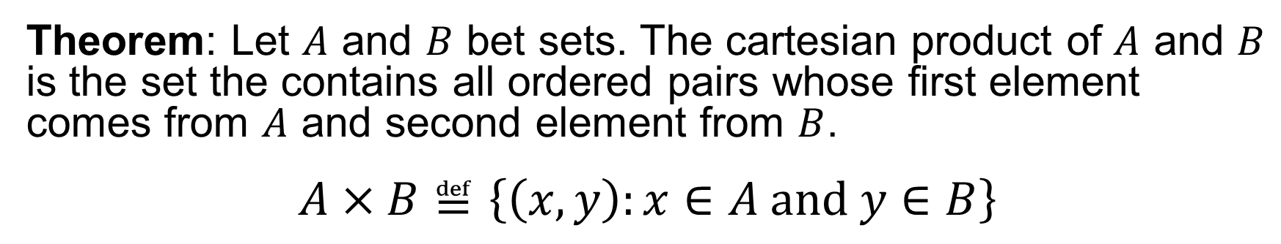
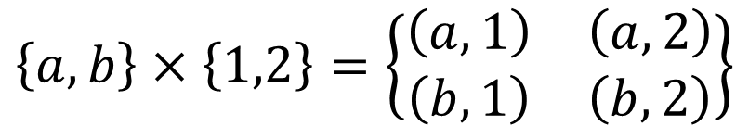
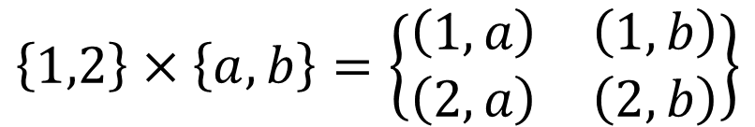

Cartesian Product
Theorem: Let $A$ and $B$ bet sets. The cartesian product of $A$ and $B$ is the set the contains all ordered pairs whose first element comes from $A$ and second element from $B$.
$$A×B≝\left\{\left(x,y\right):x∈A and y∈B\right\}$$
$$∅×A=∅$$
$$A×∅=∅$$
$$\left\{1,2\right\}×\left\{a,b\right\}=\left\{\begin{matrix}\left(1,a\right) & \left(1,b\right) \\ \left(2,a\right) & \left(2,b\right)\end{matrix}\right\}$$
$$\left\{a,b\right\}×\left\{1,2\right\}=\left\{\begin{matrix}\left(a,1\right) & \left(a,2\right) \\ \left(b,1\right) & \left(b,2\right)\end{matrix}\right\}$$

Slide 18




Cartesian Product
$$A$$
$$A×B$$
$$B$$

Slide 19
Group Exercises
Form groups of 3-4

